Slide 1
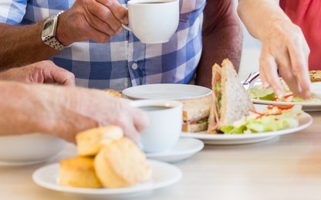
Nutrition Programs:
Meal Site Dietitian
Training
Notes:
Thank you to the Area Agency on Aging for hosting the meeting and a huge thank you to Sarah and the other Dieticians that developed the training with myself. Thanks to all of you for all your hard work and dedication to help seniors in Idaho.
ICOA conducted reviews and Townhall Meetings in 2019 statewide. Several gaps were found that needed improvement. ICOA wrote a 4 year state plan…..addressing the goals and outcomes. One of the goals for my nutrition program is to develop three trainings. The Dietitian training you are attending today is one of them.

Slide 2
Dietitian Training for Meal Sites and Staff
Notes:
Today we will learn together what the Dietitian plays for a role in all of our working lives. The Dietitian will provide Nutrition Education, Nutrition Counseling, and will approve all menus submitted by the meal sites and will give advice to menu creators to be in compliance.

Slide 3
Learner Objectives
Review regulations and Dietary Guidelines
Discuss menu planning, templates and menu planning help sheet
Sanitation: To Glove or not to Glove..?
Food costs.. how to make a dollar go further.
Heating / Cooling and Storage
Dietitian Counseling
Notes:
Today we will talk about …….

Slide 4
Older Americans Act, S. 339.Nutrition
A State that establishes and operates a nutrition project under this chapter shall— Utilize the expertise of a dietitian Provides meals that comply with the most recent Dietary Guidelines for Americans Provide a minimum of 33 and 1⁄3 percent of the dietary reference intakes established by the Food and Nutrition Board of the National Academies of Sciences, Engineering, and Medicine if the project provides one meal per day. To the maximum extent practicable, adjusted menus to meet special dietary needs of program participants. Including meals adjusted for cultural considerations and preferences and medically tailored meals. Encourage individuals who distribute nutrition services to provide homebound older individuals with available medical information approved by health care professionals, such as informational brochures and information on how to get vaccines, including vaccines for influenza, pneumonia, and shingles, in the individuals’ communities Link to the Older Americans Act
Notes:
Above I added a few very important requirements out of the OAA for your convenience.

Slide 5



OAA Nutrition Program Goals
  Reduce hunger & food insecurity and malnutrition
  Promote socialization
  Promote the health and well-being of older individuals
Notes:
Above I added a few very important requirements out of the OAA for your convenience.
The purposes of these programs are to 1) reduce hunger, food insecurity and malnutrition, 2) promote socialization, 3) promote health and well-being, and 4) delay adverse health conditions. The intent is to make community-based nutrition services available to older adults who may be at risk of losing their independence and their ability to remain in the community.
To promote the health and well-being of older individuals means assisting such individuals to gain access to nutrition and other disease prevention and health promotion services to delay the onset of adverse health conditions resulting from poor nutritional health or sedentary behavior.

Slide 6
Dietary Guidelines for Americans
The Dietary Guidelines for Americans provide evidence-based nutrition information and advice for people ages two and older to help Americans make healthy choices about food and beverages in their daily lives. The Guidelines also serve as the basis for federal food and nutrition education programs.
The Dietary Guidelines for Americans, produced by the Department of Health and Human Services and the U.S. Department of Agriculture every five years, analyze the latest research to help Americans make smart choices about food and physical activity so they can live healthier lives.
The link is provided here: https://www.hhs.gov/fitness/eat-healthy/dietary-guidelines-for-americans/index.html
Notes:
These guidelines focus on making small shifts in daily eating habits to improve your health over the long run such as:
Follow a healthy eating pattern across the lifespan. Eating patterns are the combination of foods and drinks that a person eats over time.
Focus on variety, nutrient-dense foods, and amount.
Limit calories from added sugars and saturated fats, and reduce sodium intake.
Shift to healthier food and beverage choices.
Support healthy eating patterns for all.
The new Dietary guideliens just cam eout and I send out an email to all AAAs with the new guidelines, also to find on our website under www.aging.Idaho.gov as you can browse around and find a lot of other nutrition information under congregate and home delivered meals.

Slide 7
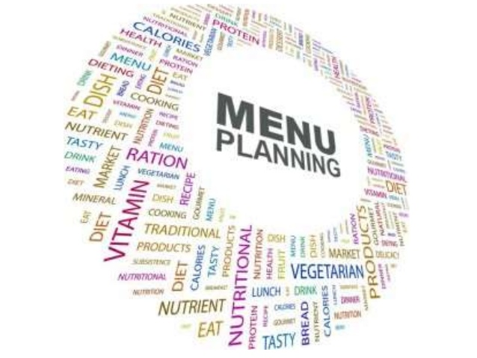
Menu Planning
Notes:
Menu planning can be tough! People want you to include their favorite dish, cooks want an easy meal to prep, the food bank doesn’t have prime rib, and your nutritionist is saying you need more whole grains! This powerpoint won’t solve all your problems but will help clear some things up. If there are any further questions or if you are having problems with anything be sure to reach out. We are happy to help.

Slide 8
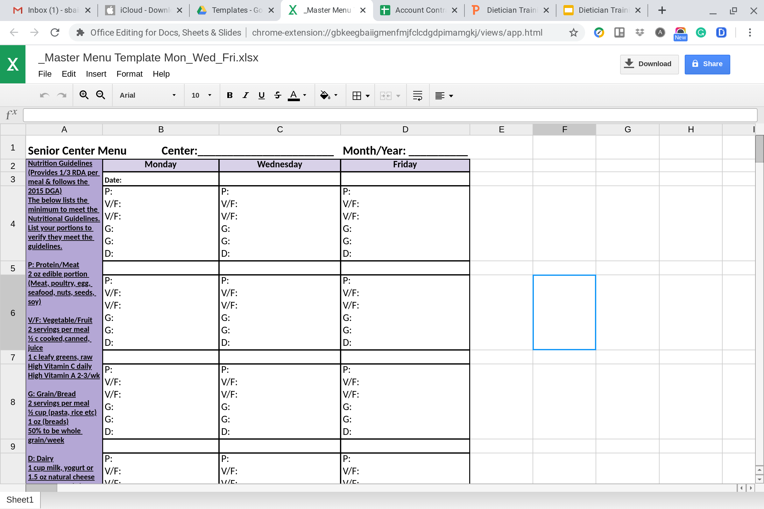
Menu Recommendations
Notes:
This is one example in excel. You can remove days that you don’t serve (for instance, this is for a center that serves Mon/Wed/Fri). In excel you can also add a sheet for each month of the year to keep your menus all in one place. You can copy and paste from the month previous. Also, you could have one sheet with the portion to submit to the dietitian and then copy and paste to a second sheet to decorate and print for your participants. Let your dietitian know if you need help setting these up. I have prepared a video for your convenience…....
Play video with excel spreadsheet

Slide 9
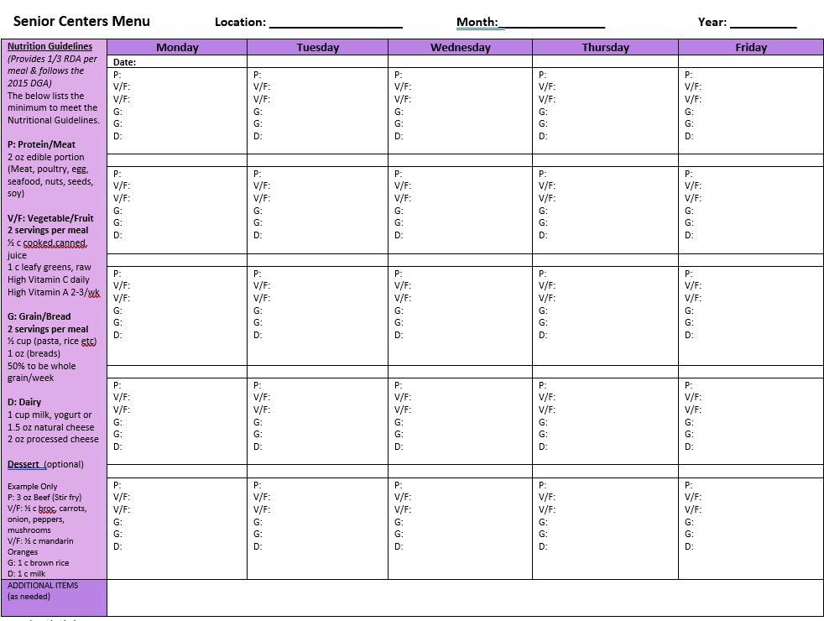
Menu Recommendations
Notes:
This version is in Word format for anyone who prefers this. You could also do a second page in word to copy and paste for a more decorative page without portions to print.
I prepared a video in word format as well……play video

Slide 10
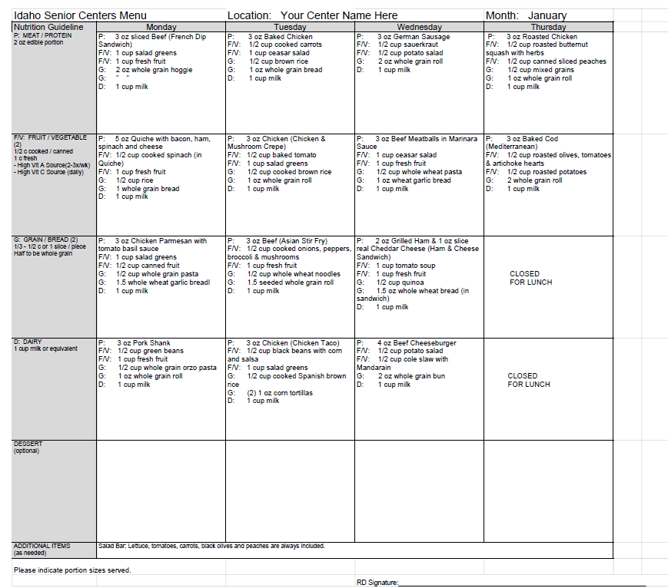
Menu Recommendations
Notes:
This is a completed menu example. Let me know if you’d like any help setting up a template that works better for your needs.

Slide 11
Menu Recommendations
Other Tips and Tricks:
Use the format that works for you, but it must:
  Be in calendar layout
  Include portion sizes
  Include center name
  And list the month
You can reuse previously approved menus; just let the dietitian know.
You can submit several menus at a time, for instance quarterly.

Slide 12
Menu Recommendations
Guidelines:
Nutrition Guideline: Portion size must be included
P= Meat or Protein 2 oz edible portion
V= Vegetable ½ C cooked or canned, or 1 C fresh F=Fruit ½ C cooked or canned or 1 C fresh (High Vit A source 2-3x/wk) (high Vit C source daily)
G=Grain/Bread 1/3-1/2 C or 1 slice/piece (half to be whole grain)
D-Dairy 1 C milk or equivalent
Dessert optional
Notes:
Sometimes there are not high-quality items used

Slide 13
Ounces - vs - Cups
Ounces are a weight measurement. We weigh items so that we don’t have to grind and/or smash them into a scoop or measuring cup. These are items such as:
Meats
Breads and pastries
If purchasing meats and breads pre portioned or pre-sliced then you will be able to determine the portion size from the packaging and will not have to physically weigh them.
If slicing meat or making homemade bread - slice one that weighs the desired amount then use it as your guide for future slices.
Cups should be used for all other measuring. (8 oz of lettuce would be about 5 cups, that’s a huge side salad!)
Notes:
Meats are in ounces and fruits and veggies are in cups

Slide 14
Menu Recommendations
Grains:
1 serving =
  1 oz bread
  ½ cup rice or pasta
2 servings are recommended per meal
Check your bread labels and list the oz on the menu.
  Some are:
  1.5 oz or even 2 oz.
  Rolls are often 2 oz.
1 oz of rice or pasta DOES NOT = 1 serving. (see the slide on ounces vs cups)
Please do not list a roll every day for the 2 grains. This is boring for participants getting it on their plate day after day.
Breading, gravy and oatmeal on dessert is counted as ½ of a grain serving.
More on grains on slide 18

Slide 15
Menu Recommendations
Vitamin A and C (more on slide 17 & 20)
“½ cup vegetable” doesn’t provide enough information to ensure vitamin A and C recommendations are met. Be sure to list the vegetable or fruit that will be served.
Including vitamin A and C items on the salad bar will help meet this recommendation. To cut down on space you can list just the items that are always offered and high in A and C.
However, specific vegetables still need to be listed to ensure variety of vegetables and fruits (and therefore vitamins and minerals) are offered.
4 oz Chicken Breast 1/2 Cup Broccoli 1 cup Salad Bar 1 Whole Grain Roll 1 cup Milk | 4 oz Sloppy Joe with 2 oz Wheat Bun 1/2 cup peas 1 cup Salad Bar 1 cup Milk | Salad Bar offered daily and always includes: lettuce, carrots, tomatoes, broccoli, variety of salad dressings

Slide 16
Menu Recommendations
As Defined by the Dietary Guidelines 2015- 2020
Variety—
A diverse assortment of foods and beverages across and within all food groups and subgroups selected to fulfill the recommended amounts without exceeding the limits for calories and other dietary components. For example, in the vegetables food group, selecting a variety of foods could be accomplished over the course of a week by choosing from all subgroups, including dark green, red and orange, legumes (beans and peas), starchy, and other vegetables.
Notes:
Other than looking for high vitamin A and C items, we are also verifying that a variety of fruits and vegetables are provided to ensure the seniors receive a variety of vitamins and minerals throughout the month.

Slide 17
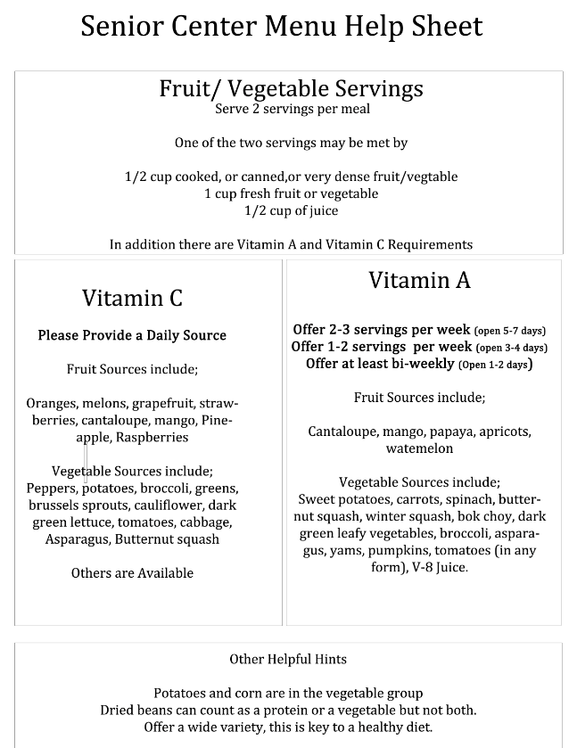
Meal Site Menu Help Sheet

Slide 18
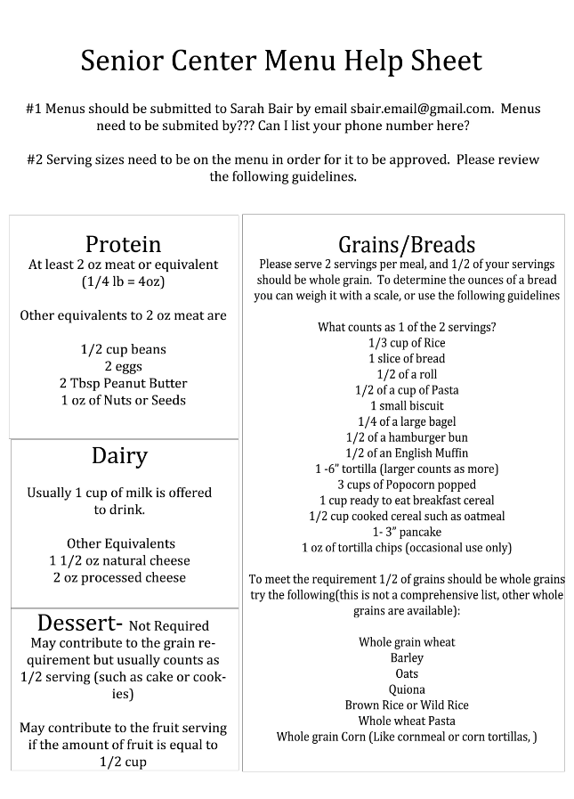
Meal Site Menu Help Sheet

Slide 19
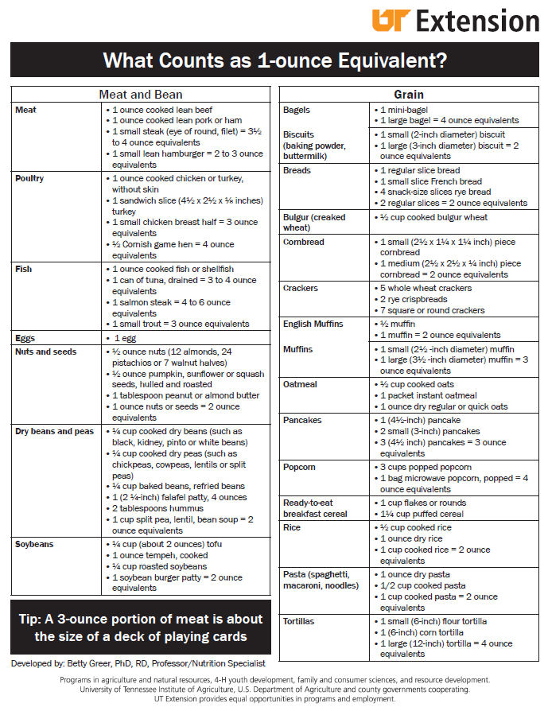
Meal Site Menu Help Sheet

Slide 20
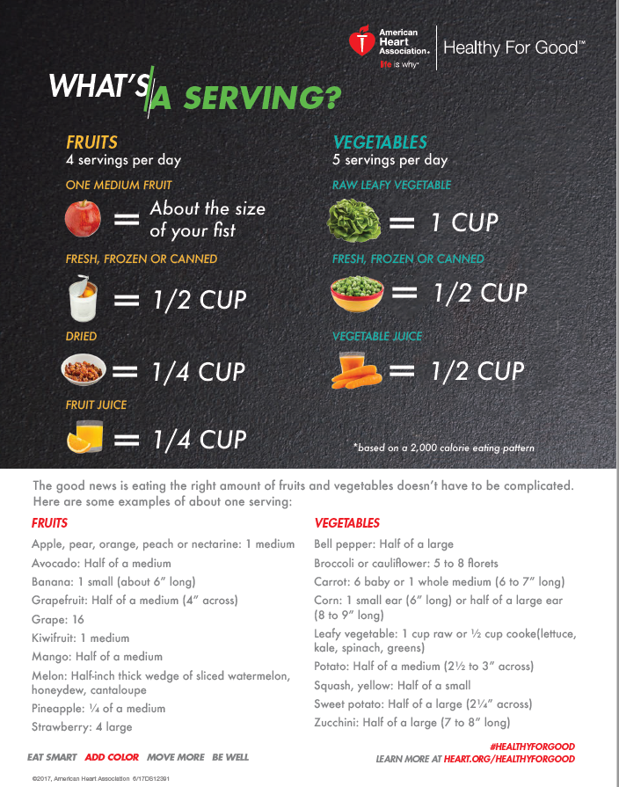
Meal Site Menu Help Sheet

Slide 21
Sanitation
To Glove or not to Glove? That is the question.
Wear gloves with anything that is going to come into contact with the consumer’s mouth (that is not still going to be cooked). Ready to eat foods, silverware, glasses, etc.
Other option is to use utensils for the food whenever possible and not touch glasses and silverware where the mouth may touch.
Change gloves when changing tasks and when gloves have come into contact with a non-food item that may be contaminated.
Wash hands prior to putting gloves on and when changing gloves.
Notes:
Gloves are not worn to protect your hands! Gloves can give a false sense of security, just because your hands are gloved does not mean everything is protected. Think of yourself as a surgeon, after you have properly washed your hands and/or gloved your hands anything you touch could contaminate your hands. Once you have touched something, that will contaminate the next thing, and so on.

Slide 22
Sanitation-COVID-19
Coronaviruses are generally thought to be spread from person-to-person through respiratory droplets. Currently there is no evidence to support transmission of COVID-19 associated with food. Before preparing or eating food, it is important to always wash your hands with soap and water for 20 seconds for general food safety. Throughout the day, wash your hands after blowing your nose, coughing or sneezing, or going to the bathroom.
It may be possible that a person can get COVID-19 by touching a surface or object that has the virus on it and then touching their own mouth, nose, or possibly their eyes, but this is not thought to be the main way the virus spreads.
In general, because of poor survivability of these coronaviruses on surfaces, there is likely very low risk of spread from food products or packaging.
You should always handle and prepare food safely, including keeping raw meat separate from other foods, refrigerating perishable foods, and cooking meat to the right temperature to kill harmful germs. See CDC’s Food Safety site for more information.
https://www.cdc.gov/coronavirus/2019-ncov/downloads/healthcare-facilities/316157-A_FS_KeepingPatientsSafe.pdf
Notes:
https://www.cdc.gov/coronavirus/2019-ncov/downloads/healthcare-facilities/316157-A_FS_KeepingPatientsSafe.pdf

Slide 23
Sanitation COVID-19
CDC Guidelines:
Go home when you feel sick, stay home when you are sick.
Wear a face cover in public places.
Wash your hands very often with soap for 20 seconds.
Use an alcohol-based hand sanitizer with at least 60% alcohol.

Slide 24

Food Costs
Meat is often the highest cost for menus. Look at reducing portions. Or cutting down the meat in recipes. Purchase larger cuts and break it down yourself.
Do homemade when possible. Breads, soups, desserts, etc
Utilize food on hand before it expires. Keep the inventory manageable.
Track and use leftovers.

Slide 25
Cooling / Heating / Storage
Take and record food temps prior to service.
Cooling to 70 degrees in 2 hours and 41 degrees in 6 hours (may have to break down into smaller sections or containers to meet this).
Storing leftovers with labels and dates. Tossing expired items.
Thawing in the refrigerator, under water or cook from frozen.

Slide 26
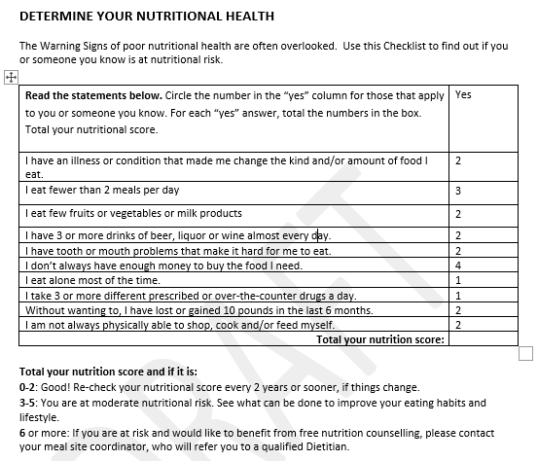
Diet Counseling
Notes:
This is a reminder for everyone to please make sure that participants fill out the Congregate Meal Registration Form and the Nutritional Risk Survey

Slide 27
Q&A

Slide 28
Congratulations
  Your Opinion Counts!
  This training is designed to equip you to succeed as the menu preparer.
  Please invest 5 minutes to provide your feedback in a survey-monkey that I will send out after the training.
  THANK YOU!!!

