Slide 1
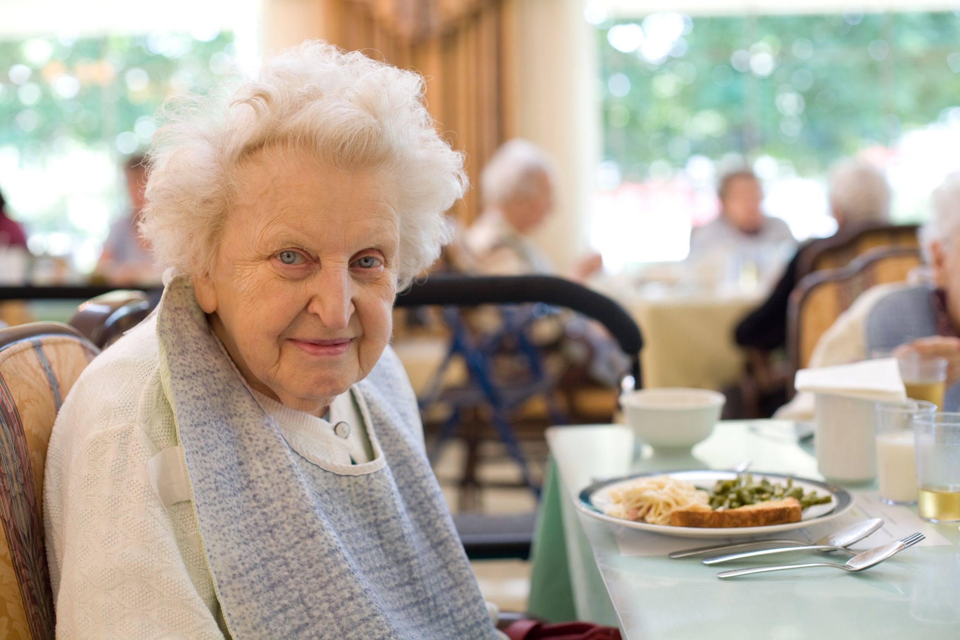
Nutrition Programs:
Meal Site Coordinator Foundations
Notes:
KEY TO SYMBOLS & TYPOGRAPHY
Key Point
Participant materials
Items in bold suggest things you should do
Phrases in italics are the important talking point details or actual script
TIPS provide hints and suggestions for you
NOTES provide supplemental information
Discussion points
Video title, simplified URL and duration Slide 1
Key Point (designated with the key symbol) summarizes the most important concept of the current slide
Participant materials, either electronic or hard copy, (designated with a piece of paper icon and in red) are provided as reminders to have participants use their materials. They can be either referenced or specifically opened during this slide.
Items in bold suggest things you should do at that point in the presentation
Phrases in italics (and preceded by a square icon) are the important talking point details for the current slide. Please make sure they are included in your presentation of this slide.
TIPS (designated with a checkmark) provide hints and suggestions for you to utilize to optimize the session’s effectiveness
NOTES (designated with the hand holding a pen icon and in blue text), provide supplemental information regarding the topic that you may find useful for your own reference or to share with participants
Discussion points (designated with the speech bubble icon and in blue) provide suggested points of discussion you can introduce to engage participants
Videos (designated with the clap board icon and in red), usually utilize the ICOA video slide layout. Information about the video includes the video title, simplified URL and duration.
Introduce training session
If anyone in the audience doesn’t know you, take a moment to introduce yourself and provide some of your background. Likewise, take a few minutes to allow participants to provide brief introductions of themselves for your benefit and anyone in the class who may not know them.
For in-person classes, ask if attendees have signed in on the roster (if using) and if they all have either the hard copy materials you have provided OR have accessed the electronic materials. If anyone needs assistance accessing electronic materials, assist them before continuing. For online classes, ask if everyone can hear you and see your screen. If not, aid. Also ask if they have accessed the materials and if not, provide assistance before continuing. Provide any logistical information necessary including plans for breaks, lunch (if applicable), what to do if virtual service stops on your end as the presenter etc.

Slide 2
Learner Objectives
Understand how nutrition programs are funded & structured
Identify Focus Areas important to Meal Site Coordinators
Identify Focus Area tasks for which Coordinators are responsible
List steps necessary to complete identified tasks
Create a timeline for ensuring, on-time task completion
Identify methods for ensuring timely, effective communication with members of the Board
Plan methods for providing quality training for staff & volunteers
Notes:
Training objectives
We will move logically and progressively through the tasks and activities that will help us be successful
Understand how nutrition programs are structured and funded
Identify Focus Areas
I0dentify focus area tasks
List specific steps necessary to accomplish focus area tasks
Identify critical activities that will result in meal-sites success
Create a timeline ensuring all tasks are completed so know how to allocate resources and ensure don’t miss deadlines
If a whiteboard or easel is available, write “Timeline” as a heading and tell them we will be building it as we move through the content.
Communication and interaction with our Board of Directors
Plan methods for providing quality training for staff and volunteers.
Training objective: Meal site Coordinators will have the knowledge, skills and attitudes necessary to complete focus area tasks so our meal sites and those involved with it succeed, for the benefit of our consumers.

Slide 3
Nutrition Programs
Getting Started
Notes:
Nutrition program overview topic
Take a few minutes to better understand the structure of the nutrition programs

Slide 4
Nutrition Program Authority & Funding Flow
Older Americans Act (OAA) Nutrition Program for Older Adults
Administration for Community Living (ACL)
Idaho Commission on Aging (ICOA)
AAA
Area Agency on Aging (AAA)
Meal Site Nutrition Programs
Notes:
OAA, ACL, ICOA, AAAs and meal site structure
Understand how programs originated
Sources of funding
Who has oversight
Activities and reporting flow back and forth through this structure
Older Americans Act (OAA), Authorizes nutrition programs for older adults
Administration for Community Living (ACL), Where program authority and funding originates
Receives our reports, Provides funding to state agencies
Idaho Commission on Aging (ICOA)
Tasked with overseeing aging issues and programs
Contracts with six Area Agencies on Aging (AAAs), located throughout Idaho
AAA`s serve specific geographic area, contract directly with meal sites and oversee and communicate with meal sites and their Coordinators
Meal Site Coordinator manages meal site, staff and volunteers
Ask if there are any questions about this structure

Slide 5
OAA Nutrition Program Goals
Reduce hunger & food insecurity
Promote socialization
Delay onset of adverse health conditions
Notes:
Three OAA nutrition program goals
Food insecurity - income, lack of transportation, inability to physically shop due to mobility or stamina issues
Socialization - one of the biggest risks to health of older adults including depression and general health deterioration
Delay onset of adverse health conditions – proper nutrition, socialization, and education support general health

Slide 6
Program Participant Eligibility
Congregate Meals
Home Delivered Meals (HDM)
Age 60+
Age 60+
Homebound
Frail
Unable to prepare meals at home
Notes:
Basic congregate and HDM eligibility requirements
Congregate Meals
Any person 60 years or older , regardless of income or residency
Home-delivered Meals
60 years or older, homebound, frail, and unable to prepare meals in their own home

Slide 7
Idaho’s 94 Congregate & Home-Delivered Meal Providers
1,034,635 meals
16,727 clients
$1,981,429 Total provided to Area Nutrition Programs
Figures from FY2017 (10/01/2016-09/30/2017). Dollars total Title III C1, C2 and NSIP funding
Notes:
High-level meal provider contributions in Idaho
Figures show what we have been able to do in Idaho as it relates to providing for the nutritional needs of older Idahoans
Figures from fiscal year 2017 (October 2016 - October 2017)
Work to expand and deliver more meals to more people
Refer to your own specific Area slide to discuss the statistics. If there are significant increases or decreases for some reason, please take a moment or two to mention those changes.]
Close out this discussion after reviewing your AAA statistics on the following slides
Transition: Now that we have that in mind, let’s start focusing on the tasks and activities that will help us maintain productive, successful meal sites

Slide 8
Area I: 12 Meal Providers
138,625 meals provided
2,435 clients
$320,697 total provided to Area Nutrition Programs
Figures from FY2017 (10/01/2016-09/30/2017). Dollars total Title III C1, C2 and NSIP funding

Slide 9
Area II: 13 Meal Providers
100,906 meals provided
2,051 clients
$204,104 total provided to Area Nutrition Programs
Figures from FY2017 (10/01/2016-09/30/2017). Dollars total Title III C1, C2 and NSIP funding

Slide 10
Area III: 27 Meal Providers
357,742 meals provided
4,415 clients
$629,563 total provided to Area Nutrition Programs
Figures from FY2017 (10/01/2016-09/30/2017). Dollars total Title III C1, C2 and NSIP funding

Slide 11
Area IV: 16 Meal Providers
170,231 meals provided
3,642 clients
$269,440 total provided to Area Nutrition Programs
Figures from FY2017 (10/01/2016-09/30/2017). Dollars total Title III C1, C2 and NSIP funding

Slide 12
Area V: 13 Meal Providers
126,914 meals provided
2,484 clients
$269,286 total provided to Area Nutrition Programs
Figures from FY2017 (10/01/2016-09/30/2017). Dollars total Title III C1, C2 and NSIP funding

Slide 13
Area VI: 13 Meal Providers
140,217 meals provided
1,700 clients
$288,316 total provided to Area Nutrition Programs
Figures from FY2017 (10/01/2016-09/30/2017). Dollars total Title III C1, C2 and NSIP funding

Slide 14
Meal Site Coordinator Focus Areas
Focus Area 1: Health District permit-license to operate a meal site
Focus Area 2: Food establishment inspection
Focus Area 3: 501 (c)3 status through IRS determination letter
Focus Area 4: Accredited food protection manager training certification
Focus Area 5: Congregate meal registration form and nutritional survey
Focus Area 6: Rosters and/or sign in sheets for participants, visitors and volunteers
Focus Area 7: Donations & donation box placement
Focus Area 8: Donation tracking sheet
Focus Area 9: Nutrition education at meal sites
Focus Area 10: Invoicing for reimbursement
Focus Area 11: Knowledge of Nutrition Services Incentive Program (NSIP) funds
Focus Area 12: Knowledge of additional nutrition guidance
Commodity Donated Food Program
Eligible / Ineligible Participant
Home-Delivered Meal Program Compliance
Meal Frequency Waiver
Focus Area 13: Knowledge of the role of the Board and what they should know about the nutrition program
Focus Area 14: Menu approval
Focus Area 15: Training to volunteers and staff
Notes:
15 Focus Areas in the checklist
Focus Area Checklist (Nutrition_MealSite_Coordinator_FocusAreaChecklist)
Define activities critical to success for meal sites
General day to day operations and management left up to coordinator
Some items are mandatory by law or program requirements

Slide 15
Focus Area 1: Health District Permit-License
Notes:
Introduce Permit-License Focus Area
Coordinator Reference Guide, page FA1-1
Training PowerPoint format overview:
Each Focus Area has a why, what, when and how slide
Each Focus Area ends with a Toolkit with samples and forms
Each Focus Area ends with a “Summing It Up” review.
Have participants review the Coordinator Reference Guide for the current Focus Area as you move through the presentation. It is their take-a-way reference and job aid. It is important to remind them to use the materials during training..
Transition: Now, let’s move on to our first focus area which deals with the health district permit – license!

Slide 16
Why We Need a Permit-License
Complies with Idaho law (Review the entire Idaho Food Code)
Ensures food & facility safety
Includes establishing, operating & maintaining a food establishment
Notes:
Required to meet state requirements and safety needs
If anyone is interested, open FA01_IdahoFoodCode.pdf from the Focus Area 1 Nutrition_MealSite_Coordinator_Toolkits folder
From this point forward, we will only provide a file name and not the full path. All resources are in the Toolkit folder for the specific Focus Area you are working in.
Actual permit may look different than the sample shown

Slide 17
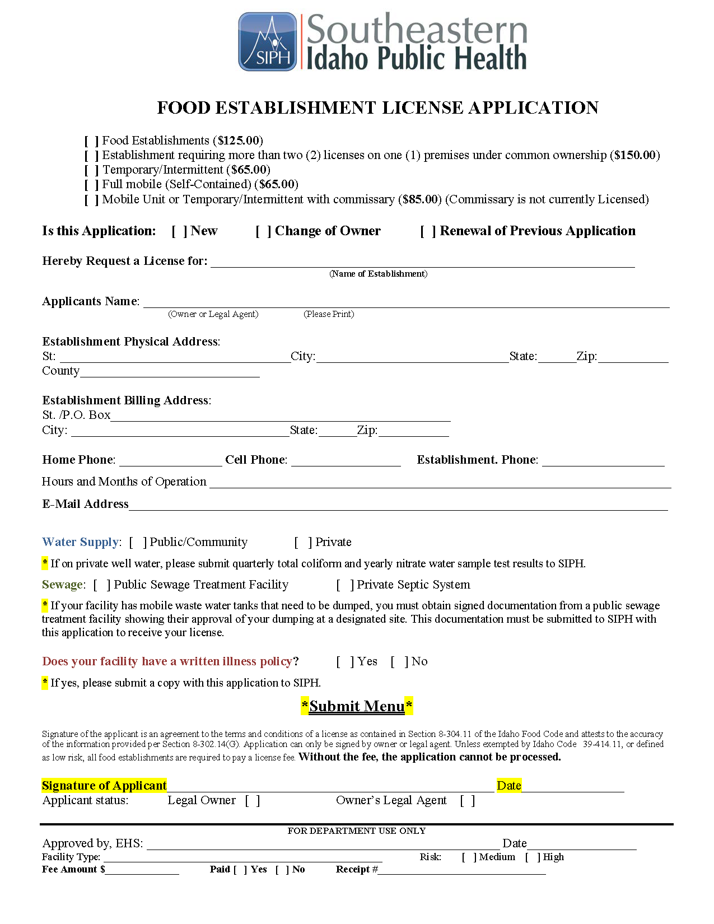
What the Permit-License Requires
Completed application for local Health District
Required supporting documentation
Site inspection See Focus Area 2
Notes:
Must apply for permit-license with local health district
Coordinator Reference Guide, page Appendix 1
Clickable Idaho Health District map on slide 19
Application may vary slightly depending on which health district facility is in

Slide 18
When We Need the Permit-License
Before opening for service
Renew annually (every year)
Check with local Health District for specific notification procedures
Notification generally sent via regular mail either in the fall or prior to your annual renewal date
Annual cost is $125
Notes:
Required before first service, renewed yearly
Renewal notification sent by regular mail, timing varies by health district, based on original permit issue date, maybe same date for everyone each year
Write “Annual” under the Timeline title on the whiteboard or easel. Under “Annual”, write in “Renew permit-license”
NOTE: Set an annual reminder with a few weeks lead time so you know to look for the renewal notification and complete it prior to the deadline
No renewal = permit cancellation
Be sure to budget for annual fee

Slide 19
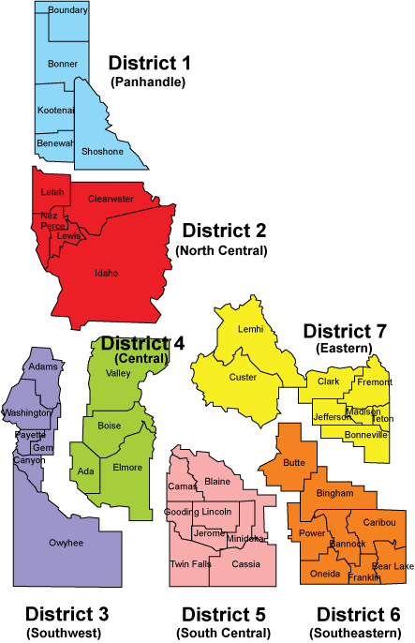
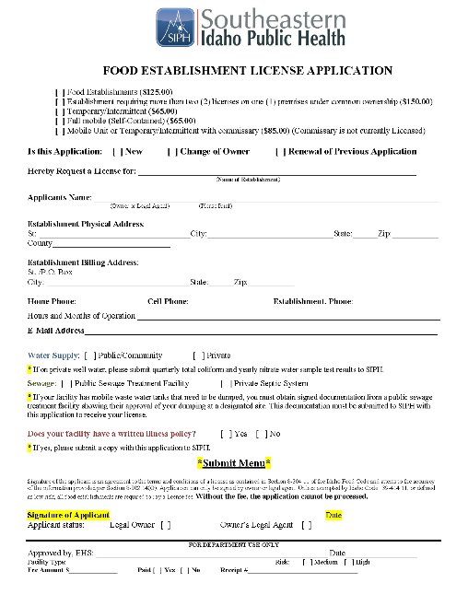
How to Apply for the Permit-License
Application available through local Health District
Instructions on application
Complete all fields
Include all requested documentation
Common errors:
Check the appropriate permit type
Include the proper fee
Notes:
Use local health district application for initial request and renewals
Coordinator Reference Guide, page Appendix 2
Provide the correct local health district information for the meal site(s) of those participating in this training session
Write N/A instead of leaving blanks
Click image of Idaho on lower right to display Health & Welfare webpage
Ask if everyone knows their district
If you know the personnel at the local health district, take this time to provide a specific name or location in a building etc. that will make the coordinator feel more comfortable with whom to contact.

Slide 20
Your Permit-License Toolkit
Idaho Food Code (FA01_IdahoFoodCode)
Permit-License Sample (FA01_Permit-License)
Application for local Health District (obtain from Health District website to ensure latest version)
BONUS: Who Needs a Food License brochure (FA01_WhoNeedsAFood License_ June 2016)
Items can be found in your training packet or from the ICOA website
Notes:
Permit-License toolkit contents and when/how to use
Explain toolkit structure: Each focus area has a toolkit, with the exception of Focus Area 15 which is about staff and volunteer training. Each focus area toolkit is located in the main toolkits folder. Each Focus Area Toolkit is in a subfolder with the focus area number and name.
Open the main Toolkits folder, then the Focus Area 1 Toolkit folder
Explain file naming: Notice the first file name. The actual file name is F a 01_Idaho Food code. All toolkit files begin with “FA” and the focus area number in which they belong. The file name ends with a brief description of the item, so we know what focus area it belongs to and what it is without having to open the file. Unless they are meant to be usable forms, the materials and the toolkits are provided in PDF format.

Slide 21
Summing It Up: Health District Permit-License
Focus Area 1
Health District permit-license to operate a meal site
Before first service
Applications via local Health District
Renew annually
Assistance: local Health District
Notes:
Permit-license required to operate meal site, renewed yearly
Coordinator Reference Guide, page FA1-1
Ask for questions about the permit process
Transition: Getting the permit is one of two things we must do before our first service. The other is having a site inspection which is the topic of Focus Area 2, so let’s go!

Slide 22
Focus Area 2: Food Establishment Inspection
Notes:
Introduce Inspection Focus Area
Coordinator Reference Guide, page FA2-1
As consumers, we generally like to think the restaurants we go to have been properly checked out, so we can be reasonably sure it is clean and serves safe food. If we expect that as a consumer, we should also be accountable for providing a safe environment as the provider. That is our second Focus Area topic that we’ll investigate now.

Slide 23
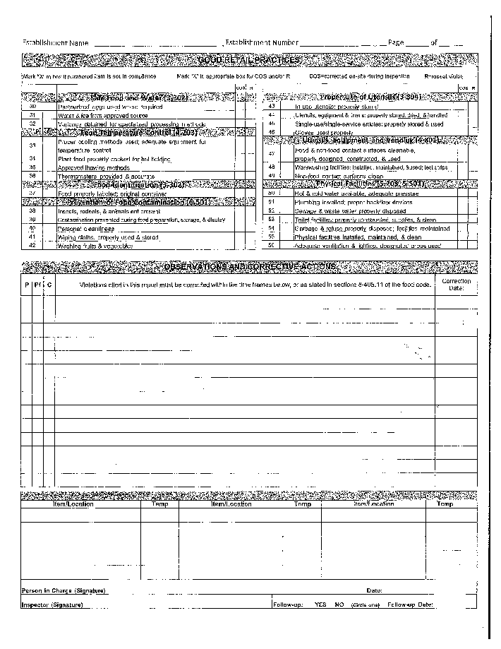
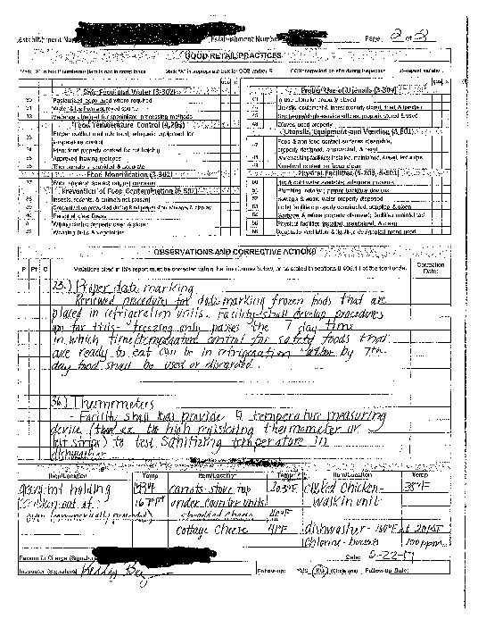
Why We Need an Inspection
Complies with State food safety regulations
Prevents food-borne illness
Ensures safe, sanitary setting for staff, volunteers & consumers
Notes:
Site inspection required by law, and to ensure safety
Coordinator Reference Guide, page Appendix-3

Slide 24
What Inspection Includes
Requirements based on current safety & sanitation standards
Areas related to food storage, prep & service
Performed by local Health District
Notes:
Includes all food prep, storage and service areas

Slide 25
When Inspection Occurs
Part of initial permit-license process
Health District can perform unscheduled inspections at any time, for any reason
Best practice: Always be prepared & in compliance It’s not about passing the inspection, it’s about managing a consistently safe, sanitary service & facility.
If inspection fails, a corrective action plan may be employed by the Health District to provide opportunity to remedy deficiencies
Notes:
Can occur at any time, without prior notification
Do to resource limitations, may not occur annually

Slide 26
How to Work with Inspections
Facilitate all Health District safety & sanitation inspections
Consistently maintain all standards
Modify site or procedures to comply with recommendations
Retain inspection reports & corrective action plans
Notes:
Always maintain compliant environment and provide all documentation/access requested by inspectors
Coordinator Reference Guide, page Appendix-4
Facilitate any communication and on-site visit interactions with health district personnel
Modify site or procedures to comply with recommendations

Slide 27
Your Health Department Inspection Toolkit
Food Establishment Inspection Report (blank) (FA02_FoodEstablishmentInspectionReport_Blank)
Food Establishment Inspection Report (filled example) (FA02_FoodEstablishmentInspectionReport_Ffilled)
Items can be found in your training packet or from the ICOA website
Notes:
Inspection toolkit contents and when/how to use
Does not require a lot of intervention, just cooperation

Slide 28
Summing It Up: Health Department Inspection
Focus Area 2
Food establishment inspection
Retain all inspection reports
Prior notification not required
Maintain site to pass inspection at any time
Resolve an violations as soon as possible
Notes:
Must always comply with and pass inspections, resolving any inadequacies ASAP
Coordinator Reference Guide, page FA2-1
if always prepared, the inspections should not require any additional time or effort.

Slide 29
Focus Area 3: IRS 501 (c)3 Non-Profit Status
Notes:
Introduce Non-profit Status Focus Area
Coordinator Reference Guide, page FA32-1
In addition to ensuring we have a permit and inspection in place before starting operations, another important activity is to ensure we have our non- profit status recognized by the IRS

Slide 30
Why We Need 501 (c)3 Status
Official recognition as non-profit organization
Saves money & administrative/record-keeping time
Provides exemption from federal, sales & property taxes
Offers exemption from payroll taxes on employees
Notes:
Meal sites need 501 (c)3 non-profit status
501(c) 3 is reference to United States revenue or tax code that defines nonprofits
Requesting IRS to officially recognize meal site as non-profit
Allows funds to be used for services instead of taxes
Saves time normally required for record keeping and reporting associated with taxes

Slide 31
What 501 (c )3 Status Requires
Application, updates & changes handled through the IRS
Application requires significant information & documentation
Best practice: If possible, work with a tax accountant & be sure s/he provides a review at least annually
Preparation & approval can take up to one year,
Review the Internal Revenue Service’s charities & non-profits pages for additional information
Notes:
Lengthy IRS application with significant documentation
Coordinator Reference Guide, page Appendix-6
Coordinator Reference Guide, page Appendix-7
Not a simple “print off the page, fill out a few lines and put it in the mail” process
If site doesn’t have nonprofit status, begin working on it as soon as possible
Recommend use of an experienced TAX accountant, not just a CPA
Recommend meeting with the tax accountant at least once a year
Click the link to open the IRS website, if it is of interest to participants
ink URL: https://www.irs.gov/charities-non-profits/charitable-organizations

Slide 32
The Difference between For Profit & Nonprofit Organizations Dr. Kenneth Acha
View this video at (duration 3:24)
Notes:
The ten main differences between for profit and non-profit entities
NOTE: this is an optional slide that contains a video that explains the difference between for profit and nonprofit organizations. If the participants are new coordinators, and do not have a clear understanding of non-profit status, view this short video as part of the presentation. If they have a solid understanding, the slide and the video can be skipped.
Video title: The Difference Between For Profit and Nonprofit Organizations (Dr. Kenneth Acha) URL: https://youtu.be/Zw9j1g1wsq8 Time: 3:24

Slide 33
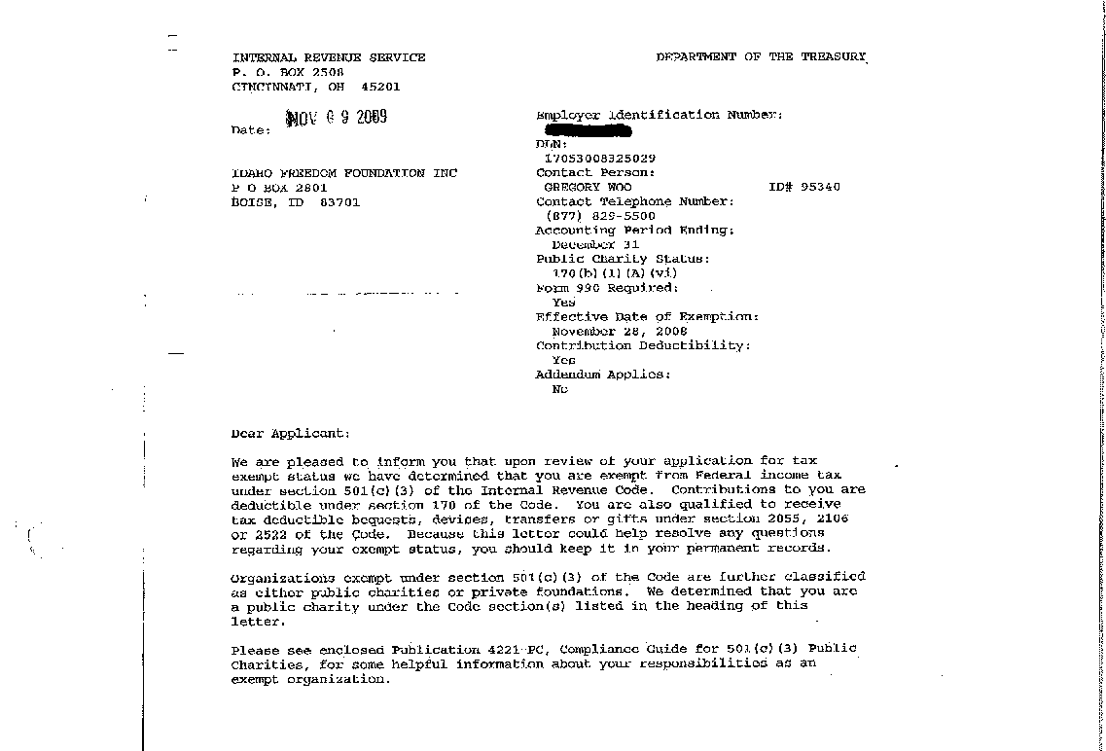
How To Apply for 501 (c)3 Status
Existing facilities may already have this status
Application can take up to 100 hours to complete
If participating in application process:
Review IRS Publication 4220
Gather & prepare corporate documents
Work with your organization Board & accountant
Receive Determination letter when approved
Notes:
Work with the Board and accountant to apply and retain determination letter
Coordinator Reference Guide, page Appendix-6
Important and worthwhile designation
Ask if participants know their nonprofit status. For those who claim it, ask how they know and where their determination letter can be found.
This is a point of discussion and discovery and should not make participants feel uncomfortable or like it is a confrontation
Keep copy of IRS Determination letter in meal site records (original should be kept with the corporate records)

Slide 34
How to Start a Non-Profit Nonprofit Ally
View this video duration 4:45)
Notes:
Process of applying for non-profit status
Video title: How to Start a Nonprofit (Nonprofit Ally) URL: https://youtu.be/UaiKlOTRH2M Time: 4:47

Slide 35
Your 501 (c)3 Toolkit
IRS 501 (c)3 Determination Letter (FA03_IRS_501c3DeterminationLetter)
Form 1023 (application) (FA03_IRS_Form1023_Form)
Publication 4220 (instructions) Form 1023 FAQ
Items can be found in your training packet or from the ICOA website
Notes:
Non-Profit toolkit contents and when/how to use
Publication 4220 (Instructions) web page: https://www.irs.gov/pub/irs-pdf/p4220.pdf
Form 1023 (FAQ) web page: https://www.irs.gov/pub/irs-pdf/f1023.pdf

Slide 36
Summing It Up: 501 (c)3 Status
Focus Area 3
501 (c)3 status through IRS determination
Keep determination letter in corporate binder
Work with accountant to produce records & reports
If necessary, apply as soon as possible,
Be sure documentation & corporate documents are current & accurate
Notes:
Apply ASAP, keep records current, and retain all documentation
Coordinator Reference Guide, page FA3-1

Slide 37
Focus Area 4: Accredited Food Protection Manager Certification
Notes:
Introduce Food Production Manager Focus Area
Coordinator Reference Guide, page FA4-1
We now understand the necessity to have both a permit and a site inspection completed prior to our first service. We also know that receiving nonprofit designation by the IRS as soon as possible is important as well. Focus Area 4 relates to accredited food protection manager certification and is the next item we need to consider.

Slide 38
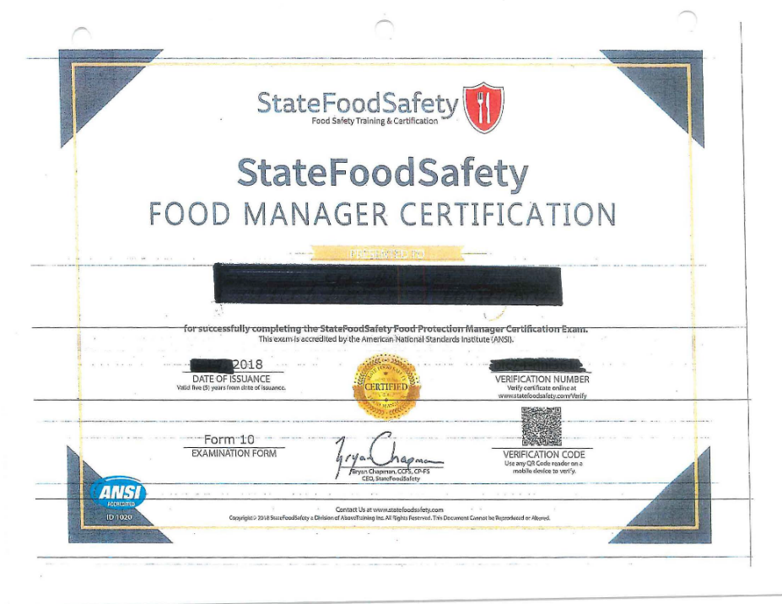
Why Manager Certification is Necessary
Required by Health & Welfare since 7/1/2018 (Idaho Food Code, paragraph 2-102.12(A) )
State certified Food Protection Manager (“Manager”) oversees food production
On-site during operating hours or ensures someone as equally qualified (but not necessarily certified)
Certified person trains food handlers
Ensures adherence to food handling & safety procedures
Notes:
Required by the Idaho Food Code with Manager or equivalent person on-site
Coordinator Reference Guide, page Appendix-8
Coordinator Reference Guide, page Appendix-9
Tell participants we will use “Manager” during this focus area instead of the full “Food Protection Manager” title
Open Idaho Food Code if anyone wants to review it
A state certified food protection manager is a person who oversees food production This person or someone who is equally qualified but not necessarily certified must be on the premises anytime food handling and production occurs

Slide 39
What Idaho Requires for Managers (Idaho Food Code, paragraph 2-102.12(A) )
Have supervisory authority to direct & control food preparation activities
Have supervisory authority to correct food safety violations
Have successfully completed a nationally accredited food safety examination provided by a recognized vendor:
360 Training ®
Above Training/State Food Safety®
National Registry of Food Safety Professionals®
Prometric (testing only, no prep)
ServSafe® (National Restaurant Association)
Managers must be recertified every 5 years
For more information, refer to Accredited Food Manager Guidance
Notes:
Supervisory authority and accredited exam every 5 years
Recognized exam providers may change, so refer to Health & Welfare website for current list
Write “Food Protection Manager Certification” on the timeline, with a designation of every 5 years

Slide 40
How to Prepare for the Exam
Up to the individual
Vendor-specific study materials can be found online
360 Training ServSafe
Cost for study materials and/or test preparation varies by vendor
Notes:
Method up to individual from various traditional or online sources
People with food service experience may not need as much preparation as a person new to the field

Slide 41
Free Exam Prep Videos Central District Health, Part 1 of 6
View this video duration 5:19) Search YouTube for “Basic Food Safety Course Central District Health” for other videos in this series
Notes:
Sample of online resources
if participants are new to Food Service, are interested in seeing an example of what training would contain, or if you’d like to have a 5-minute break in the lecture, view the video presented on the slide. Otherwise, it can be skipped.
Other resources include an actual 4-hour presentation: https://youtu.be/uO8PK9Le_E4 Food
Video title: Safety Course (Part 1 of 6) (Central District Health) URL: https://youtu.be/URgF2Er026c Time: 5:19
Search YouTube for “Basic Food Safety Course Central District Health” for other videos in this series

Slide 42
How to Register for the Exam
Exams can be taken :
Online
At testing center
As part of an instructor-led class
Register via vendor’s website
Follow instructions carefully
Exam cost is approximately $125
Notes:
Register with vendor for online or testing center exam
Follow all instructions carefully, especially for online exams

Slide 43
How Certification Happens
80 multiple choice test questions (+10 demographic/research questions that do not count as part of the exam)
60 correct (60/80 or 75%)to pass
Exam certified by ServSafe
Valid for 5 years
Notes:
Multiple-choice exam taken every 5 years requires 75% or 60/80 to pass
Multiple-choice only, no essay, fill in the blank, or scenarios
Usually notified immediately whether passed or not

Slide 44
How Retakes Occur
May re-take twice within 30 days
Must wait 60 days for 3rd attempt
Only 4 attempts allowed in 12-month period
Cost for re-takes varies, usually full price of exam
Notes:
Limited retakes available in certain time period
If don’t pass after 2nd try, recommended to do more studying, get some formal preparation materials if haven’t done so before, or ask for mentoring from someone who has passed the exam.

Slide 45
Your Food Protection Manager Certification Toolkit
The Idaho Food Code (FA04_IdahoFoodCode)
Learn 2 Serve accredited manager certification program booklet (FA04_Booklet_LearnToServe_AccreditedFoodManagerCertification)
Food Protection Manager Certificate sample (FA04_AccreditedFoodProductionManagerCertificate_Sample)
Items can be found in your training packet or from the ICOA website
Notes:
Food Protection Manager toolkit contents and when/how to use

Slide 46
Summing It Up: Food Protection Manager Certification
Focus Area 4
Accredited Food Protection Manager certification
Exam prep & testing from various sources
Only use Idaho certified vendors for exam
Keep copies of certificate on file
Re-certify every 5 years
A certified person or person with equivalent knowledge on-site during operating hours
Notes:
Manager or equivalent on-site with current certification documentation
Coordinator Reference Guide, page FA4-1
Transition: And with that, we have covered the initial Focus Areas related to the more behind-the-scenes activities. Are there any questions about the permit, inspection, non-profit determination or Food Protection Manager certification?
Clarify any questions from focus areas 1-4 before moving on

Slide 47
Focus Area 5: Registration & Nutritional Health Survey
Notes:
Introduce Registration & Survey Focus Area
Coordinator Reference Guide, page FA5-1
Ensuring state requirements for a meal site are in place are critical elements of starting and maintaining a successful meal site. Our focus on daily operations though, surrounds our ability to provide nutritious meals and nutrition education to our consumers. The interaction with consumers begins when they first arrive at check-in.

Slide 48
Why Collect Registrations & Surveys
Accurate counts of meals provided required for program funding & meal site reimbursement
AAA only reimburses for documented meals served to qualified consumers
Federal funding based on reported data
Registration form documents self-reported qualification confirmation
Meal site can offer nutritional counseling or referral based on survey results
Notes:
Accurate meal counts, reimbursement, nutrition referrals
Registrations are the only official documentation of qualified consumers
Nutritional health survey addresses third objective of Older Americans Act nutrition programs, to minimize effects poor nutrition has on chronic conditions

Slide 49
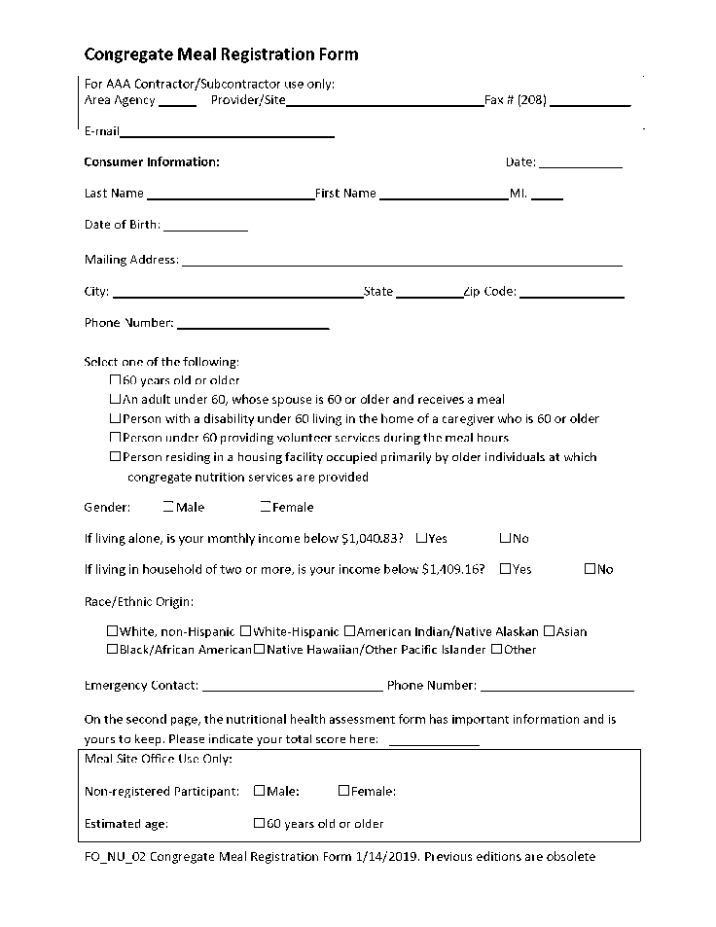
What the Registration Form Does
Registers qualified consumers & volunteers
Collects basic information including:
Contact
Eligibility for service (checkbox)
Demographics
Emergency contact
Registers for all Idaho meal sites
Includes person on roster See Focus Area 6
Notes:
Collects basic demographic and eligibility info from consumers and volunteers
REVISED: ICOA wants all eligible persons and volunteers to register. Do not want to “force” someone but need to explain why it is important for those who want to say they are “just visiting” as it makes a difference in official meals served through the program and reimbursement. Registering al volunteers is also the new standard.
Demographic information used to analyze program utilization
Emergency contact information important since at site, often unaccompanied, with potential issues related to food, activities, or everyday situations that might occur
Registration covers all Idaho meal sites

Slide 50
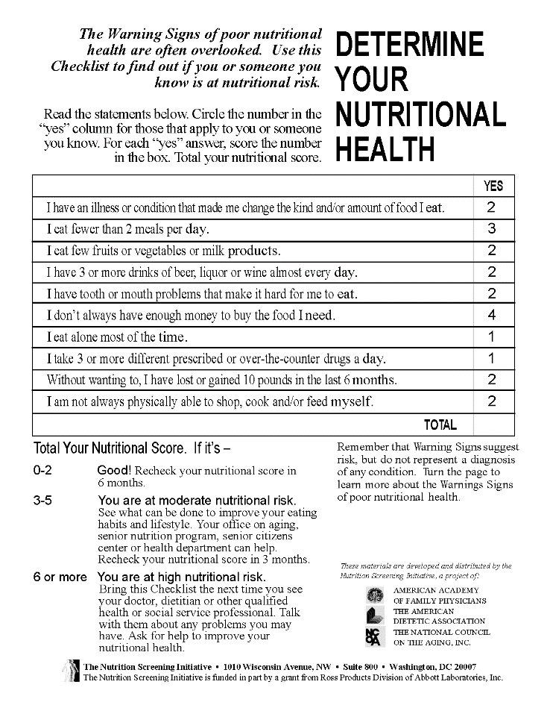
What the Nutritional Health Survey Does
Completed with registration
Asks 10 yes/no questions
Each has score for a “yes” answer
Total score gives suggestions for possible follow-up
Individual on their own
Coordinator
Physician or Dietician with the person
With permission, may speak with a family member
2nd page has explanations of how the areas affect nutrition
Consumer score >=6 can request nutrition counseling from Dietitian
Notes:
10 questions with score determining follow-up recommendation
If consumer scores 6 or more, eligible for free nutritional counseling from the Dietitian
Important to instruct staff, especially check-in clerks, to notify Coordinator if scores >6 Then the Coordinator will inform their Dietician with the contact information and the approval of the client to do a one-on -one counseling by calling the participant or in person. This is up to the Dietician.
Or the client can take the Nutritional Health Risk Form with them to their Doctor to talk about it.

Slide 51
When We Need Registration
New consumers
Disenrolled consumers
Note: Consumers can be automatically disenrolled if not active for a specified period of time
Notes:
All volunteers, qualified consumers and if disenrolled due to inactivity
Disenrollment is being reviewed so can be standardized across the state, but currently applies to a person who is not active for nine months or more and is important to keep databases clean and accurate.

Slide 52
How to Complete Registration
All consumers 60+ years old should complete a registration form & survey to register
Volunteers should register so their meals can be reimbursed
Refusal to register does NOT prevent a qualified person from receiving a meal, they are treated as a visitor
Note: The registration form is updated annually when the Federal Poverty Guidelines are updated
Best practice: One-time visitors who are 60+ years should complete the registration so they can be counted & their meal reimbursed by the AAA
Submit registrations to AAA per their requirements
Notes:
Registration form and survey by all volunteers and qualified consumers, then submitted to AAA
Check-in clerks should be able to assist consumers with forms, as necessary
Reiterate to participants and instruct them to make it clear to staff and volunteers, that refusal by anyone to register does not prevent them from receiving the meal. If a person refuses to register, they are simply treated as a visitor.
Registration form updated every year, with new form distributed by ICOA, to AAA’s, and on to meal sites

Slide 53
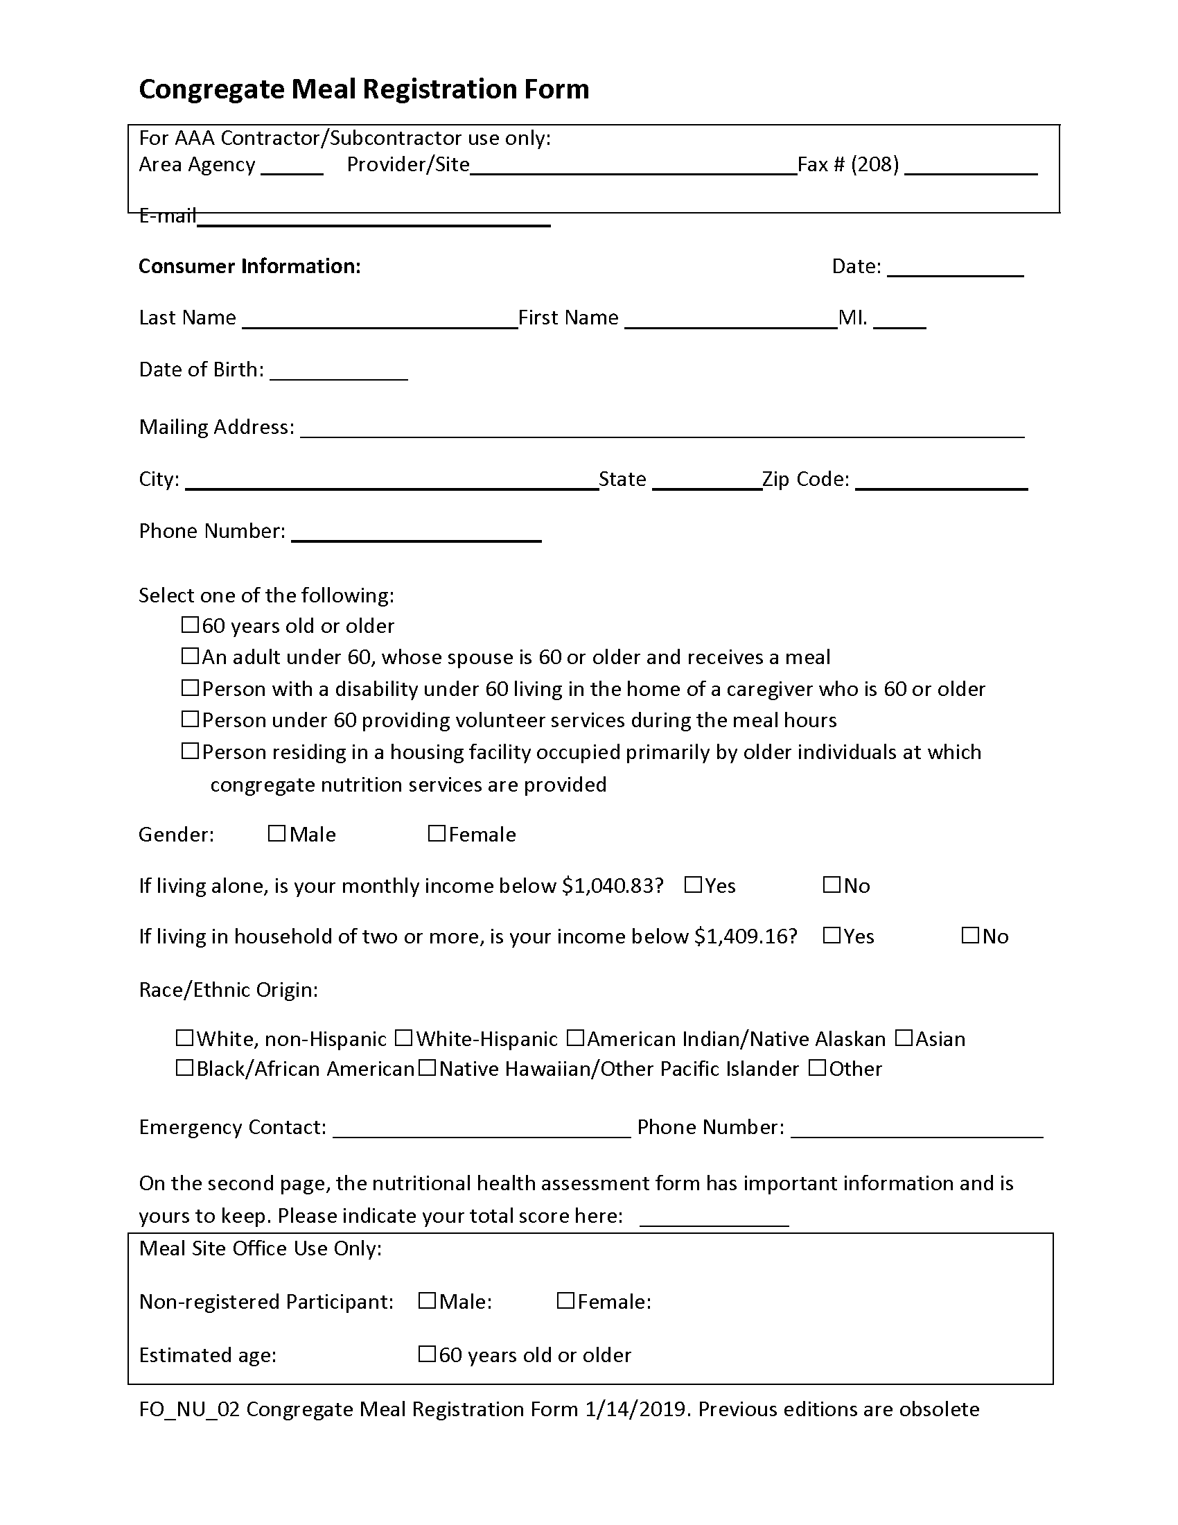
Sample Registration Form
Notes:
Review registration form
Coordinator Reference Guide, page Appendix-11
Answer any questions. Ask how they currently process the new registration form each year.

Slide 54
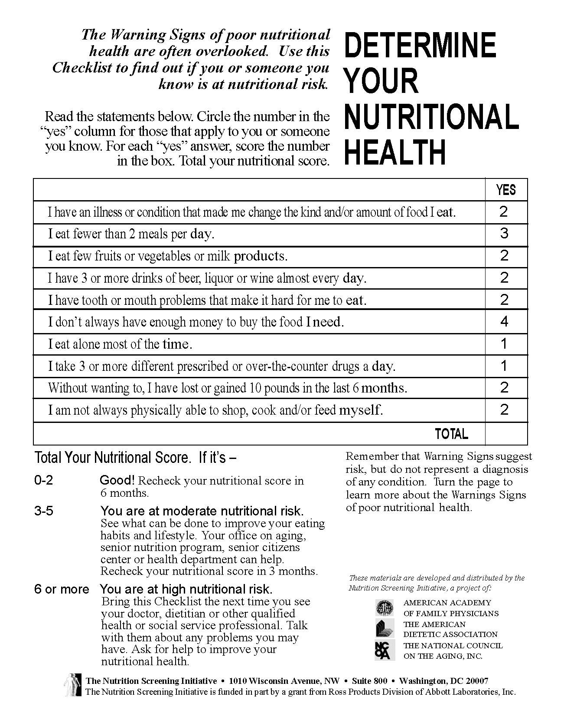
Sample Nutritional Health Survey
Notes:
Review survey and scoring
Coordinator Reference Guide, page Appendix-12
Answer any questions about using the nutritional health survey

Slide 55
Your Registration & Nutritional Health Survey Toolkit
Sample Registration Form (FA05_CongregateMeal Registration_Form_2019)
Sample Nutritional Risk Survey (FA05_CongregateMealRegistration_NutritionalChecklist)
Items can be found in your training packet or from the ICOA website
Notes:
Registration & Survey toolkit contents and when/how to use

Slide 56
Summing It Up: Registration & Nutritional Health Survey
Focus Area 5
Congregate meal registration form & nutritional health survey
Register everyone 60+ & volunteers
Cannot deny meal for refusal to register
Follow-up with Dietician based on survey, if indicated
Registrations & surveys submitted to AAA per instructions
Notes:
Registrations and Nutritional health Surveys for all volunteers and qualified consumers, submitted to AAA
Coordinator Reference Guide, page FA5-1
Emphasize important for program viability that all qualified consumers and volunteers register
Transition: That brings us to the end of Focus Area 5, the first of our focus areas that interfaces directly with our consumers. Next, we’ll explore how those registered consumers and others are tracked.

Slide 57
Focus Area 6: Rosters & Sign-In Sheets
Notes:
Introduce Roster & Sign-in Sheet Focus Area
Coordinator Reference Guide, page FA6-1
We understand why having qualified consumers register for services is important. The registration is the starting point. It allows us to generate rosters that can be used in conjunction with sign-in sheets to more easily track participation in our program.

Slide 58
Why We Need Rosters & Sign-In Sheets
Provides required data for everyone 60+ including volunteers
Basis for monthly invoices
Required for participation reporting, program funding & reimbursement
Reported to State Legislature & ACL
Sign-in sheets document non-qualified and those who refuse to register
Notes:
Official required documentation for meal counts, invoicing, program reporting
Starting point of documentation path for reporting that allows AAA, ICOA, and the ACL to understand program utilization
Is any local (city or county) funding based on the meal site’s or AAA’s reporting?
This is why a simple process of registering a qualified person, so they are included on rosters is such an important activity

Slide 59
What Rosters & Sign-In Sheets Capture
Rosters
Quick check-in for registered consumers
Standard format for data entry & documentation
Sign-in sheets capture all non-qualified people (under 60) & visitors who refuse to register)
Goal is to capture who is utilizing the program
Notes:
Rosters provide quick, formal meal count and sign-in sheet tracks visitors
Rosters provide standardized format for reporting and data-entry
Currently, allowed to use whatever system works for a meal site but must provide the standardized completed roster with the monthly invoice
Roster + sign-in sheet = total people utilizing the program

Slide 60
When We Need Rosters & Sign-in Sheets
Rosters should be received electronically from AAA prior to the start of the month
Should be used to capture participation at each service
Specific reporting requirements determined by AAA
Generally submitted at least monthly
Ask AAA Nutrition Program staff to clarify questions
Notes:
Completed as part of check-in, provided to AAA at least monthly

Slide 61
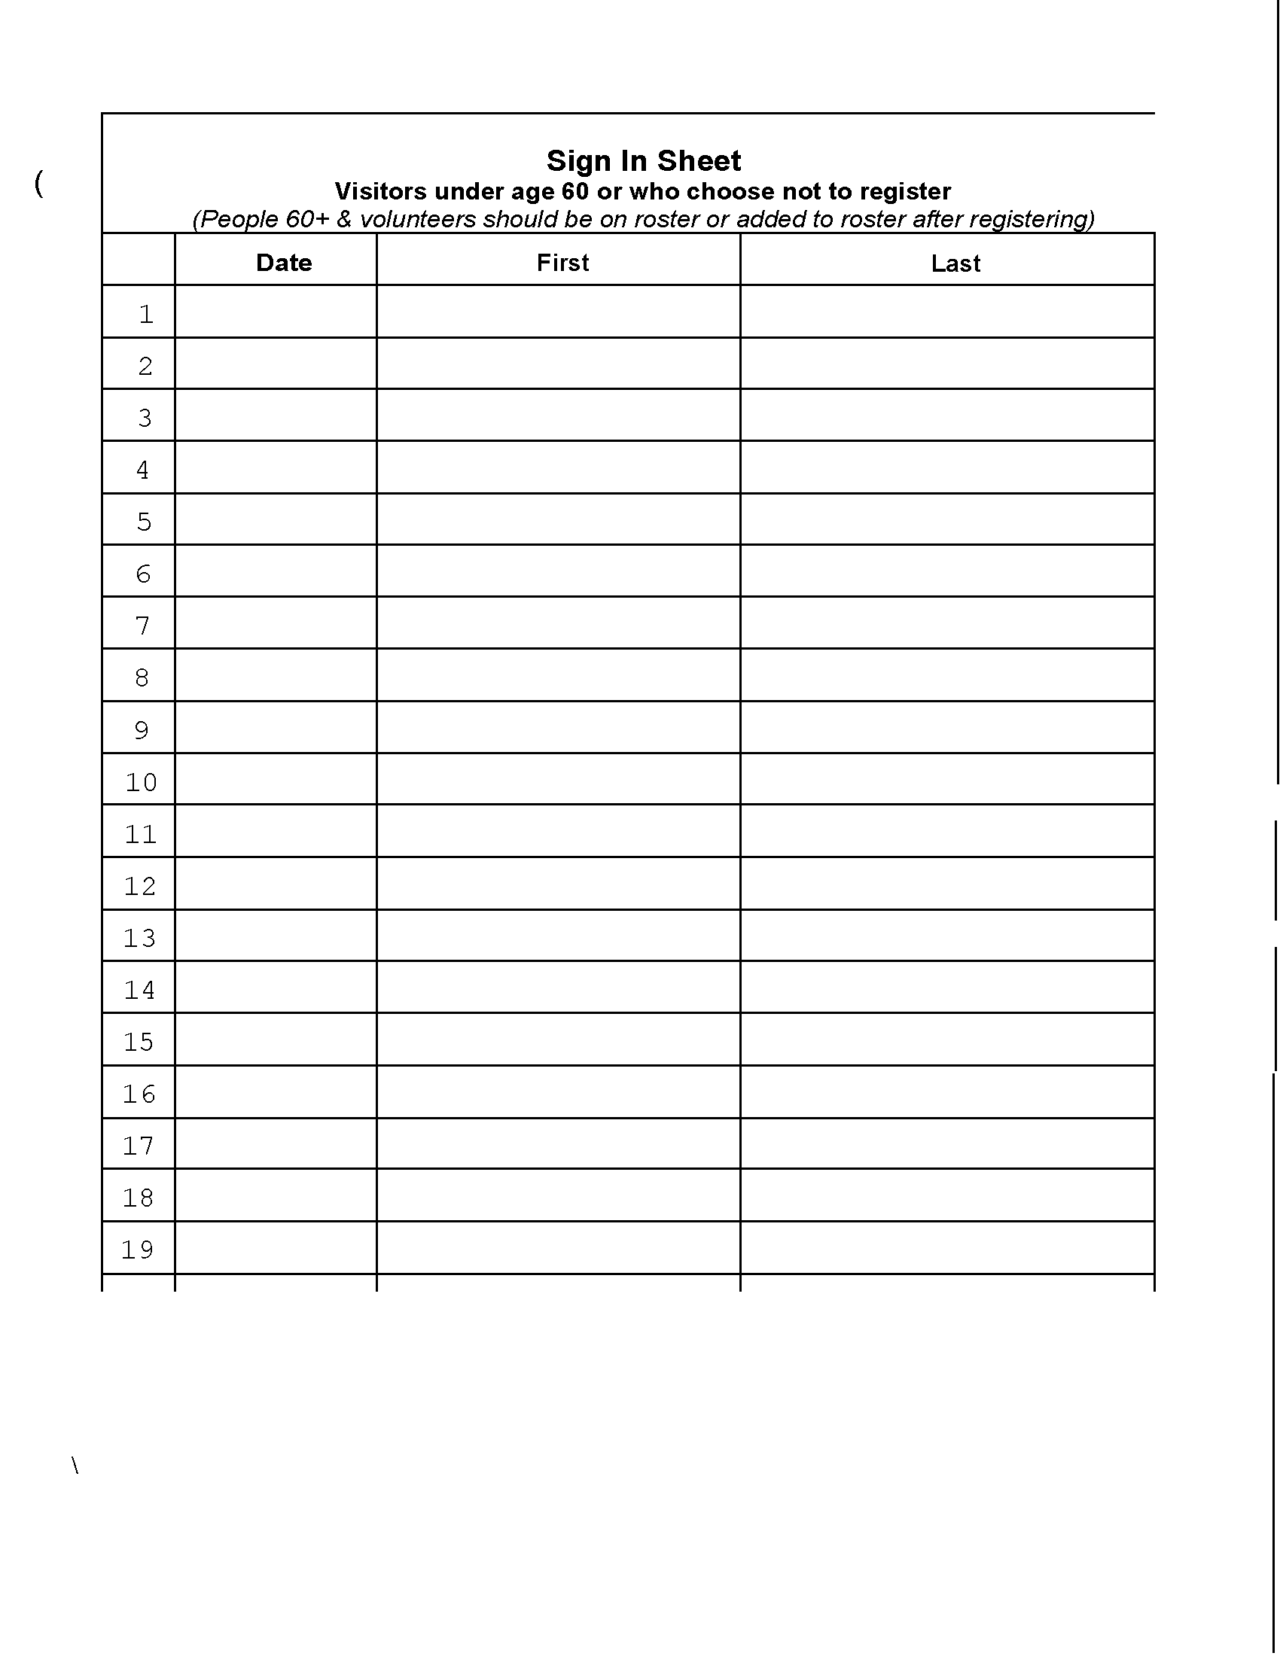
How to Complete Rosters & Sign-in Sheets
Use rosters to check-in previously registered consumers & volunteers
Write- in names of people who register for the first time at of the roster
Indicate their participation for the current meal
Sign-in sheets
People <60 or refuse to register
Meal site can charge people <60 for the meal unless Idaho Food Bank commodities used, then cannot charge
Notes:
Indicate on roster at check-in, write-in newly registered and visitors use sign-in sheet
Can we charge for a meal? Clarify the rules for charging for meals. Will discuss charges in later focus area, but for now know that visitors can be charged for meals unless Idaho Foodbank commodities are used at the facility, then people cannot be charged. This is an important requirement.
Coordinator Reference Guide, page Appendix-15

Slide 62
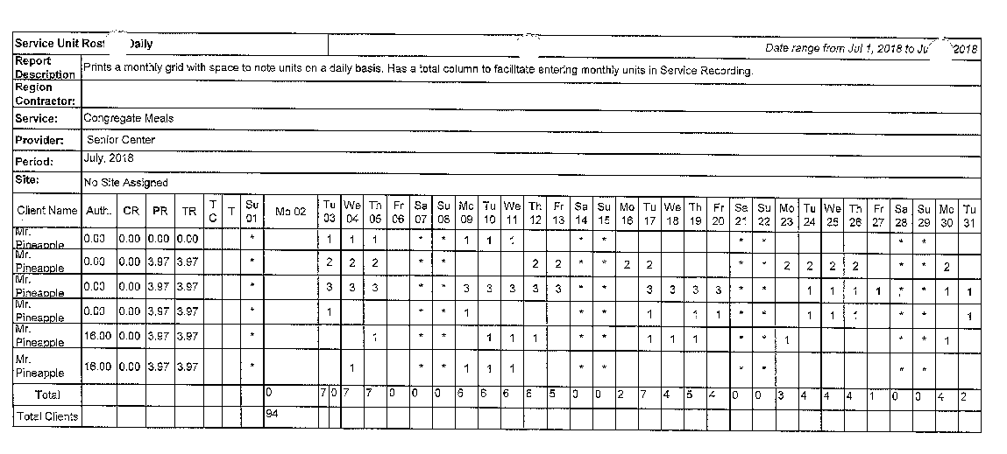
Sample Roster
Notes:
Review roster use
Coordinator Reference Guide, page Appendix-14

Slide 63
How to Submit Documentation
Submit per AAA instructions
Include:
Completed invoice See Focus Area 10
Supporting rosters with meal counts for each person
Keep detailed documentation for 3 years:
Rosters & sign-in sheets
Deposit documentation See Focus Area 9
Volunteer timesheets
Notes:
Follow AAA instructions to submit, and retain documentation for 3 years
Keep detailed documentation for at least three years (longer if required by the Board or accountant)
Documentation includes rosters, sign-in sheets, deposit documentation for donations and volunteer timesheets

Slide 64
Your Roster & Sign-In Sheet Toolkit
Sample roster (FA06_Roster)
Sample Sign-in sheet (FA06_SignInSheet)
Items can be found in your training packet or from the ICOA website
Notes:
Roster & Sign-in Sheet toolkit contents and when/how to use
Sign-in sheet can be printed from the file in the toolkit folder

Slide 65
Summing It Up: Rosters & Sign-in Sheets
Focus Area 6
Rosters & sign-in sheets capture all meals provided
Rosters capture reimbursable meals
Sign-in sheets capture those <60 or who refuse to register
Rosters critical for reporting & reimbursement
Retain for 3 years
Notes:
Every volunteer and eligible consumer on roster, all visitors on sign-in sheet, submit to AAA and keep for records
Coordinator Reference Guide, page FA6-1
Answer any questions related to the difference between rosters and sign-in sheets, or how they should be used. Sites may use any method they want during service, but official roster must be submitted with invoice.

Slide 66
Focus Area 7: Donations & Donation Box Placement
Notes:
Introduce Donations & Donation Box Placement Focus Area
Coordinator Reference Guide, page FA7-1
We have discussed the importance of funding from ACL, and the State of Idaho. Another important source of income for our site comes from donations. Some of our focus areas come with specific guidance, and the area of donations is one of those. In this focus area, we’ll discuss what the guidance says and how it should be implemented so we’re in compliance.

Slide 67
Why Follow Donation Guidance
Ensures everyone understands donations:
Are voluntary
No meal is ever denied based on a person’s choice to donate or not
Establishes donor privacy & confidentiality
Relieves consumer concern that donations are being monitored
Provides staff & volunteers confidence that they are adequately prepared to work with donations
Notes:
Ensure voluntary, private, secure donation opportunities and quality customer service
Important when dealing with public funds to ensure the utmost of adherence to any designated procedures related to activities
No meal can ever be denied based on a person’s choice to donate or not
Guidance establishes donor privacy and confidentiality

Slide 68
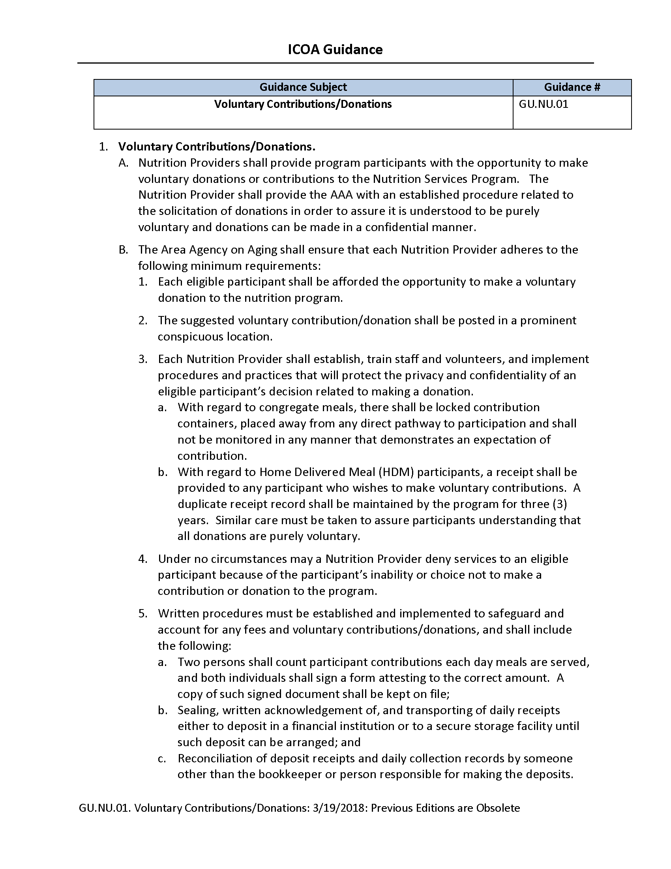
What Correct Donation Acceptance means
Following Voluntary Contributions/Donations Guidance (GU.NU.01)
Train staff & volunteers how to protect privacy & confidentiality of consumers decision related to donating.
Notes:
Privacy, confidentiality and box placement follow Contributions/Donations Guidance
Coordinator Reference Guide, page Appendix-26
Coordinators must clearly understand the guidance, so they can instruct staff and volunteers how to properly administer donations
Open FA07_VoluntaryContributionsGuidance document from the toolkit. Read through the document, emphasizing the following important points:
Donations are voluntary
The AAA is responsible for ensuring the provider adheres to specific processes
Suggested donation must be clearly posted
Provider trains staff & volunteers to ensure privacy & confidentiality
Donation box must be secured & placed to ensure privacy, apart from main pathways & not monitored
Can never deny a meal based on contribution or lack thereof
Must create specific procedures for documenting donations
Answer any questions about the Guidance or what it requires

Slide 69
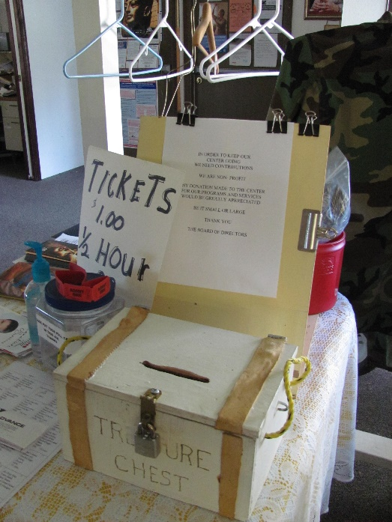
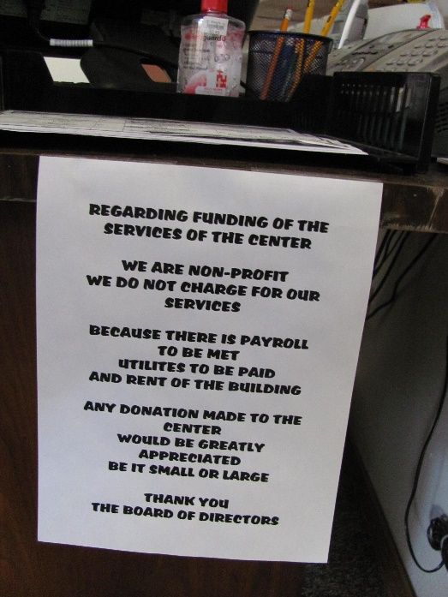
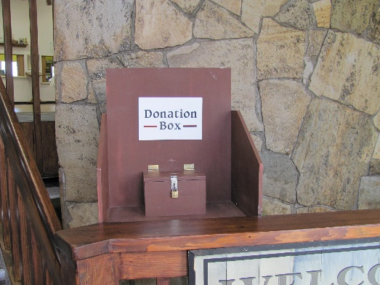
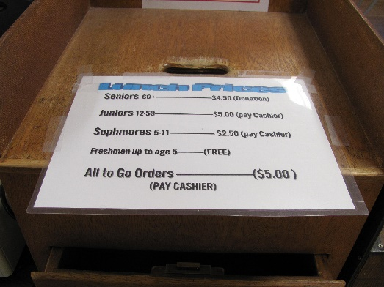
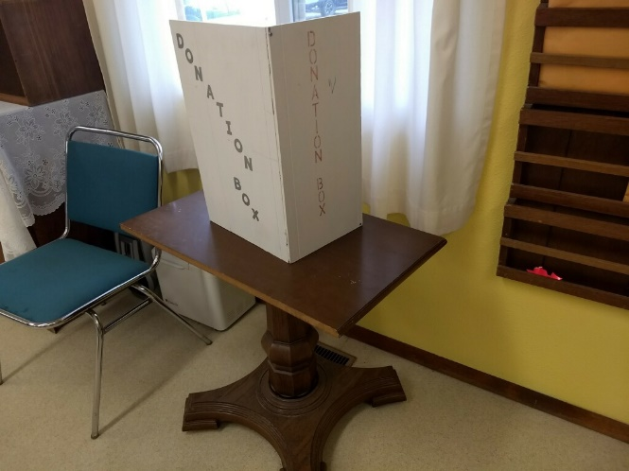
Which Image(s) Follow Guidelines?
To see a larger version, click or tap one of these images. Use the link on the bottom right of the zoom slide to return to this slide.
Notes:
Do the images illustrate following guidance or not
Each of our meal sites is very different from others. So, let’s take a few minutes to consider some examples of donation box placement and signage and think about how they might comply or not comply with guidance.
Click images to see a full-slide version
Discuss what participants think the strengths and weaknesses of each might be. If necessary, prompt them by asking if they have enough information to know. For example, is the image showing the surrounding area? If not, how do we know if it is private?
Because there are so many variations in meal sites including the space in which we have to work, it’s important to always consider donation box placement in the context of a specific site

Slide 70
When Donations Are Accepted
Donation box should be available:
During all service times
Reasonable amount of time before & after service
Should be counted, recorded & secured at least daily see Focus Area 8
Notes:
Donations accepted at meal times and as long before/after as possible
Staffing may determine how long before and after service the donation box can remain available, but make it available as long as possible
Contributions should be counted and properly documented at least once a day

Slide 71
How to Ensure Proper Donation Processes
For each service:
Donation box properly placed & secured
Voluntary contribution amount clearly posted
Staff & volunteers properly trained on donation guidance & approved procedures
Privacy provided
“Under no circumstances may a nutrition provider deny services to an eligible consumer because of the consumer’s inability or choice not to make a contribution or donation to the program.”
Notes:
Slide 71 - Have To Ensure Proper Donation Processes
Ensure proper placement, signage, security, privacy, confidentiality
It may seem that donation requirements are repeated over and over. Proper donation box placement and contribution acceptance is such a vital part of programs and can come under such scrutiny, that’d it deserves a bit of repetition.
Read the slide

Slide 72
Your Donations Toolkit
Voluntary Contributions Guidance (FA07_VoluntaryContributionsGuidance)
Items can be found in your training packet or from the ICOA website
Notes:
Donations & Donation Box Placement toolkit contents and when/how to use

Slide 73
Summing It Up: Donations & Donation Box Placement
Focus Area 7
Donations & donation box placement
Train all staff & volunteers
Ensure proper placement, signage & security
Must be voluntary & confidential
Meals can never be withheld based on donation
Notes:
Train staff & volunteers for proper placement, signage, security, privacy, confidentiality of voluntary donations
Coordinator Reference Guide, page FA7-1
Because we are entrusted with the acceptance and management of contributions, we must ensure that donations and donation box placement adhere to all requirements. We do this by ensuring that all staff and volunteers are fully and appropriately trained. Physically, we ensure proper placement, signage, and security of the box itself. We then work to let our consumers know that donations are purely voluntary and that they are able to do so or not confidentially. Regardless of their choice, meals can never be withheld based on donations.
Answer any questions related to Focus Area 7, either based on guidance or any of our specific meal sites

Slide 74
Focus Area 8: Donation Tracking Sheet
Notes:
Introduce Donation Tracking Sheet Focus Area
Coordinator Reference Guide, page FA8-1
In Focus Area 7, we talked about the importance of following guidance regarding the placement of the donation box and the procedures related to donations. We mentioned in passing the importance of properly documenting donations. Focus Area 8 discusses proper methods four utilizing the Donation Tracking Sheet as part of the documentation process.

Slide 75
Why Complete Donation Tracking Sheets
Donations required to support nutrition programs
AAA contract sets requirements for meal site income & in-kind match reporting
Donation totals included with monthly invoice See Focus Area 10
Reported to State Legislature & ACL
Notes:
Donations must be accurately recorded

Slide 76
What Should Be Tracked
All Nutrition Program donations
All forms of payment
Cash
Checks
Snap
Notes:
All donations, all forms of payment

Slide 77
When to Count Donations
Recommended after each service
Daily totals are best practice
Monthly totals required with invoice
Notes:
Record at least daily, report monthly
Waiting to total donations until end of week or month only makes it more difficult, especially if there are any issues or errors

Slide 78
How to Complete Donation Tracking Sheets
Voluntary Contributions/Donation Guidance
Written procedures established & implemented safeguard & account for fees & donations:
Two persons count each day
Both sign a for correct amount
Copy kept on file
Sealed daily & deposited or secured until deposited
Deposit receipts reconciled by someone other than person responsible for making deposits
All funds with documentation reported to Coordinator who
Seals the donations
Checks for written acknowledgement
Makes the deposit
Notes:
Follow process outlined in guidance
Process is intended to safeguard and account for the fees and donations received and ensure they are appropriately credited to the related programs
The same person can perform more than one task of the donation process, but they cannot be tasked with completing two activities in a row. For example, they cannot both make the deposit AND check the deposit slip against the bank statement.
NOTE: if smaller meal sites are concerned about the personnel required to complete this, remind them that a staff member or volunteer can count the money, the coordinator can seal and deposit the money, and the same staff member or volunteer could then reconcile the deposit receipt. Because the coordinator completes a step between the initial count and the reconciliation, this still meets the minimum requirements.
Intention is to protect any person from ever having their actions questioned.
Does this procedure make sense to everyone? Answer any questions about it or how it can be accomplished at a specific site
This policy has been in place but has not been fully enforced in the past. All meal sites need to review their current procedures and make sure that they are complying.

Slide 79
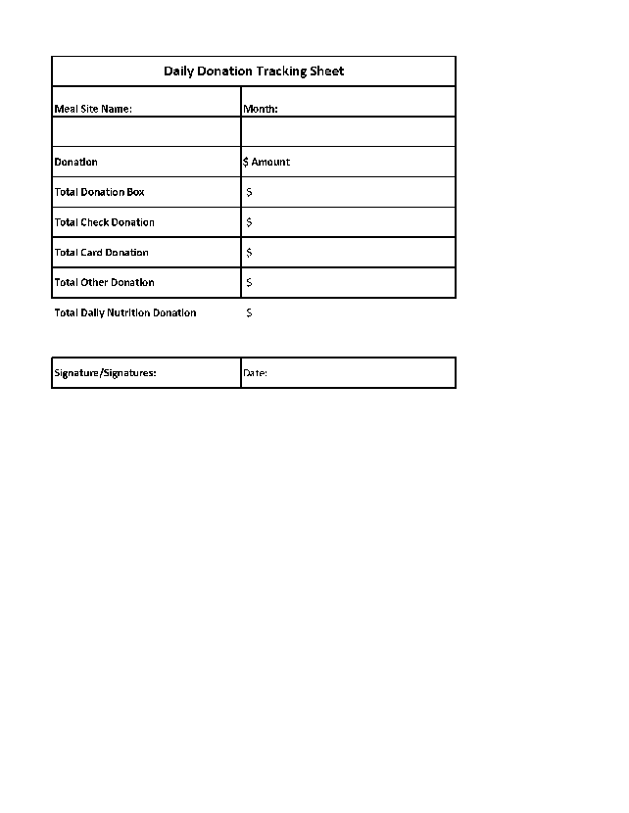
Daily Tracking Sheet
Notes:
Review Daily Tracking Sheet
Coordinator Reference Guide, page Appendix-17
Tracking sheets have been standardized
Open FA08-DailyDonationTracking Sheet and review
Use template provided in toolkit

Slide 80
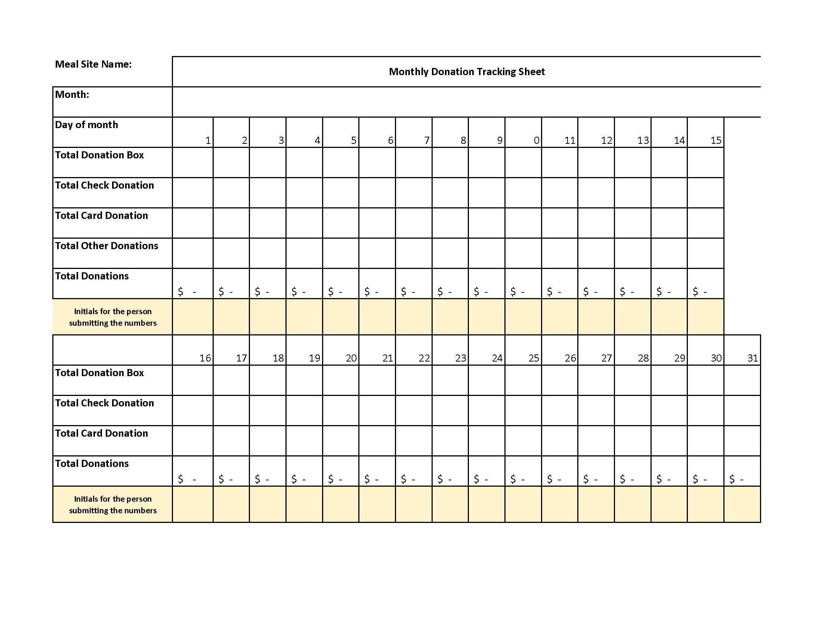
Monthly Tracking Sheet
Notes:
Review Monthly Tracking Sheet
Coordinator Reference Guide, page Appendix-18
Open FA08-MonthlyDonationTracking Sheet and review
Use template provided in toolkit

Slide 81
Your Donation Tracking Sheet Toolkit
Voluntary Contribution Guidance (FA08_VoluntaryContributions Guidance)
Daily Tracking Sheet (FA08-DailyDonationTracking Sheet)
Monthly Tracking Sheet (FA08-MonthlyDonationTracking Sheet)
Both Sheets in Excel (FA08-TrackingSheet_Week AndMonth_2010)
Items can be found in your training packet or from the ICOA website
Notes:
Donation Tracking Sheet toolkit contents and when/how to use
The tracking sheets are available in both PDF format, with one file for the daily sheet and a separate file for the monthly sheet
Also, an Excel file that can be electronically filled then printed or e-mailed, with two worksheets, one for the daily and one for the monthly tracking

Slide 82
Summing It Up: Donation Tracking
Focus Area 8
Donation tracking sheet
Use provided tracking sheets to document donations
Guidance states several processes to follow
Double-check calculations
Coordinator includes donation amounts on invoices
Numbers reported to State & Federal stakeholders
Notes:
Accurately track & report donations
Coordinator Reference Guide, page FA8-1
Transition: Focus Areas 7 & 8 ensure we know how to properly accept and handle monetary donations and fees. We know that the guidance provides specific procedures to follow. Those procedures primarily ensure that we have double checked our calculations and responsibly insured they are properly accounted four and deposited with documentation to back it up. This is really a middle step in our overall process, where we will ultimately simplify a coordinator’s ability to create accurate invoices at month them.

Slide 83
Focus Area 9: Nutrition Education
Notes:
Introduce Nutrition Education Focus Area
Coordinator Reference Guide, page FA9-1
One of the goals of Older Americans Act nutrition programs is to help aging Americans live healthier lives. The ultimate goal is to reduce some of the common ailments associated with aging, as well as delaying the onset or minimizing the negative impacts of chronic conditions. As Albert Einstein once said, “knowledge is power.” That is why an important part of our nutrition programs is providing nutrition education.

Slide 84
Why Provide Nutrition Education
Required of programs funded by the OAA
Enhances health & wellbeing
Clarifies optimal nutrient intake concept
Engages clients using a variety of delivery methods
Takes advantage of face-to-face contact to increase nutrition awareness
Notes:
OAA requirement to enhance health & wellbeing
Take advantage of face-to-face contact when people visit the meal site
While it is understood that HDM deliverers often have very limited time, it is important to say a little something or leave information with the delivery
To reach OAA goals, need to not only provide the individual meals, but also enhance consumers’ ability to make healthy choices on their own

Slide 85
What Nutrition Education Includes
Useful information about healthy eating & lifestyle choices
Food-related topics including shopping, selection, preparation storage, micro/macronutrient & alternative choices
Physical activity
Holistic wellness
Provided in any useful format
Provides knowledge, skills & attitudes that assist consumers in improving their health & wellbeing
Notes:
Information about nutrition & general health
Get participants excited about nutrition education
People learn in different ways, so offer information people can see, hear, participate in, touch, taste or smell

Slide 86
When to Provide Nutrition Education
Generally at meal site, before or after meal times
Required at least quarterly (once every three months)
Preferred monthly
Notes:
At least quarterly, prefer monthly
Do not present education during a meal as it is difficult for many consumers to focus on more than one thing at a time and we do not want to interrupt the social aspect of the meal
Write “Nutrition education” on the timeline. Note it as monthly or quarterly.
Before displaying the next slide, ask what kind of creative, engaging ways can participants think of to present nutrition education?

Slide 87
How Education Can Be Presented
Nutrition flier
30-minute presentation
Brochure
Lunch talk
Cooking class
Fresh produce shopping with Dietitian
Write a recipe with Dietitian
Use your imagination! Make it engaging!
Notes:
Use creative delivery methods
Depending on how in-depth the discussion was, briefly read the items on the list, specifically indicating any that were not mentioned
Relate it to a particular food or theme reflected in the menu or times of year and holidays

Slide 88
How to Provide Nutrition Education
Several sources of content:
Dietitian
AAA
ICOA
Reliable source
choose my plate.gov
US Department of Agriculture
Document date, times & materials used
Include information on that month’s Invoice See Focus Area 10
Notes:
From any reliable source, be sure to document date, time & materials
NOTE: Count each person attending education sessions, not just the session itself
Choose web sources carefully
Do not use materials or presenters that promote a specific product or service. As a nonprofit, need to remain neutral and cannot support specific for-profit ventures.

Slide 89
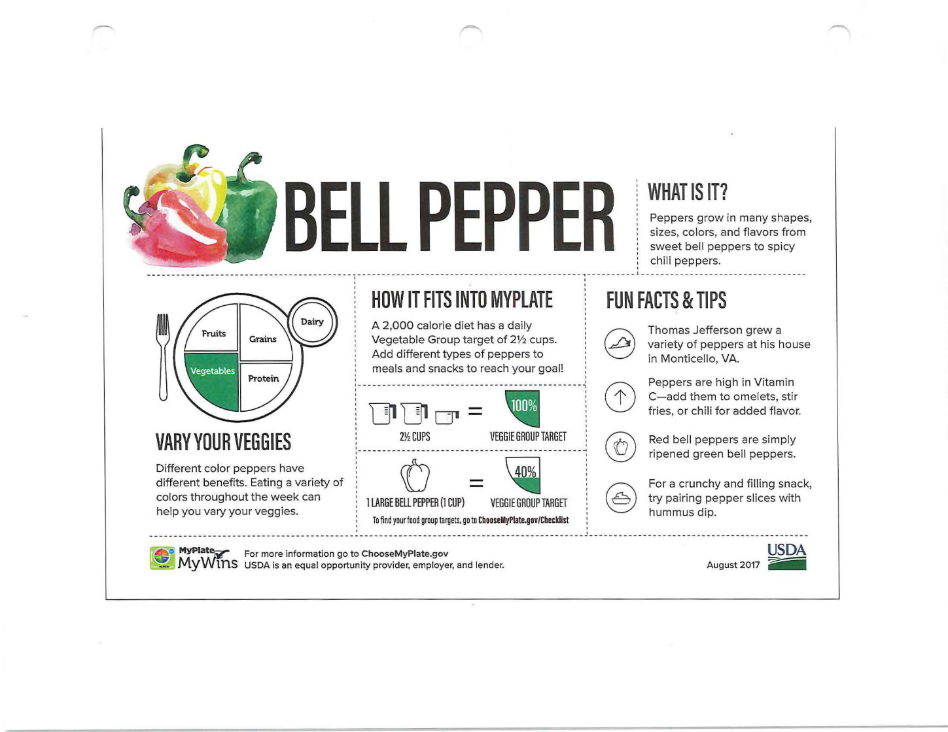
ChooseMyPlate.gov Food Identification, Use & Nutritional Value Sample
Notes:
Review sample education about peppers
Coordinator Reference Guide, page Appendix-19
This document is provided as part of your toolkit. Because it comes directly from one of our three identified reliable sources, we know it is OK to use.
This page from the Choose My Plate newsletter, specifically discusses bell peppers. It is very graphical, making it more engaging than plain text. Images are also easier to recall than text, so it can be helpful, including some of our consumers who may be facing some memory challenges.
We should be mindful though, that vision may also be an issue. Can our consumers see the images? It is really challenging to find materials that meet all needs, but in general, try to use materials that offer high contrast.
This is one example of a colorful, interesting, educational peace that could be utilized as part of a presentation, activity, or handout. We might have different kinds of bell peppers to let people touch and smell, and maybe we used them in one of our entrees that month.

Slide 90
Your Nutrition Education Toolkit
Your Dietician or AAA Nutrition Program staff
Reliable internet resources
Sample nutrition education document FA09_NutritionEducation
Items can be found in your training packet or from the ICOA website
Notes:
Nutrition Education toolkit contents and when/how to use
Provided sample nutrition education about bell peppers in PDF format with 3 pages

Slide 91
Summing It Up: Nutrition Education
Focus Area 9
Nutrition education to the meal sites
Provide often, at least once per quarter
Any variety of methods, topics & presenters
Track facts & stats
Included on monthly invoice
Notes:
Provide education at least every quarter, keep documentation
Coordinator Reference Guide, page FA9-1
Now that your mind his brimming with all the possibilities for fantastic educational opportunities, are there any questions about this area?

Slide 92
Focus Area 10: Invoicing for Reimbursement
Notes:
Introduce Invoicing Focus Area
Coordinator Reference Guide, page FA10-1
We’ve mentioned it many times, and now the time is here! The highly anticipated Focus Area 10 which is about invoicing for reimbursement. I know we’re all excited, so let’s get to it!

Slide 93
Why Submit Invoices
Meal sites want reimbursement from contracting AAA
Request for reimbursement & supporting documentation required by AAA
Notes:
Invoice required for reimbursement & reporting
Necessary part of achieving OAA, ACL, ICOA, AAA and meal site goals is ensuring can continue to fund programs

Slide 94
What Invoicing Involves
Invoices are formal request for reimbursement
Include all necessary information
Meal site identification
Dates
Quantities
Prices/Costs
Supporting documentation might include:
Rosters
Total in-kind match & program income
Nutrition education materials
Notes:
Provide all identifying, reimbursement, education info & documentation
Invoice = formal request for payment
We have mentioned throughout our time together several pieces that make up the invoice. This is where we formally put those pieces together.
Following recommended procedures and guidance for registration, rosters, donation tracking sheets, and logging education efforts, information should be easily transferred to invoice

Slide 95
When Invoices Are Due
Submit to AAA by 15th every month
Includes information for 1st through end of prior month
Notes:
Invoices due by 15th of month or earlier if AAA requires
Start of bigger process involving reports through AAA, ICOA and ACL
Deadline is important since other agencies rely on it to do their own reporting
Include information for entire prior month,
Example: Invoice submitted between July 1st and 15th will include information for June 1st through June 30th

Slide 96
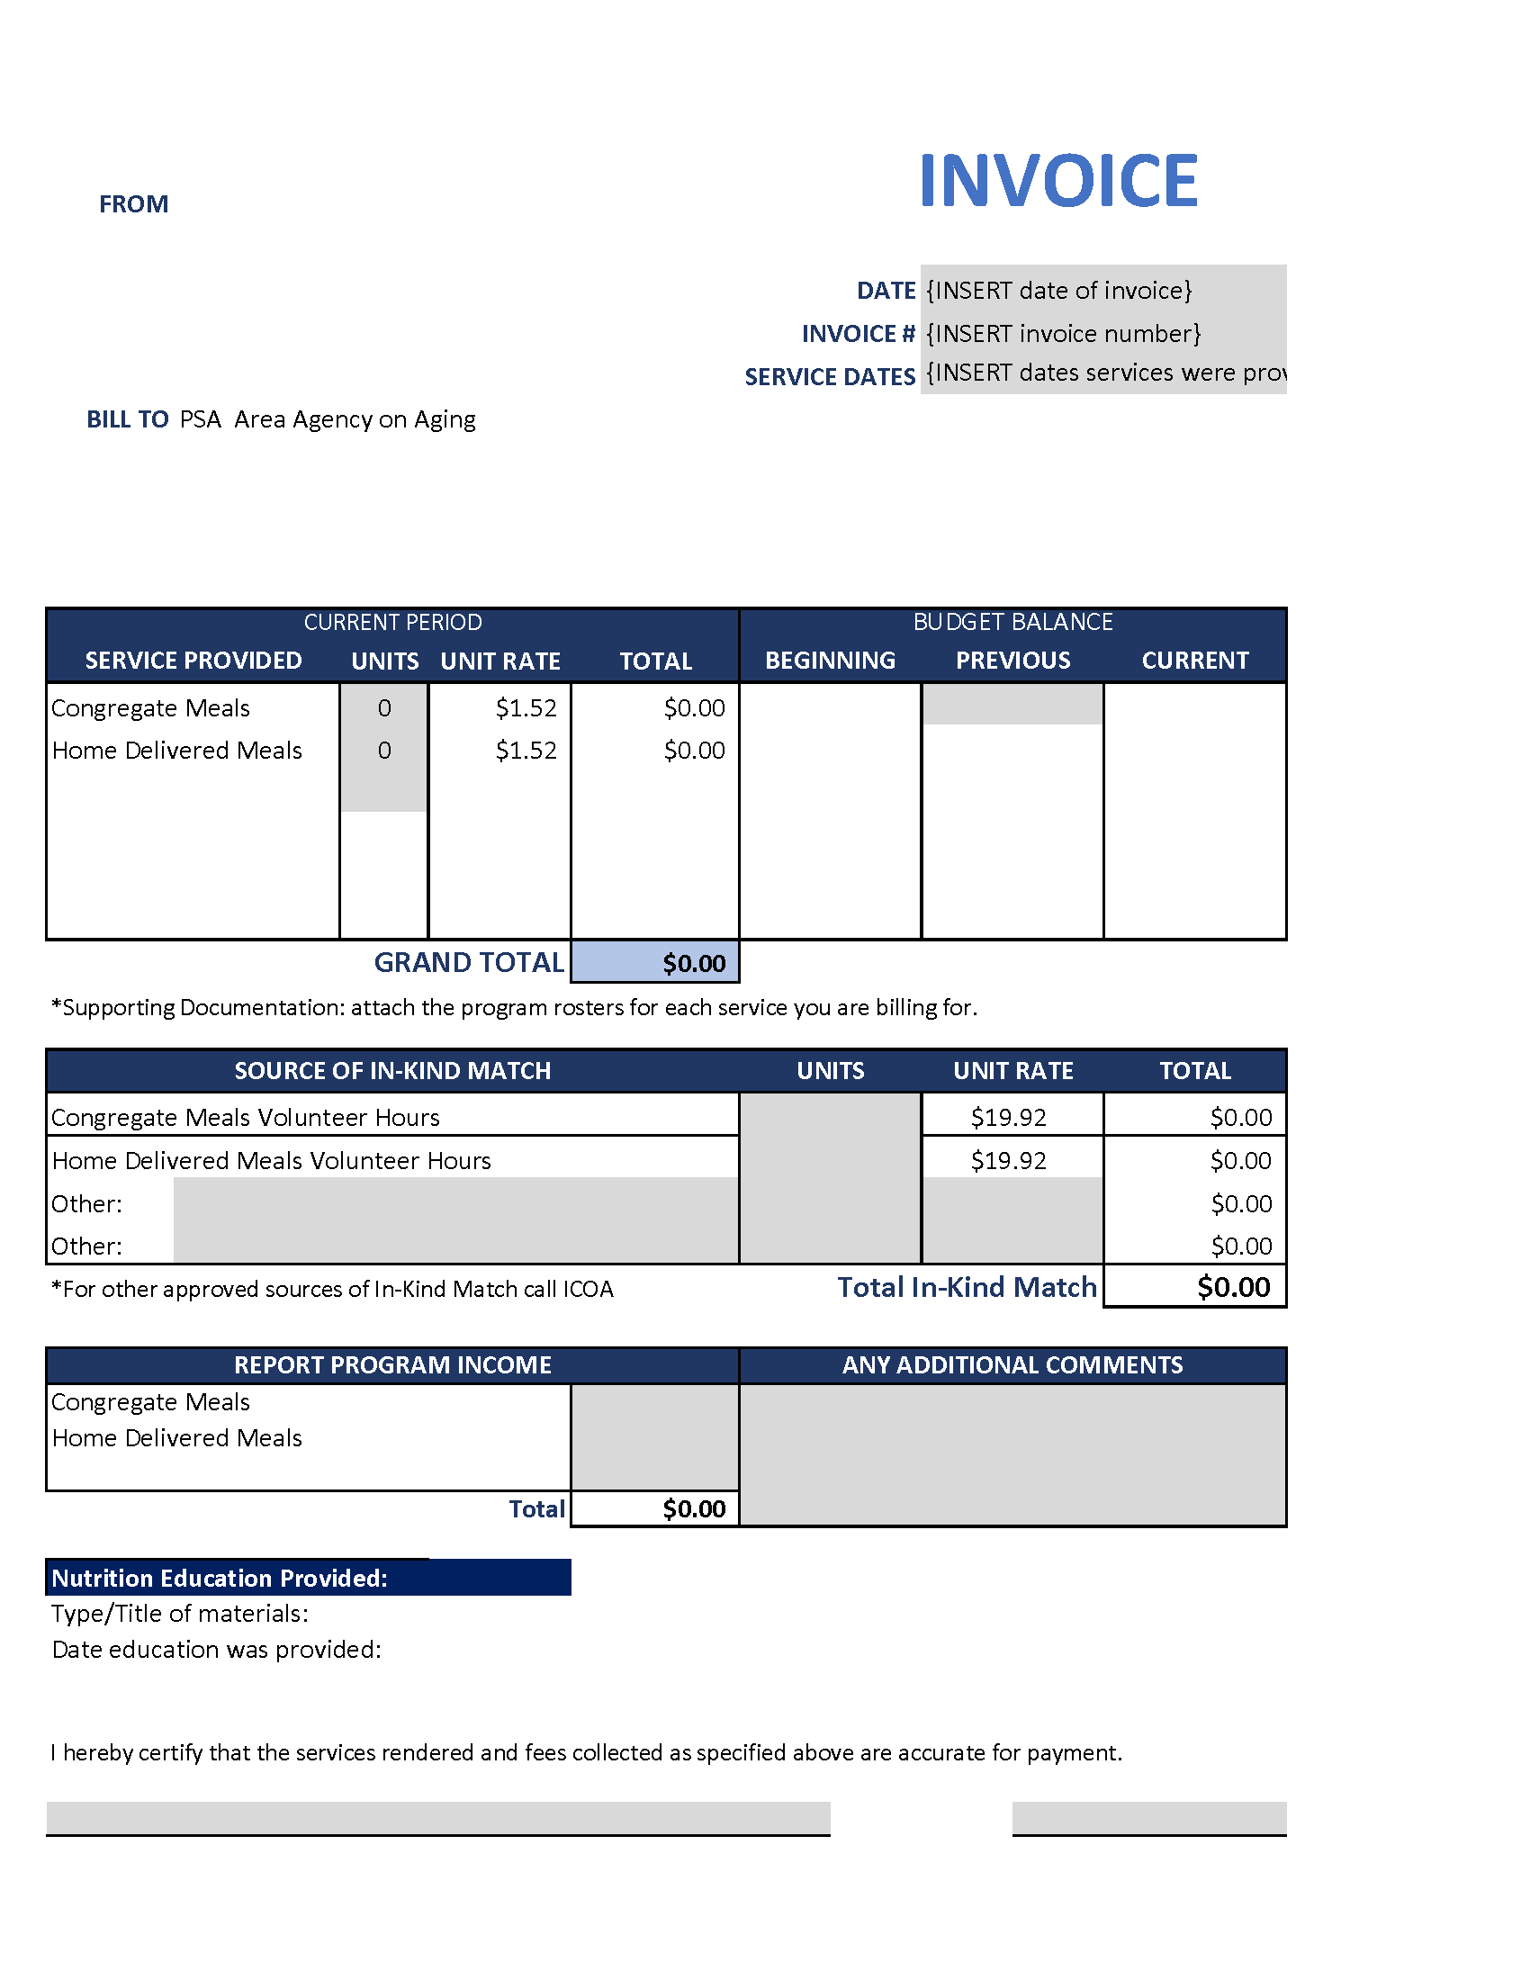
How Invoices Are Completed
Best practice: All invoice items should have supporting documentation
Use the Invoice template provided on ICOA website
Shaded areas are input fields
Include the following:
Date
Invoice number
Dates of service
Relevant units & rates/costs
Enter beginning, previous & current budget balance
Volunteer hours & total value
Program income
Type & title of education
Date education provided
Notes:
Use provided template and include all documentation
Coordinator Reference Guide, page Appendix-20
Any line item on an invoice should have supporting documentation
Invoice template provides easy to identify shaded entry fields
Discuss how coordinators will fill out the beginning budget balance, previous budget balance, and current balance. Be sure they understand where the values come from.
Include volunteer hours and calculate value
Transfer program income including totals from donation tracking sheets
Clearly identify dates, times, and types of nutrition education provided and copies of education materials
The number of education instances is a count of people, not sessions, meaning a menu writing activity with 20 people counts as 20, not 1

Slide 97
Your Invoicing Toolkit
Invoice Template in Excel FA10_Invoice
Items can be found in your training packet or from the ICOA website
Notes:
Invoicing toolkit contents and when/how to use
Invoice template Excel file, easy to fill in, save, and print or email

Slide 98
Summing It Up: Invoicing for Reimbursement
Focus Area 10
Invoice AAA (including documentation
Provide back-up for all invoice entries
Complete all fields
Submit by 15th for services prior month
Reimbursement & program funding depend on invoices
Keep complete copies for 3 years
Notes:
Submit invoices with documentation by due date
Coordinator Reference Guide, page FA10-1
Transition: We hope that with all the buildup to Focus Area 10 and invoicing, that the reality of it was not a letdown. Actually, we intended it this way. By following the basic processes we have outlined along the way, creation of the invoice should be a straightforward and simple process.
Answer questions about invoicing or any other focus areas already covered. Depending on the audience, ask about a few specific activities or processes. If you are aware of any specific difficulties a site has had, take time to make sure they are clarified before moving on.

Slide 99
Focus Area 11: Nutrition Services Incentive Program (NSIP) Funds
Notes:
Introduce NSIP Funds Focus Area
Coordinator Reference Guide, page FA11-1
Our nutrition program receives significant funds through ACL’s implementation of the Older Americans Act and state funding. We also generate income from fees and donations at our site. One of our easiest funding sources comes through the Nutrition Services Incentive Program or NSIP. Let’s take a few minutes to make sure we understand how we can optimize our funds from this program.

Slide 100
Why NSIP is Important
Provides federal funding to local programs
Based on meals served the prior year
Funds received 3-5 times per year
“To encourage & reward effective performance & efficient delivery of nutritious meals to older individuals”
Notes:
Provides additional funds
Purpose of the program is to encourage and reward meal sites for effective performance and efficient delivery of nutritious meals to older individuals. In other words, NSIP funding depends directly on the number of people served. That is why the “incentive” part is so critical.
Read the quote at the bottom of the slide

Slide 101
What NSIP Funding Requires
Accurate recordkeeping of meals served
Accurate transfer to appropriate reports
On-time reporting to AAAmonthly
NSIP uses the Federal fiscal year, which runs 10/1 – 9/30 (not the calendar or State fiscal year)
Funds can only be used to purchase domestically produced food
Notes:
On-time, accurate reporting with year-end by 9/30 each year
Add “Total meal counts for NSIP” as an annual item on or before 9/30 on the timeline
Figure used by ACL to calculate the amount of money will receive in installments over the next year

Slide 102
What Changes Can Be Made
Final report due 10/30
changes to counts must be provided to AAA no later then 11/1
As soon as possible include :
Date change was requested
Description of change
Reason for change
Notes:
Changes after 9/30 to AAA ASAP
AAA completes formal documentation, but if change is necessary, meal site needs to include relevant information, so it can be processed

Slide 103
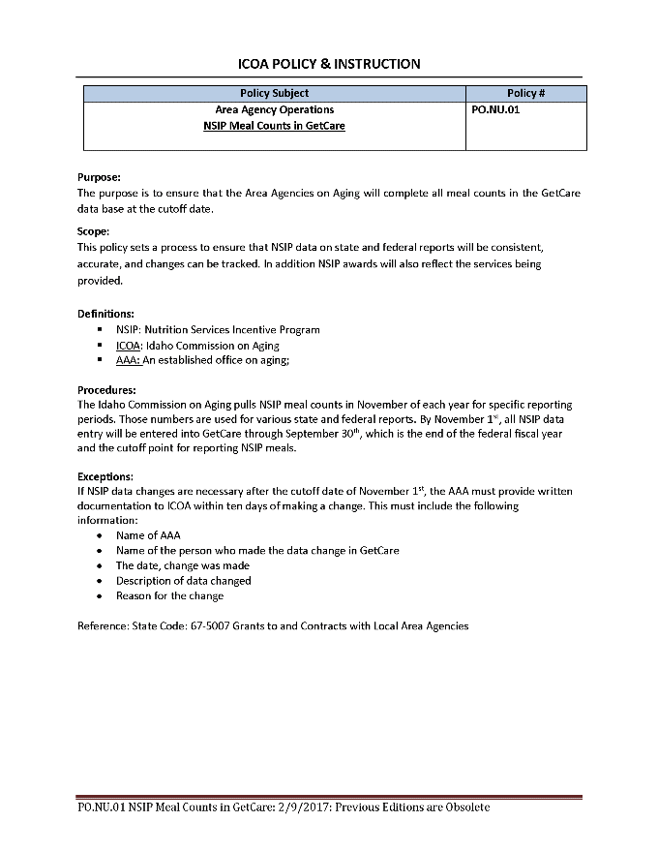
How to Participate in NSIP
Double-check all calculations in monthly reporting
Provide accurate final counts to AAA by 10/30 each year
If changes are necessary, report to AAA within 4 days& provide all requested information about the change
Use NSIP funds to purchase domestically produced food
Build program & number of meals served each year through this incentive program
Refer to Guidance for details
Notes:
Provide accurate reports, use funds for domestically produced goods
Coordinator Reference Guide, page Appendix-21
Utilize tools and follow recommendations in focus areas so numbers are easy to find and accurate

Slide 104
Your NSIP Resources Toolkit
ICOA NSIP Guidance (FA11_NSIP_Guidance)
Items can be found in your training packet or from the ICOA website
Notes:
NSIP toolkit contents and when/how to use
Any additional information, news or instructions will be provided directly from AAA

Slide 105
Summing It Up: NSIP Funds
Focus Area 11
Knowledge of NSIP funding via ACL & OAA
Paid 3-5 times/year
Based on prior year count provided to AAA
Must provide final counts by 9/30 each year
Report changes within 4 days (by 11/5)
Use to build meals served
Notes:
Accurate, on-time reporting provides extra funds to build program
Coordinator Reference Guide, page FA11-1
The objective of Focus Area 11 is for meal site coordinators to have knowledge of NSIP funding via ACL and the OAA

Slide 106
Focus Area 12: Nutrition Guidance
Notes:
Introduce Nutrition Guidance Focus Area
Coordinator Reference Guide, page FA12-1
We referred specifically to guidance when we talked about donations and donation box placement. We also mentioned guidance was available for NSIP, although we did not specifically read through it. Focus Area 12 provides the opportunity for us to discuss a few more pieces of guidance that can be helpful in our operations but did not necessarily fit into a specific focus area.

Slide 107
Why Provide Nutrition Guidance
Guidance = policy
Identify specific requirements of State & Federal rules
Reduces need for corrective action plan to remedy lack of compliance
Notes:
Guidance = policy, defines requirements

Slide 108
What Nutrition Guidance Includes
Most daily activities directed & managed by the site
Guidance provides succinct listing of important program policies
ICOA guidance addresses four areas related to meal sites:
Commodity donated food
Consumer eligibility
Home delivered meals
Meal frequency waiver
Guidance may include:
Purpose
Requirements
Procedures
References
Notes:
Guidance identifies program requirements
Copies of the guidance can be found in our Coordinator Reference Guide, on pages 22-25 of the Appendix or the PDFs are in the Focus Area 12 folder of your toolkit

Slide 109
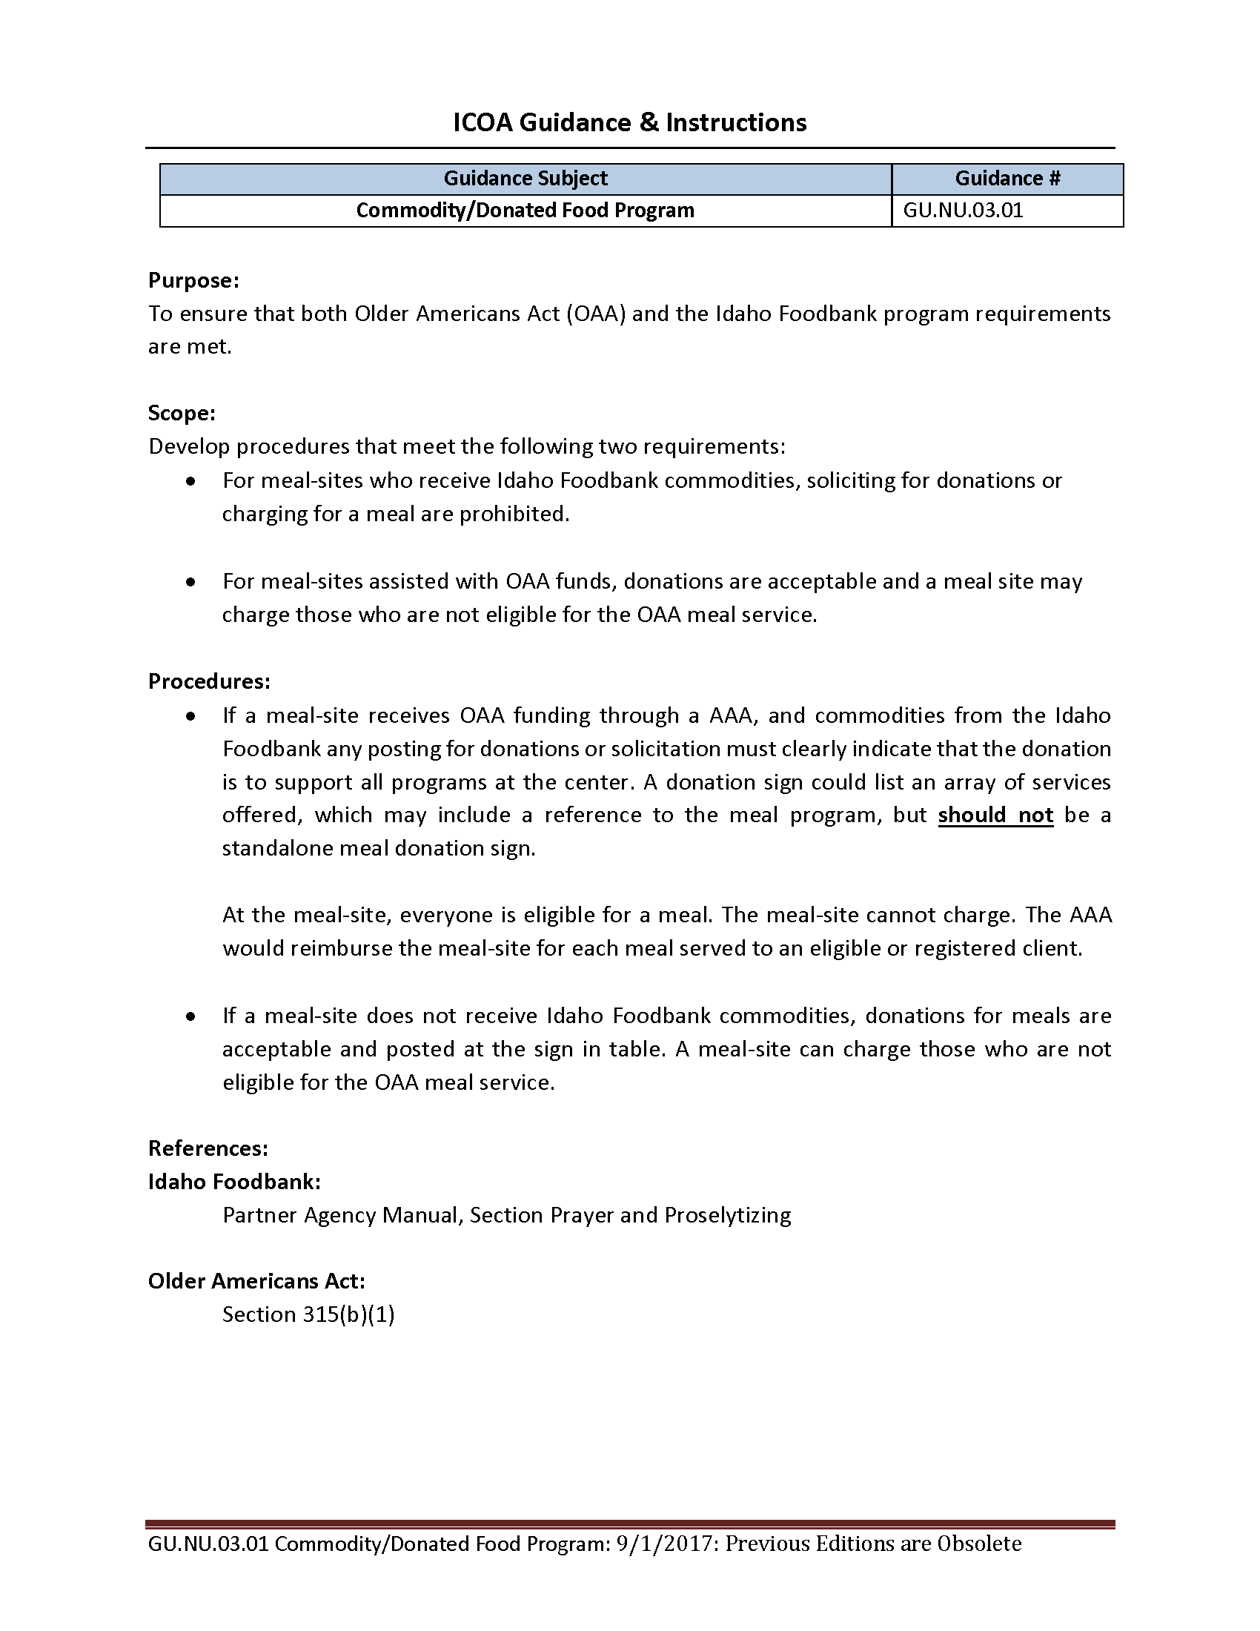
What Commodity Donated Food Guidance (GU.NU.03.01) Includes
Addresses ICOA & Idaho Foodbank requirements
Identifies how procedures must be defined
Addresses solicitation & acceptance of donations & meal charges related to Foodbank commodity use
Review full guidance for complete details
Notes:
Cannot charge for meals that use commodity donated food
Coordinator Reference Guide, page Appendix- 22
Read the slide
Elicit questions and discussion until you feel participants fully understand the guidance requirements
Display and read through FA12_ Commodity Donated Food Program Guidance if anyone is interested or has further questions
Ask if any of the sites utilize donated commodities. If there are questions about what a donated commodity is, or what qualifies as one, answer the questions.

Slide 110
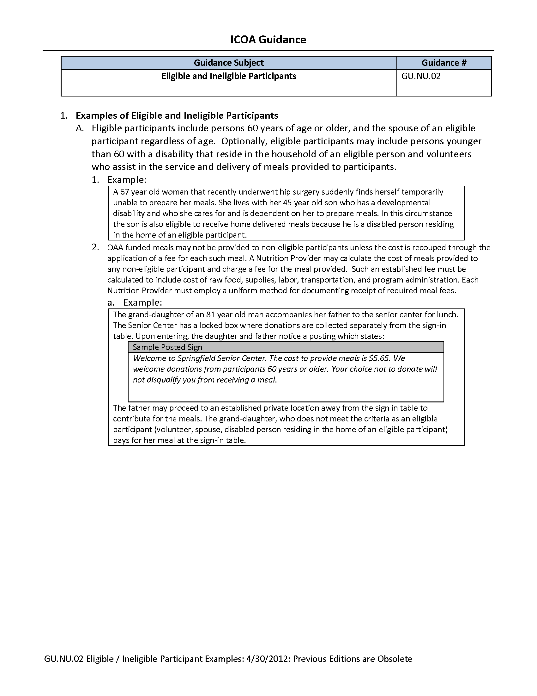
What Eligibility Guidance (GU.NU.02) Includes
Identifies who is eligible to receive meals
Provides examples & scenarios
Lists sample donation sign text
Review full guidance for complete details
Notes:
Age plus other eligible/ineligible people
Coordinator Reference Guide, page Appendix- 23
Open and read as necessary from FA12_Eligible Ineligible Participants Guidance
Let’s work through this one for a minute.
Remember, this addresses two things, really. First, should the person be registered. Second, should they be charged for their meal.
The first important addition is that the spouse of an eligible participant is also eligible, regardless of the spouse’s age
So, the 50-year-old spouse of a 65-year-old person is also eligible and should be registered and not charged for their meal
In addition, any person younger than 60 with a disability that lives with an eligible participant is also eligible
So, let’s say the developmentally delayed, 25-year-old son of a father who is 65 and lives with his father comes to a meal site. They are both eligible, should be registered and not charged for their meals.
If, on the other hand, the son lives in a care facility but comes with his father. In that case, the son is NOT eligible and should be treated as a visitor, including signing in and being asked to pay for his meal
Finally, volunteers who provide services related to congregate or home-delivered meals are also eligible. This is why we have standardized our registration and roster process to ensure we are all capturing volunteers as registered clients.
Now, on to #2. We have touched on this earlier. This is where we see the requirement that non-eligible people must be charged for their meal to help recoup the costs of the meal
It specifically says the meal site needs to determine this calculation and that it should include all related costs, including support staff, program costs, and transportation
It then talks about requiring a standardized method for documenting receipt of those fees, which is why we now have the standardized donation tracking sheets we discussed in Focus Area 8
In the example for this item, we can review sample text used to identify the meal charge for visitors.
Read the text
Thanks to our guidance, we now know there are FOUR categories of eligible consumers. They include anyone 60 or older OR the spouse of an eligible person OR a disabled person who lives with an eligible person as well as volunteers
IMPORTANT: The next important clarification is that an eligible consumer may make a donation at a private donation box, but a non-eligible person paying for their meal as a visitor, pays at the registration table. We must separate donations from fees.
The eligible consumer and the visitor MIGHT make a donation, but the fee for the visitor’s meal is paid at the registration table.
That is quite a bit of information packed into this page. The area of donation and fees is a very important one because we are utilizing public funds and in doing so, we must be extra vigilant about following the procedures related to donations and fees.
Does anyone have any specific situations related to eligibility they’d like to share? Are there any questions about eligibility or this guidance before we move on?

Slide 111
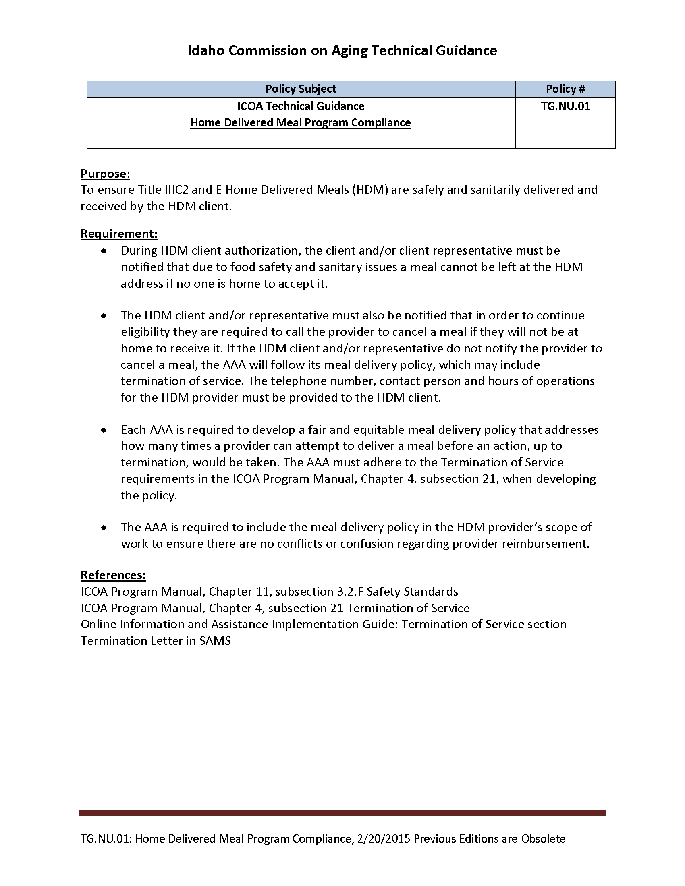
What HDM Guidance(TG.NU.01) Includes
Ensure that HDM are safely, sanitarily delivered to & received by consumer
AAA must have fair & equitable meal delivery policy that outlines consumer duty for delivery
Process for notifications
Requirements to terminate delivery service to consumer
Review full guidance for complete details
Notes:
Outlines requirements for notification regarding service
Coordinator Reference Guide, page Appendix- 24
Separate training is available for specifics related to home-delivered meals
Read the slide then display and read through FA12_HomeDeliveredMealProgram_ComplianceGuidance
Elicit questions and discussion until you feel participants fully understand the guidance requirements

Slide 112
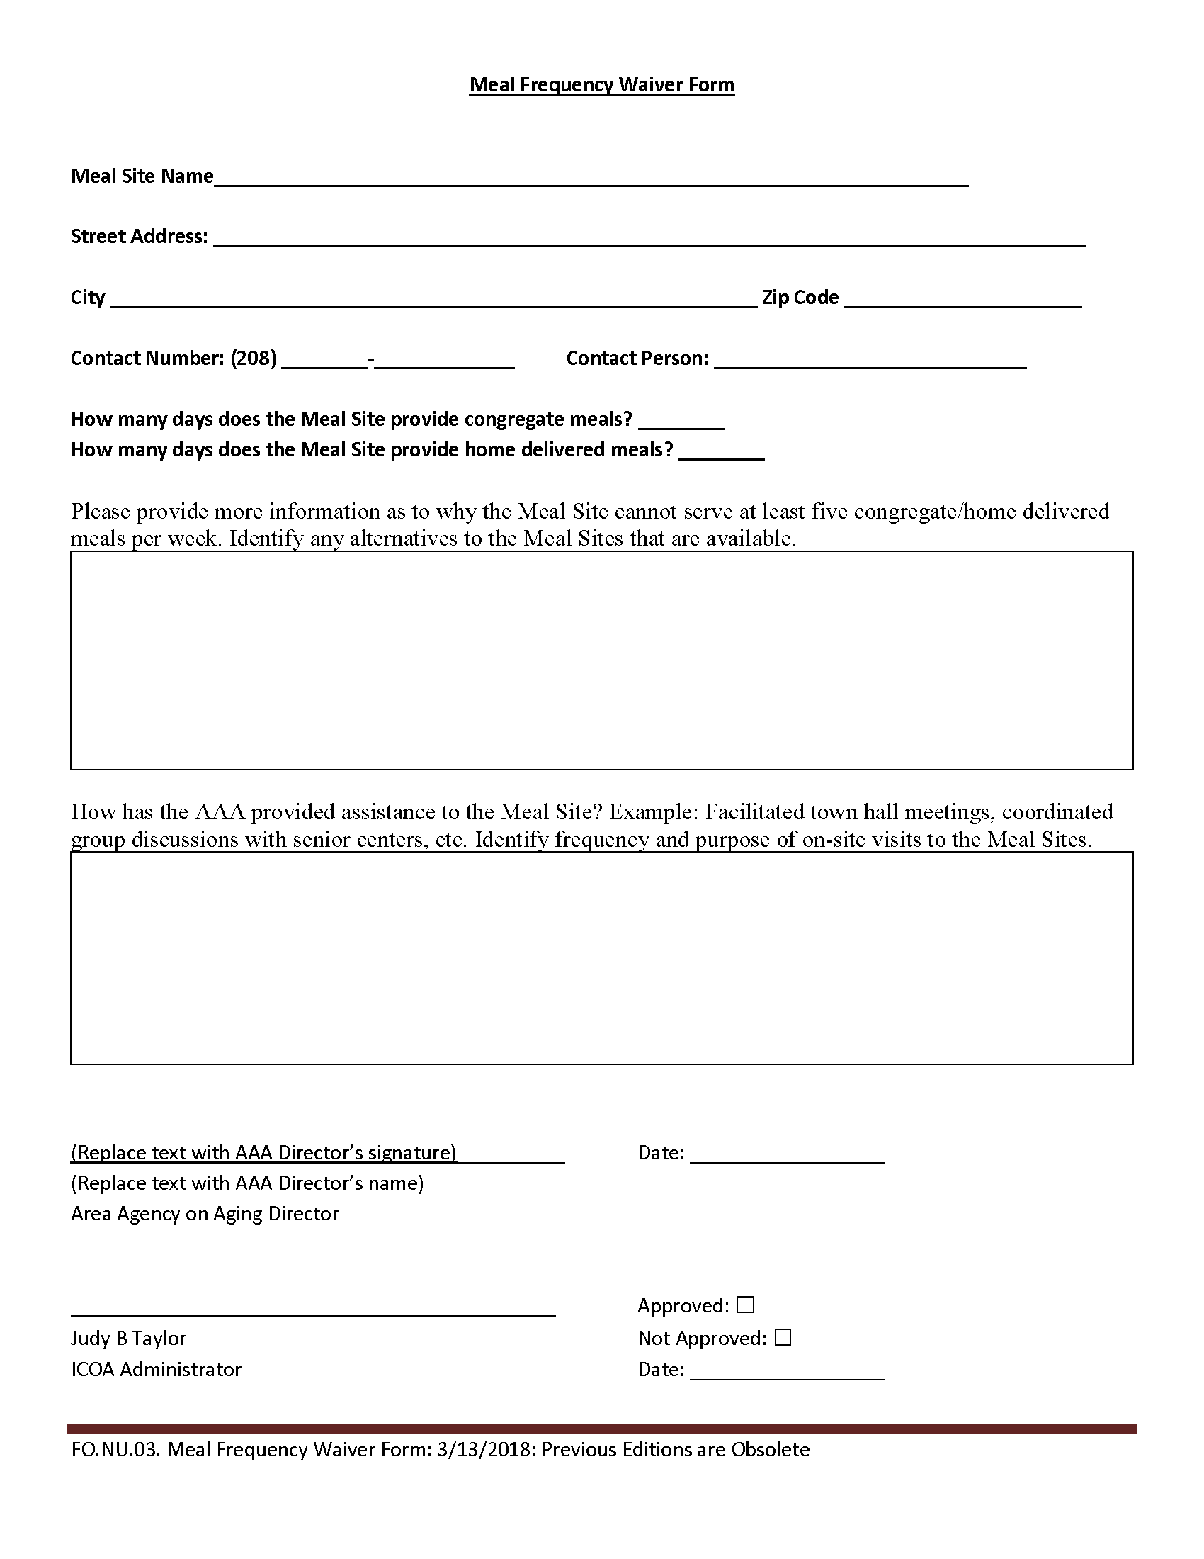
What Meal Frequency Waiver Guidance Includes
Meal sites required to provide at least five meals per week
Form required if unable to comply
Meal site location & contact information
Number of congregate & HDM meals provided each week
Explanation of inability to provide required meals
Suggested alternatives
Description of how AAA has assisted
Requires signature of AAA Director & ICOA Administrator
Review full guidance for complete details
Notes:
Required if site is not providing at least 5 meals/week
Coordinator Reference Guide, page Appendix- 25
Read the slide and only open FA12_MealFrequencyWaiverForm if necessary
If a Meal Frequency Waiver form is required, it should not come as a surprise to the AAA. We would hope that we would have worked together to discuss delivery and related challenges in hopes of providing at least the minimum service.

Slide 113
How to Utilize Nutrition Guidance
Know & follow guidance
Be able to refer to & quickly access actual guidance, electronically or in hard copy
Guidance updates provided to coordinator by AAA with updated document via e-mail
Work with your AAA nutrition staff to resolve questions
Notes:
Coordinators need to know guidance and ensure they and their staff follow as standard practice
If at any time we have any questions about guidance, whether the ones mentioned here or others in this training, we should work with our AAA nutrition staff to resolve any questions and make sure we fully understand and are able to comply.

Slide 114
Your Nutrition Guidance Toolkit
Commodity Donated Food Program Guidance (FA12_ CommodityDonated FoodProgramGuidance)
Eligible/Ineligible Participants Guidance (FA12_EligibleIneligible ParticipantsGuidance)
HDM Program Compliance Guidance (FA12_HomeDeliveredMealProgram_ComplianceGuidance)
Meal Frequency Waiver (FA12_MealFrequencyWaiverForm)
Items can be found in your training packet or from the ICOA website
Notes:
Nutrition Guidance toolkit contents and when/how to use

Slide 115
Summing It Up: Nutrition Guidance
Focus Area 12
Knowledge of additional nutrition guidance
Guidance = policy
Four specific areas
Know & follow to ensure compliance
Corrective action plan remedies non-compliance
AAA provides updates
Notes:
Know & follow all guidance
Coordinator Reference Guide, page FA12-1
Guidance = policy
Watch for updates, although they do not occur frequently
We know there are a lot of details and specifics related to guidance, but at the moment, are there any questions?
Give a few seconds for responses and answer any questions posed, as long as they aren’t too detailed. If they are, tell the person you’d be happy to discuss their situation with them personally outside of training.

Slide 116
Focus Area 13: Role of Idaho Non-Profit Board of Directors
Notes:
Introduce Role of the Board Focus Area
Coordinator Reference Guide, page FA13-1
Hopefully, we have provided insight into specific processes that need to be accomplished, but also identified some of the supports we have at managing our nutrition programs. These include our dietitian or nutritionist, our AAA nutrition program staff, local health district, and ICOA’s nutrition program specialist. In Focus Area 3, we talked about the need for non-profit status and suggested that the Board of Directors was a good support resource related to attaining that determination. In Focus Area 13, we want to further identify how the Board of Directors can support our programs and what we should do to facilitate them in doing so.

Slide 117
Why Consider the role of the Board
Acknowledges oversight by Board of Directors
Informs the Board of significant issues or concerns, as well as successes & goals
Provides assistance with corporate administration items like non-profit status & reporting requirements
Assists with good communication, efficient management & growth of the meal site within the organization
Notes:
The Board has oversight and is also a support and resource
Read the slide

Slide 118
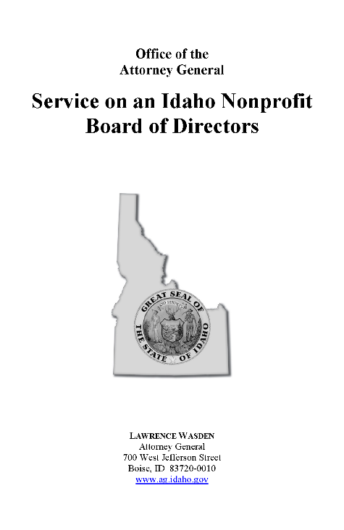
What Needs to Be Known About the Role of the Board
Follow direction provided in Manual for Non-Profits by State of Idaho, Office of Attorney General Lawrence Wasden
Divided into 6 chapters:
Service on Charitable Organizations
Understanding a Board Members Role Need to understand the Nutrition Program & its Purpose
Understanding a Board Members Rights Must be able to make informed decisions
Understanding a Board Members Responsibilities Duties of care, Loyalty & Obedience
Personal Liability
Resources
Notes:
Be familiar with the Manual for Non-Profits, provided by the State
Coordinator Reference Guide, page Appendix-26

Slide 119
How to Interact with the Board
Make yourself known
Calendar the dates & plan to attend meetings
Prepare brief summaries of nutrition program activities
Ask to be added to their agenda for updates
Make sure all board members know how to contact you
Notes:
Create relationships & be involved
As the meal site Coordinator try to be involved in the board meeting to make sure the board members know what is going on at their meal site. Also ask if the board would consider allowing program participants to attend Board meetings.
How often are Board meetings held at the participant’s sites?
On the timeline, add “Board Meetings” followed by the frequency your audience provided, such as “monthly” or “quarterly”

Slide 120
Your Non-Profit Board Toolkit
Idaho’s Non-Profit Guide for Board Members (FA13_BoardMembersServiceNonprofit)
Also available online
Items can be found in your training packet or from the ICOA website
Notes:
Non-Profit Board toolkit contents and when/how to use

Slide 121
Summing It Up: The Role of the Board
Focus Area 13
Knowledge of a Board member’s role & what the board members should know about the Nutrition Program
Make yourself known
Attend board meetings
Provide regular updates
Be engaged
Notes:
Build relationships, be involved
Coordinator Reference Guide, page FA13-1
These past three focus areas, starting with the NSIP program, the nutrition guidance, and now the role of the board, ask us to have knowledge of these areas of our business. Knowledge is sometimes hard to quantify. In this case, our objective is for us to realize the Board both deserves and has the right to fully understand our nutrition program.
Are there any questions about the role of the Board of Directors, or how we can create a good, open relationship with the board?

Slide 122
Focus Area 14: Menu Approval
Notes:
Introduce Menu Approval Focus Area
Coordinator Reference Guide, page FA14-1
We have the ability to perform most of the important activities related to being a meal site coordinator. We have one more operational focus area to cover. This is Focus Area 14 and is about menu approval.

Slide 123
Why Approve Menus
Complies with requirement for approval by registered Dietician or Nutritionist (“Dietician”) Allows “second set of eyes” to review menu
Promotes balanced, nourishing meals for consumers
Notes:
Required by program

Slide 124
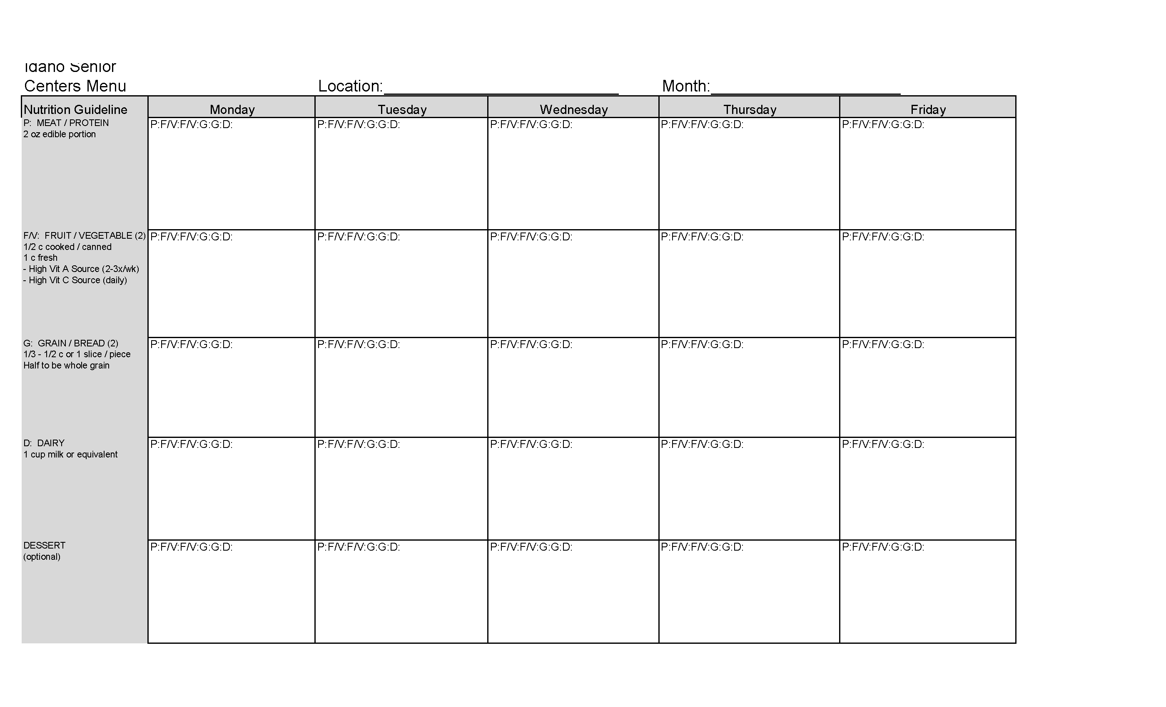
What Menu Approval Requires
Menus prepared by authorized kitchen staff
Completed menus reviewed by Dietician to ensure nutritional quality
Dietician signs to indicate approval
Signed menus retained for reference & audit purposes
Notes:
Prepared by staff, submitted for Dietician approval
Coordinator Reference Guide, page Appendix-27

Slide 125
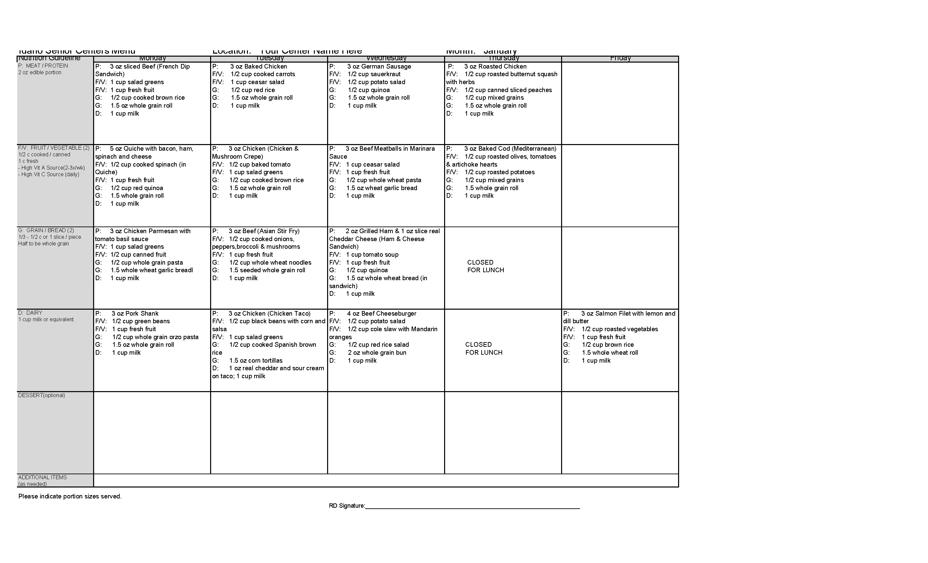
When Menus Should Be Approved
Minimum: One month prior to planned service
Required: Prior to serving
Notes:
Prior to service, prefer >30 days prior
Coordinator reference Guide, page Appendix-28
Need to ensure adequate time for the dietitian to review, approve and/or respond.
Need to be able to ensure meal sites have time to gather ingredients and resources
Ask participants when a menu for service beginning October 1st needs to be submitted. Answer: Our menu for the month of October, should be submitted by August 31.
Absolutely cannot provide a meal that has not been approved by the Dietitian

Slide 126
How Menus Are Approved
Use menu template provided by Dietician
Complete menu for the month, following template instructions
Submit to Dietician >30 days before first service from that menu
If menu changed:
Must be re-approved
Contact Dietitian
Get verbal approval
Send revised menu for written re-approval
Retain approved menus for your records
Notes:
Use Dietician’s template, submit & resubmit if any changes
Most dietitians will provide the template for the way they prefer menus to be provided. Make sure you use their menu template. Complete the menu for all meals that will be served at the site, following any specific instructions provided with the menu template.
Menus often take quite a bit of time to develop. There may be several rounds of modifications by the kitchen staff and others before it is considered ready. At that time, submit the menu to the dietician.

Slide 127
Your Menu Approval Toolkit
Blank Menu Template (FA14_MenuTemplate_Blank)
Completed Menu Sample (FA14_Menu_Sample)
Items can be found in your training packet or from the ICOA website
Notes:
Menu Approval toolkit contents and when/how to us

Slide 128
Summing It Up: Menu Approval
Focus Area 14
Menus approved by Dietician before service
Prepared by approved kitchen staff
Submitted to Dietician for approval
Changes require re-approval
Retain approved menus
Notes:
Use Dietician’s template, submit & resubmit if any changes
Coordinator Reference Guide, page FA14-1
Are there any questions about the process of menu approval?
Transition: Great! That leaves us up to Focus Area 15 which is the final focus area for meal site coordinator training

Slide 129
Focus Area 15: Training Staff & Volunteers
Notes:
Introduce Training Staff & Volunteers Focus Area
Coordinator Reference Guide, page FA15-1
In just a few minutes, we will be considered trained meal site coordinators. We have discussed a variety of activities that will enable us to manage and maintain a successful meal site. Our position is really to organize and facilitate the team. That team is made up of our paid staff and volunteers. In fact, for many meal sites, volunteers far outnumber paid staff. Just like we hopefully now appreciate having training to support us in our job, our staff and volunteers will likewise appreciate being trained in theirs.

Slide 130
Why Train Staff & Volunteers
Assists compliance with site, program, State & Federal requirements
Ensures staff & volunteers ability to provide services
safely for themselves & others
Helps people feel valued & thrive in their position
Promotes sense of value to program & community
Notes:
Provides necessary skills & improves morale
Most of us appreciate training for challenging were difficult activities. Sometimes we tend to underplay the importance of training for what may seem like more routine activities. Remember, what is very familiar to us based on our experience and training, may not be to someone else.
Training assists with compliance with site, program, state, and Federal requirements. Almost every focus area we discussed, in one way or another, is about complying with some type of requirement. By providing training to our staff and volunteers, we ensure they are able to provide services safely, effectively and in compliance.
While we often focus on requirements, it is important when it comes to training, to recognize what are sometimes called the soft benefits. Training helps people feel valued and when they are valued they tend to thrive in their position. What does that mean?
When a volunteer is offered 3 hours of a coordinator’s time to train them in their duties, the person knows that they and the job they are doing has value because the coordinator is making time for them. The coordinator is delaying other things they could be doing to invest in training the volunteer.
In addition, training promotes a sense of value to the program and the community. When resources are devoted to training, those who are aware of the program, know that it is being taken seriously. The Board may realize our program is being run as a professional business whereas before, maybe they thought of it as something else because it was mostly run by volunteers. They may also see the value the program has for its community, both by the volunteers who choose to participate and the effects it has in various ways.
Our paid staff benefits in the same ways. Even though they receive a paycheck, we all realize their dedication to working for a non-profit is not just for the paycheck, it is also the value they feel being part of such a program.

Slide 131
What Training Will Be Provided In the Near Future
Both paid staff & volunteers
Kitchen staff
Sign-in clerks
HDM deliverers
Notes:
All staff & volunteers for areas indicated
Anyone that is part of providing services at a meal site or for home-delivered meals needs to be properly trained. The trading we’re discussing here is in addition to specific external job- related training or certification. Our training is specific to one particular job role at our site.
Coordinators should ensure the following jobs are adequately informed of activities and processes related to their work. This includes kitchen staff, sign-in clerks, and home-delivered meal or HDM deliverers.
Training for these three specific job roles has been developed by ICOA and made available for coordinators to use in training our own staff and volunteers.

Slide 132
When Training Should Occur
Determined by meal site coordinator
New staff: preferably before beginning work
New volunteers: “shadow” experienced volunteers before complete own training
Recurrent/refresher: As necessary
Notes:
Determined by Coordinator, based on need
A common question people have is when training should occur. If we provide it too often, we end up doing a lot of one-on-one training. While there isn’t anything wrong with that, it can end up taking a lot of time. On the other hand, if we wait too long, we have a larger group of people who have not been properly prepared to do their jobs for some period of time. This can lead to them feeling frustrated, having to figure things out on their own.
Lack of training can also lead to improper procedures which could cause issues with our permits or funding.
As a general guideline, new staff should be trained before beginning full work on their own. This usually means in the first few days. We do realize that this is not all was possible, but something to work toward.
New volunteers can often shadow and experience volunteer for some time before they complete their own training. While some wonder why a paid employee can’t do the same thing, the answer is really financial. Both paid and volunteer staff have value. Generally, we are more able to have two volunteers working the same job for a period of time than we are able to have two paid staff members doing the same job.
You must strike a balance, based on your own staffing, hiring, and current needs. Determine how often and when training can be provided.
We’d like to remind coordinators that training is not just for new staff and volunteers. It’s not just for when a new piece of guidance is put into place. It’s a good idea to plan a regular recurrent or refresher training as well.
As the name implies, this can simply refresh people’s memory on certain procedures that are important to follow. It provides that feeling of value, especially since the training is offered more than simply at the start of one’s work at the site.

Slide 133
How Training Is Provided
Specifics determined by meal site coordinator
Training materials provided by AAA & ICOA for the following job roles
Kitchen staff
Sign-in clerks
HDM deliverers
Contact your AAA nutrition program staff for additional information
Notes:
Determined by Coordinator
When training is provided will be determined by the meal site coordinator
How training is provided is also determined by the coordinator
Remember, the training materials are provided by the AAA and ICOA for kitchen staff, sign-in clerks, and HDM deliverers.
As the saying goes, don’t reinvent the wheel! Contact the AAA nutrition program staff for additional information on accessing these valuable training resources.

Slide 134
Your Staff & Volunteer Training Toolkit
All information & samples provided in this training can be used to train others, if appropriate
Use the AAA or ICOA training packages from the AAA or ICOA website
Kitchen staff
Sign-in clerks
HDM deliverers
Items can be found in your training packet or from the ICOA website
Notes:
Staff & Volunteer Training toolkit contents and when/how to use
All of the information and samples provided as part of this training can be used to train others. The materials and the toolkits as well as the Coordinator Reference Guides and the document samples can be used and distributed for your own internal training as well.
For the specific job roles we discussed, be sure to utilize the ICOA training packages that provide ready to present presentations and materials to lessen the development time on your part.

Slide 135
Summing It Up: Training Staff & Volunteers
Focus Area 15
Training to volunteers & staff
All staff & volunteers confident in providing effective service
Coordinator decides who, when & what
Materials for kitchen staff, check-in clerks & HDM deliverers available
Notes:
Materials provided by ICOA for Coordinators to use as necessary
Coordinator Reference Guide, page FA15-1
For our final focus area, Focus Area 15, we are going to ensure that we train our volunteers and staff. This will ensure that they are all confident in providing effective, courteous service to our consumers.
As the coordinator we will decide the who, when, and how, but we all want to leverage existing resources. This includes the materials that have been developed and prepared specifically for us. When training kitchen staff, check-in clerks and HDM deliverers, materials and content is ready to go!
For this final topic, are there any questions about training our staff and volunteers question
Fantastic! Them take a deep breath! We made it through our focus areas and are ready to finish things up.
Closing: Finishing Up

Slide 136
Finishing Up
Closing
Notes:
No introduction, move directly to the Sixty Second Summary slide

Slide 137
Sixty Second Summary
Program funding from many sources, State & Federal
Sites using those funds must comply with certain program requirements
Meal Site Coordinators manage local programs with AAA & Board oversight
Work to ensure safe site & smooth operations complying with all requirements
Fifteen Focus Areas clarify expectations
Utilize AAA Nutrition Program staff & local Health District for assistance
Ensure safety, quality, & compliance always top priority
Key Point
Notes:
Coordinator Reference Guide, Focus Area Checklist
Hopefully we have provided you with additional confidence in performing your duties as a meal site coordinator. If you have experience in Food service, some of this may be very familiar. Parts though, are unique to Older Americans Act, ACL, and ICOA nutrition programs.
Once we are aware of the requirements and recommendations, we can integrate it into our everyday operations, so it becomes second-nature. To summarize it all…
Read through the bullet points with no additional discussion

Slide 138
Congratulations!
You have successfully completed the Meal Site Coordinator training. Your efforts will allow you to ensure your meal site operates smoothly, safely & in compliance with program requirements. With the tools, you are prepared to achieve good things for your site & the people you serve.
Download the Toolkit from ICOA’s website (www.aging.Idaho.gov)
. Go to Resources & search for “Meal Site Coordinator Toolkit”
Related training:
Kitchen Staff
Check-in Clerks
HDM Deliverers
Your Opinion Counts!
This training is designed to equip you to succeed as a Meal Site Coordinator.
Please invest 5 minutes to provide your feedback, so we can work to improve it for you & others in the future.
<<<AAAs, please modify to describe how you will gather class evaluations>>
Notes:
We’ve done it! You have now completed meal site coordinator training. In your training packet, you’ll find a certificate of completion that I’d be happy to sign and date to recognize your accomplishment.
If providing training remotely, tell them you will complete the certificate and either e-mail it or snail mail it to them in the next few days.
Please continue you work as a meal site coordinator, providing a valuable service to our consumers and our communities. We wish you the best in managing, maintaining, and growing your program’s capabilities. Thank you for your time and participation.
AAA Nutrition staff needs to customize the last part to facilitate what you have chosen to do for your class evaluation. This might include a paper copy or directing them to a website. Have them complete the evaluation and then they are free to leave.

Slide 140
How Does This Comply or Not Comply with Donation Box Placement Guidance (#1)
Close Image View

Slide 141
How Does This Comply or Not Comply with Donation Box Placement Guidance (#2)
Close Image View

Slide 142
How Does This Comply or Not Comply with Donation Box Placement Guidance (#3)
Close Image View

Slide 143
How Does This Comply or Not Comply with Donation Box Placement Guidance (#4)
Close Image View

Slide 144
How Does This Comply or Not Comply with Donation Box Placement Guidance (#5)
Close Image View

