Slide 1
WELCOME TO
THE IDAHO COMMISSION ON AGING
aging.idaho.gov
Nampa and Weiser Senior Centers
November 18, and 19, 2019

Slide 2
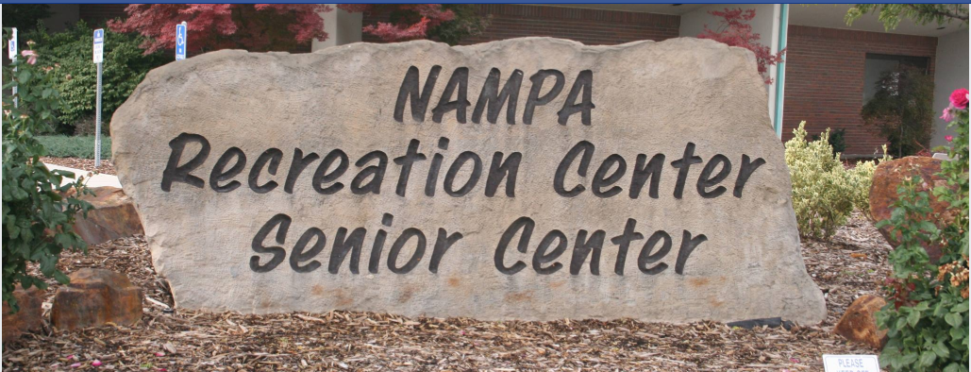
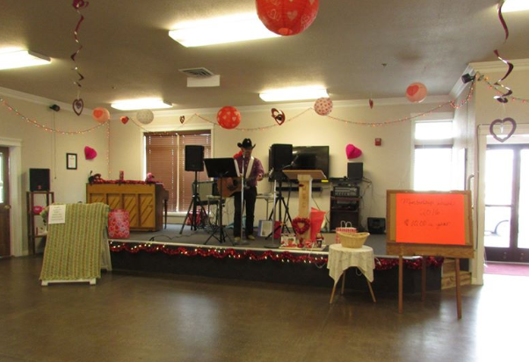

Idaho’s Senior Services State Plan Town Hall Meetings
Idaho Commission on Aging
Weiser Senior Center
Tuesday, November 19, 2019
11:00 – 3:00
Idaho Commission on Aging
Nampa Senior Center
Monday, November 18, 2019
11:00 – 3:00

Slide 3
Topic Areas
Meeting Schedules
State Plan Requirements
Legislative Intent
Funding Allocation to Area Agencies on Aging
Service Funding
Service Delivery
Next Steps

Slide 4

Townhall Meeting Schedule
September – North and North Central Idaho
  PSA I: Monday, 23rd: 11:00 – 3:00 Lake City Center (Coeur d’Alene, Idaho)
  PSA I: Tuesday, 24th: 10:30 – 3:00 Sandpoint Senior Center (Bonner City, Idaho)
  PSA II: Thursday, 26th: 11:00 – 3:00 Moscow Senior Center
  PSA II: Friday, 27th: 11:00 – 3:00 Grangeville Senior Center
October – Eastern and Southeastern Idaho
  PSA VI: Monday, 21st: 11:00 – 3:00 Idaho Falls Senior Center
  PSA VI: Tuesday, 22nd: 11:00 – 3:00 Ririe Senior Center
  PSA V: Thursday, 24th: 11:00 – 3:00 Curlew Senior Center (Stone, Idaho)
  PSA V: Friday, 25th: 11:00 – 3:00 Senior Activity Center (Pocatello, Idaho)
November – Southcentral and Southwest Idaho
  PSA IV: Monday, 4th: 11:00 – 3:00 Twin Falls Senior Center
  PSA IV: Tuesday, 5th: 11:00 – 3:00 Burley Senior Center
  PSA III: Monday, 18th: 11:00 – 3:00 Nampa Senior Center
  PSA III: Tuesday, 19th: 11:00 – 3:00 Weiser Senior Center

Slide 5



Four-year State Plan Requirements
Involve Public & Stakeholders
Administration for Community Living
Identify Senior Service
June 30, 2020
October 1, 2020
Federal Funding
Develop Funding Distribution
Address Federal Compliance
Include Supporting Documents
This Photo by Unknown Author is licensed under CC BY-SA

Slide 6

Idaho Senior Services Act
Legislative Intent
Provide efficient community services . . .
designed to permit its older people to
remain independent and . . . to avoid institutionalization
TITLE 67 STATE GOVERNMENT AND STATE AFFAIRS
CHAPTER 50 COMMISSION ON AGING 67-5005.
Legislative intent.
Notes:
TITLE 67 STATE GOVERNMENT AND STATE AFFAIRS
CHAPTER 50 COMMISSION ON AGING 67-5005.
Legislative intent.
The legislature hereby finds and recognizes the need to provide basic necessities to its older people in their later years and particularly in providing efficient community services, including access transportation, adequate nutrition, in-home services, and adult day care, designed to permit its older people to remain independent and to be able to avoid institutionalization; and that these services be provided in a coordinated manner and be readily available when needed and accessible to all older people. This act shall be known as the "Idaho Senior Services Act."

Slide 7
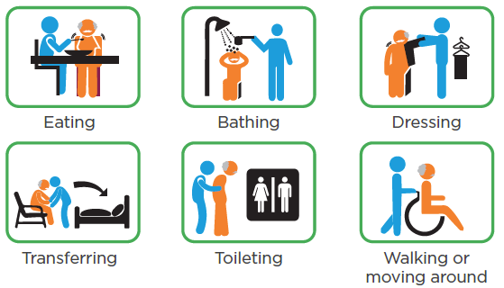

Cost of Institutionalization
Medicaid = $13,500 annually
Assisted Living Care:
Assistance with Activities of Daily Living (ADLs)
Private Pay:
Monthly:
$2,000 to $6,500
Private Pay:
Annually:
$24,000 to $78,000
=
Medicaid = $80,000 annually
Nursing Home Care:
Assistance with ADLs, but provides 24 hr. skilled nursing care
Private Pay:
Monthly:
$7,000 to $9,000
Private Pay:
Annually:
$84,000 to $108,000
=
*Self-Pay: 2018 AARP Public Policy Institute (last updated 8/28/2018)
**Medicaid: Estimates from the Bureau Chief of Medicaid Financial Operations
Notes:
As provided by the Bureau Chief of Medicaid Financial Operations, the average daily Medicaid payment for an Assisted Living facility is $37.00 per day and for a SNF the rate is $220.00 per day which is equivalent to $13,505 and $80,000. The Executive Director of the Idaho Health Care Association stated private pay rates are on an average of $2,000 - $6,500 for Assistive Living and $7,000 - $9,000 for SNF per month which would be equivalent to $24,000 - $78,000 or $84,000 - $108,000.
Assisted Living and Skilled Nursing Facilities the resident must contribute whatever he/she can for their share of cost.
If eligible for Medicaid, the federal share is 71.5% and state share is 28.5%
Source for Medicaid Residential Care Facility Cost: OPE Residential Care Report January 2018
Page 22: Residential Care Facility
Page 24: Federal and State Reimbursement percentages
ADL: Eating, Toileting, Walking, Transferring, Dressing, Bathing

Slide 8

Helping People Stay Independent
Federal: Older Americans Act
$9,076,000
=
State: Idaho Senior Services Act
$4,604,000
=
$13,680,000

Slide 9



Funding Focus Areas $13,680,000
CRISIS FOCUS
Preserving Rights and Safety
  Right to live without abuse, neglect, exploitation
  Right to live with dignity
  Right to make our own decisions
$2,162,000
TARGETED FOCUS
Preventing Institutionalization
  Assistance with independent living needs:
    Caregiving, home delivered meals, transportation, housework, medication management, employment training and referrals for low income Medicare benefits
$4,973,000
UNIVERSAL FOCUS
Investing in Healthy Aging
  Access reliable and trustworthy information, services and supports
  Opportunities for seniors to stay active in the community
  Caregiver training and resources
  Planning for your own independent living needs as you age
$6,545,000

Slide 10
Statewide Focus Areas: $3,601,000
Crisis: Preserving Rights and Safety: $340,000
Adult Protective Services Grant: $239,000
Ombudsman: $101,000
Targeted: Preventing Institutionalization: $1,335,000
Universal: Investing in Healthy Aging: $1,927,000
Senior Community Service Employment Program: $422,000
Senior Medicare Patrol (Fraud Prevention) $245,000
Dementia Capable Grant: $300,000
Nutrition Supplemental Incentive Program: Home Delivered Meals: $397,000
Nutrition Supplemental Incentive Program: Congregate Meals: $366,000
Lifespan Respite Grant: $254,000
Chronic Disease Self-Management Education: $50,000
Commodity Supplemental Food Program: $182,000
Elder Justice: $24,000
Medicare Improvements for Patients and Providers Act: $80,000
State Plan Administration: $942,000
Initial State Fiscal Year 2020 Budget

Slide 11
Area Agency on Aging Focus Areas: $10,079,000
Crisis: Preserving Rights and Safety: $1,823,000
Adult Protective Services: $991,000
Ombudsman: $725,000
Legal Assistance: $106,000
Universal: Investing in Healthy Aging: $4,618,000
Congregate Meals: $2,195,000
Targeted: Preventing Institutionalization: $3,638,000
Targeted: Preventing Institutionalization: $3,062,000
Information and Assistance & Outreach: $938,000
Home Delivered Meals: $1,743,000
Caregiver: Information & Assistance & Outreach: $273,000
In-home Services: $742,000
Transportation: $576,000
Disease Prevention & Health Promotions: $113,000
Caregiver-Respite: $469,000
Coordination and Planning: $99,000
Caregiver Training: $110,000
Local Area Plan Administration: $1,000,000
Initial State Fiscal Year 2020 Budget

Slide 12
Federal Funding Allocation Requirements
Federal Focus
State Criteria
At Risk of Institutional Placement
Seniors 75 and older
Greatest Economic Need
Seniors living in poverty
Greatest Social Need
Seniors living alone
Seniors living in rural communities
Seniors who are Hispanic
Seniors who are Racial Minority

Slide 13
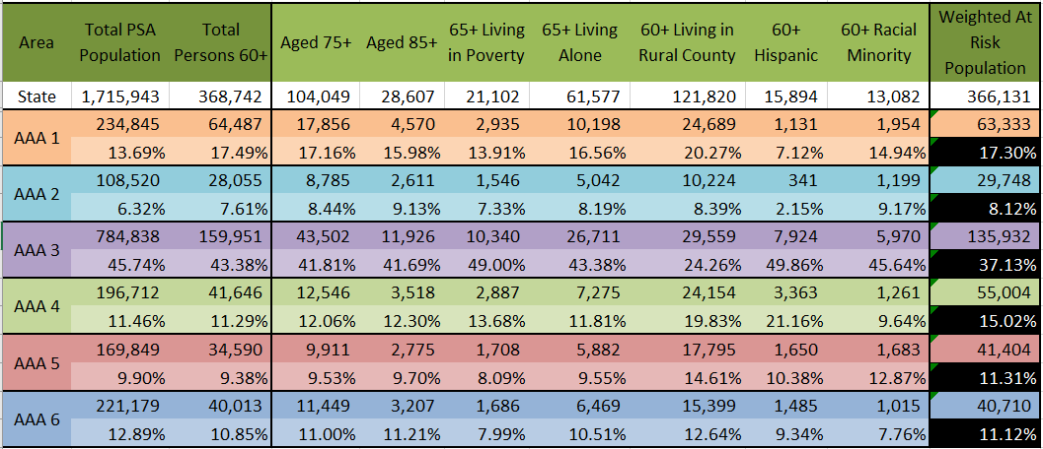
SFY2020 Funding Allocation by Census Demographics
Notes:
Census population for each PSA = % of total 60+ state population

Slide 14
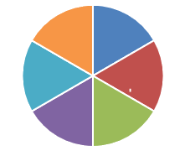


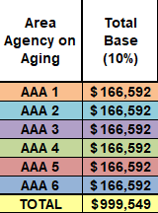
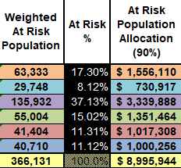

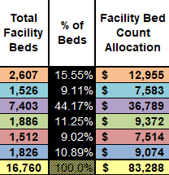

Current Funding Formula: 10,079,000
July 1, 2019 – June 30, 2020
+
=
+
=

Slide 15
State Fiscal Year 2020 Funding Summary
Area Agencies on Aging | Federal Funds | Required Match (State) | State Program Adult Protective Services | Additional State Support | Total Budget
AAA I-North Idaho | $1,050,000 | $216,000 | $194,000 | $276,000 | $1,736,000
AAA II-North Central Idaho | $548,000 | $113,000 | $78,000 | $166,000 | $905,000
AAA III-Southwest Idaho | $2,148,000 | $439,000 | $316,000 | $640,000 | $3,543,000
AAA IV-South Central Idaho | $923,000 | $190,000 | $132,000 | $282,000 | $1,528,000
AAA V-Southeast Idaho | $720,000 | $148,000 | $149,000 | $174,000 | $1,191,000
AAA VI-Eastern Idaho | $712,000 | $146,000 | $123,000 | $195,000 | $1,176,000
Total | $6,101,000 | $1,252,000 | $992,000 | $1,733,000 | $10,079,000
State Commission | Federal Funds | Required Match (State) | N/A | N/A | Total Budget
Idaho Commission on Aging | $2,975,000 | $626,000 |  |  | $3,601,000
Total ICOA and AAA | $9,076,000 | $1,878,000 | $992,000 | $1,733,000 | $13,680,000

Slide 16
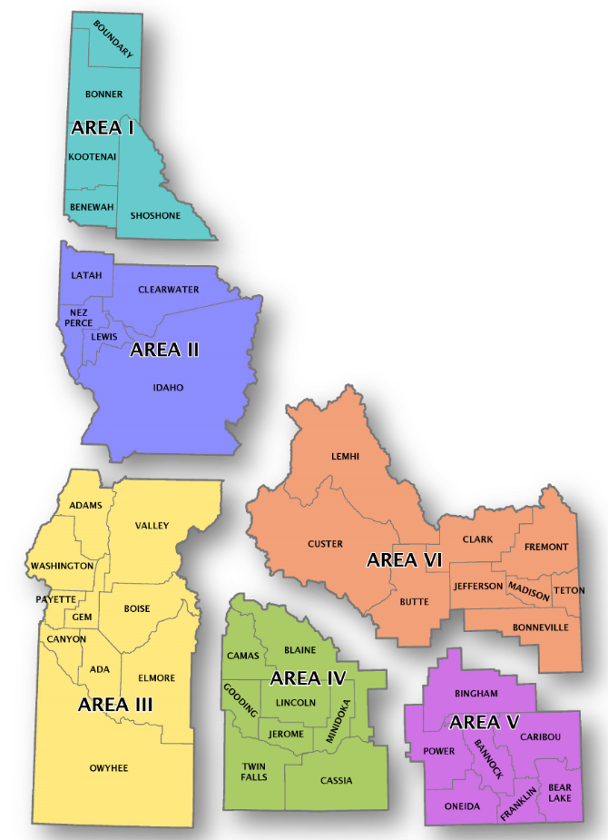
AAA Focus Area Funding $10,079,000
$1,735,000
$341,000
Crisis-Preserving Rights and Safety
$507,000
Targeted-Preventing Institutionalization
Universal-Investing in Healthy Aging
$887,000
$906,000
$162,000
$378,000
$236,000
$1,176,000
$366,000
$385,000
$555,000
$3,543,000
$587,000
$1,498,000
$231,000
$1,191,000
$1,458,000
$419,000
$541,000
$1,528,000
$265,000
$451,000
$812,000
Notes:
Federal Older Americans Act Requirement is to divide the state into Planning and Services Areas.
These are the initial PSAs since ICOA was designated in 1968.
The boundaries are the same as the Idaho Transportation Departments boundaries, but different than H&W’s.
TITLE 67 STATE GOVERNMENT AND STATE AFFAIRS
CHAPTER 50 COMMISSION ON AGING 67-5003.
(6) Designate "planning and service areas" and area agencies on aging in accordance with the older Americans act and federal regulations promulgated thereunder. The commission shall review the boundaries of the "planning and service areas" periodically and shall change them as necessary;

Slide 17
Funding Formula Methodology Change: July 1, 2022: Adding an Incentive Performance Calculation
New: Add Incentive Performance Allocation/Distribution
Current Funding Allocation/Distribution
Registered Clients Served
  Home Delivered Meals
  Homemaker
  Caregiver
  Case Management
  Chore
  Congregate Meals
  Diseases Prevention & Health Promotion Program
Census Demographic Categories
  75+
  85+
  65+ living in Poverty
  65+ Living alone
  60+ Racial Minority (not Hispanic)
  60+Hispanic
  60+ Living in Rural Counties

Slide 18
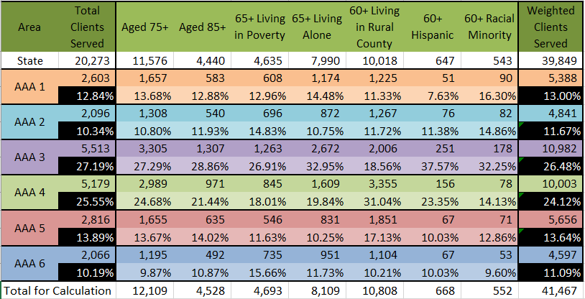
SFY2019 Registered Seniors Served in Idaho

Slide 19


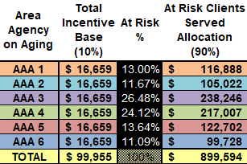



Funding Formula Change: July 1, 2022
Adding an Incentive Performance Calculation
=
+
=

Slide 20
Crisis Focus:
Preserving Rights and Safety
Area Agencies on Aging
Idaho Commission on Aging
Local Ombudsman
State Ombudsman
Local Adult Protective Services
State Adult Protective Services
Legal Assistance
  Outcomes:
  - Right to live without abuse, neglect, exploitation
  - Right to live with dignity
  - Right to make our own decisions

Slide 21

State & Local Ombudsmen
Your Rights, Your Advocates
Helping
Assisted Living and
Nursing Facility Residents
Stay Safe
General Eligibility
Seniors 60 years old and older Resident in a facility
1
Service Description | Service Delivery
Identify, investigate, and resolve complaints Protect resident health, safety, welfare and rights Assist residents to obtain services Represent resident interests before agencies Provide technical assistance and monitor laws related to long term care Provide training | Southwest Idaho: AAA 3 Expenditures: $205,414 Total Ombudsman: 4 Total Volunteers: 0 Total Facilities: 152 Total Beds: 7,541 Unannounced Visits: 650 Total Complaints: 281 Top Five Complaints: 25 – Discharge/Eviction 25 – Medication 24 – Food service 22 – Failure to respond 18 – Dignity, respect, staff attitudes
SFY2019: Statewide Trends
2
3
4
Total Expenditures: $790,669
Total Ombudsman: 13
Total Volunteers: 56
Total Facilities: 362
Total Beds: 16,758
Unannounced Visits: 3,209
Total Complaints: 1,232
Top Five Complaints:
99 – Discharge/Eviction
96 – Medications
73: Dignity, Respect, Staff Attitudes
60: Food Service
47: Failure to Respond
Contact: Southwest Idaho
Area Agency on Aging: 1-208-898-7060
5

Slide 22

Local Adult Protective Services
Right to live free of abuse, neglect and exploitation
Helping Vulnerable Adults
Stay Safe
General Eligibility
Vulnerable adults age 18 and older (State Funded Program)
1
SFY2019: Statewide Trends
4
Service Description | Service Delivery
Provide safety and protection to vulnerable adults. Investigates allegations of abuse, neglect, exploitation Assists to reduce risk of harm Provide prevention education | Southwest Idaho: AAA 3 Expenditures: $309,063 Staff: 6.3 Allegations Investigated: 686 Presentations: 13 Types of Maltreatment 242 – Abuse Allegations Substantiated: 28 191 – Neglect Allegations Substantiated: 16 128 – Exploitation Allegations Substantiated: 19 125 – Self-neglect Allegations Substantiated: 12
2
3
Expenditures: $985,372
Staff: 16.5
Allegations investigated: 2,301
Presentations: 102
Types of Maltreatment
740 – Abuse Allegations
  Substantiated: 86
585 – Neglect Allegations
  Substantiated: 49
520 – Exploitation Allegations
  Substantiated: 43
456 – Self-neglect Allegations
  Substantiated: 45
Contact: Southwest Idaho
Area Agency on Aging: 1-208-898-7060
5

Slide 23

Local Legal Assistance
Professional Advice, Counsel or Representation
SFY2019: Statewide Trends
4
Expenditures: $90,524
Total Cases: 872
Top Four Areas:
Health Care: 285 cases
Income: 191 cases
Long-term Care: 189 cases
Housing: 157 cases
Helping Seniors Stay Safe
General Eligibility
Low Income Seniors 60 years old and over
1
Service Description | Service Delivery
Legal assistance addresses issues related to: Income, Health care, Long-term care, Nutrition, Housing, Utilities, Protective services, Defense of guardianship, Abuse or neglect, and Age discrimination | Southwest Idaho: AAA 3 General: $ 31,950 = 96 Income cases = 84 Long-term care cases = 58 Housing cases = 11 Abuse cases = 6 Defense of Guardianship = 6 Age discrimination Total: $ 31,950 = 261 Cases
2
3
Contact: Southwest Idaho Area Agency on Aging: 1-208-898-7060
Boise: Idaho Legal Aid: 1-208-345-0106
Nampa: Idaho Legal Aid: 1-208-454-2591
5

Slide 24
State Adult Protective Services
Right to live free of abuse, neglect and exploitation
General Eligibility
Competitive Three-year Grant: $446,036 ICOA was 1 of 14 states awarded the nationwide grant
Helping Vulnerable Adults Stay Safe
1
Grant Description | Service Delivery
Target is to deploy the following: New screening and assessment tool Methods to capture APS case, client and perpetrator data Goal attainment scaling (GAS) intervention | Pilot: Implemented in Area Agency on Aging 3 Deploy Focused Care Coordination = strengthen vulnerable adults support network Case Manager sets GAS goals with vulnerable adult Case Manager assesses effectiveness of GAS interventions
SFY2019: Statewide Trends
2
3
4
3,997 Reports on Abuse, Neglect and Exploitation
Investigated 2,301 Maltreatment Allegations
740 – Abuse
  Substantiated: 86
585 – Neglect
  Substantiated: 49
520 – Exploitation
  Substantiated: 43
456 – Self-neglect
  Substantiated: 45
1. Protective Order/Action | 9. Social Support Activities
2. Alternative Housing | 10. Accessing Caregiver Resources
3. Medical Care | 11. Secure Financials
4. Substitute Decision maker | 12. Accessing Communication Tools
5. Guardianship/Conservatorship | 13. Accessing Assistive Devices
6. Safety Planning | 14. Accessing Benefits/Entitlements
7. Education | 15. Natural Supports (family, friends)
8. Access External Resources | Etc.
Contact: Area Agency on Aging 3 (Southwest Idaho): 1-208-898-7060
- State oversight: Deedra.hunt@aging.Idaho.gov
5
Notes:
Arizona, Arkansas, California, Idaho, Maine, Massachusetts, Minnesota, Montana, Nevada, Ohio, Oklahoma, Pennsylvania, Rhode Island and Virginia.

Slide 25
Targeted Focus:
Preventing Institutionalization
Area Agencies on Aging
Idaho Commission on Aging
Home Delivered Meals
Senior Community Service Employment Program
In-home Services (Homemaker)
Nutrition Supplemental Incentive Program: Home Delivered Meals
Caregiver Training and Support Groups
Lifespan Respite
Caregiver-Respite
Commodity Supplemental Food Program
Transportation
Medicare Improvements for Patients and Providers ACT
  Outcomes:
  - Assistance with independent living needs:
    Caregiving, home delivered meals, transportation, housework, medication management, employment training and referrals for low income Medicare benefits

Slide 26
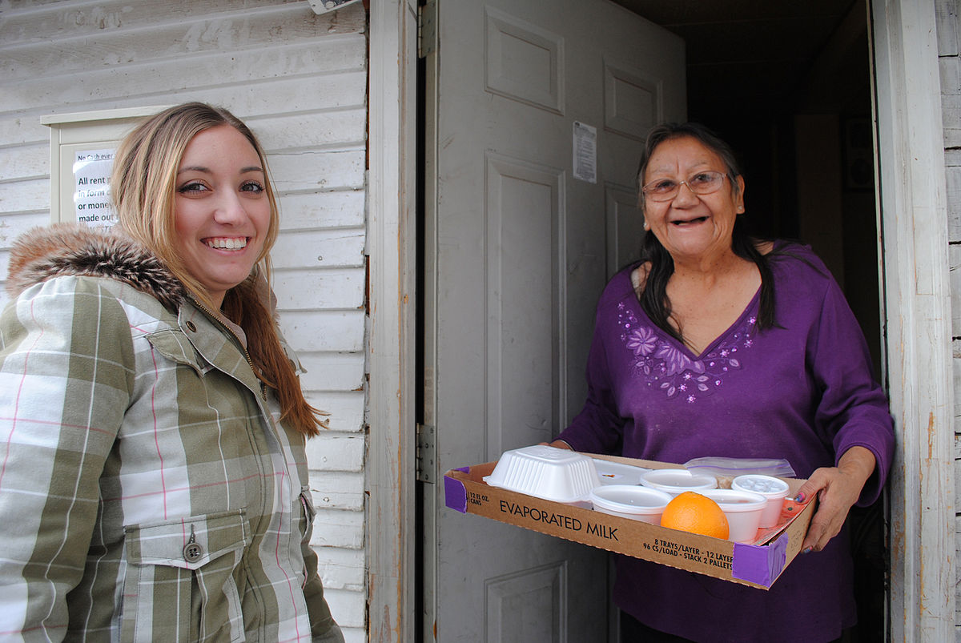

Local Home Delivered Meal Service
Helping Seniors Stay in their Homes
SFY2019: Statewide Trends
4
General Eligibility
Assessment Required Senior 60 years and older Homebound Frail Unable to safely prepare a meal
1
94 Meal Sites
Expenditures: $2,341,255
4,213 Clients
2,845 were 75+/67.5%
2,899 had 2 or more ADLs/68.8%
583,520 meals served
Average Reimbursement rate: $3.77
Senior Center | Clients | Meals
Caldwell | 125 | 20,893
Homedale | 34 | 5,454
Marsing | 17 | 2,267
McCall | 2 | 463
Metro Meals Wheels | 509 | 77,453
Mom’s Meals | 39 | 4,663
Mountain Home | 78 | 9,567
New Plymouth | 18 | 2,999
Parma | 11 | 2,184
Payette | 74 | 11,763
Saint Alphonsus | 236 | 33,608
Three Island | 14 | 2,227
Weiser | 46 | 6,662
Service Description | Service Delivery
Provide a home delivered meal 5 or more days a week: may consist of hot, cold, frozen, dried, canned, fresh or supplemental foods. | Southwest Idaho: AAA 3 13 Home Delivered Meal Sites Total Funds Distributed: $790,205 1,181 Clients 836 were 75+ which is 71.0% 955 had 2 or more ADLs which is 80.9% Meals Served: 180,203 Reimbursement Rate: $4.25
2
3
Contact: Southwest Idaho Area Agency on Aging: 1-208-898-7060
5

Slide 27

Local In-home Service: Homemaker
Maintaining Independence
SFY2019: Statewide Trends
4
Helping Seniors
Stay in their Homes
Expenditures: $700,329
45,777 hours = $15.30 per hour
1,313 Clients = Annually 35 hours per client
59.3% are 75 and older
77.9% have 2 or more ADLs
Annually, $533 per client
1
General Eligibility
Assessment Required: - Senior 60 years and older that has physical barriers preventing from maintaining a clean home environment
Service Description | Service Delivery
Provides housekeeping, meal planning and preparation, personal errands, bill paying and medication management | Southwest Idaho: AAA 3 Expenditures: $ 184,713 12,374 hours = $14.93 per hour 344 Clients = Annually 36 hours per client 50.6% are 75 and older 84.9% have 2 or more ADLs Annually, $537 per client
2
3
Activities of Daily Living (ADLs)
Instruments of Activities of Daily Living (IADLs)
Preparing a meal
Shop for food
Able to drive
Do laundry
Managing money
Housekeeping
Contact: Southwest Idaho Area Agency on Aging: 1-208-898-7060
5
Manage medication
Use telephone

Slide 28

Local In-home Service: Chore
Helping Seniors
Stay in their Homes
Maintaining safety inside and outside your home
General Eligibility
Assessment Required/Referral: - Senior 60 years and older that have physical barriers preventing them to keep their home safe.
1
SFY2019: Statewide Trends
4
All AAAs are able to link people with chore services, but some AAAs may also provide funding.
Senior Population
Age 75+: 101,249
Age 65+ living alone: 58,797
Age 60+ living in rural county: 117,927
Service Description | Service Delivery
Improve client’s safety at home through one-time or intermittent service: assistance with yard work, sidewalk maintenance, heavy cleaning and household maintenance grab bars wheelchair ramps | Southwest Idaho: AAA 3 Senior Population Age 75+: 42,110 Age 65+ living alone: 25,260 Age 60+ living in rural county: 28,713 AAA utilizes network and links people to other assistance.
2
3
Contact: Southwest Idaho Area Agency on Aging: 1-208-898-7060
5
Notes:
Not all AAAs

Slide 29

Local In-home service: Case Management
Helping Seniors Stay in their Homes
General Eligibility
Assessment Required/Referral: Seniors 60 years and older Unable to manage multiple services to meet their long-term-care needs
SFY2019: Statewide Trends
1
4
AAAs are able to link people with case management services, and for seniors who meet the eligibility, are able to provide the service.
Service Description | Service Delivery: Southwest Idaho: AAA 3
Develops and implements a supportive service plan Oversees progress until able to manage services on own | Assesses physical, psychological and social needs Considers available family members and friends who are able to assist before looking for paid options | Problems identified during assessment Exploration family assistance Identify overall goal to be achieved Records all unpaid services and contributions Arranges and records paid services
2
3
Comprehensive Assessment
Supportive Service Plan
Contact: Southwest Idaho Area Agency on Aging: 1-208-898-7060
5

Slide 30

Local Senior Transportation
Helping Seniors
Stay in their Homes
SFY2019: Statewide Trends
General Eligibility
Seniors 60 years old and over Does not have personal transportation
4
1
Expenditures: $550,618
Boardings: 162,087
Average Cost per boarding: $3.40
Partners
Metro Community | Cascade (SC)
Eagle Senior Ctr. (SC) | Council (SC)
Legacy Corps. | Gem County
Horseshoe Bend (SC) | Homedale (SC)
Kuna (SC) | Marsing (SC)
Mt. Home (SC) | McCall (SC)
Payette (SC) | Melba (SC)
Star (SC) | New Meadows (SC)
Three Island (SC) | New Plymouth (SC)
Meridian (SC) | Rimrock (SC)
Boise Basis (SC) | Weiser (SC)
Cambridge (SC)
Service Description | Service Delivery
Service is in conjunction with local transportation providers Target: reduces isolation, and promotes independent living by providing transportation to: Medical and health care services Meal programs Employment locations Shopping and community functions Adult day care facilities Social service agencies | Southwest Idaho: AAA 3 Expenditures: $250,256 Boardings: 76,657 Average Cost per boarding: $3.26
2
3
Contact: Southwest Idaho Area Agency on Aging: 1-208-898-7060
5

Slide 31

Local Family Caregiver Support Program
SFY2019: Statewide Trends
4
Helping Seniors
Stay in their Homes
Total Expenditures: $724,175
Service | Expenditures | Unit
Information Services: | $ 56,656 | NA
Access Assistance: | $ 217,459 | 3,918 Contacts
Support Group/Education | $ 73,778 | NA
Respite | $ 358,288 | 23,093 Hours
Supplemental Services | $ 17,995 | NA
General Eligibility
Caregivers and relatives as caregivers who are 55 or under 55 caregiving for an older person.
1
Service Description | Service Delivery
Support and train caregivers through the following activities: Information Services (Outreach) Access assistance (Information & Assistance) Support Group/Education Respite Supplemental Services (Limited basis) | Southwest Idaho: AAA 3 Total Expenditures: $195,685
2
3
Service | Expenditures | Unit
Information Services: | $ 2,038 | NA
Access Assistance: | $56,550 | 1,241 Contacts
Support Group/Education | $30,121 | NA
Respite | $106,976 | 6,430 Hours
Supplemental Services | $0 | N/A
Contact: Southwest Idaho Area Agency on Aging: 1-208-898-7060
5

Slide 32

Idaho Lifespan Respite Project
Trends in Idaho
4
Helping People Stay Healthy
-1 in 5 adults are family caregiver
-50% assist in person care
-33% care for a parent/in-law
-1 in 5 non-caregivers will be a caregiver within 2-years
General Eligibility
Competitive Three-year Grant: $733,163 Federal Funds Caregivers across the lifespan
1
Service Description | Service Delivery (Six Expansion Projects) and Contact Information
Partnership with the Idaho Caregiver Alliance Expand and enhance supports for caregivers across the lifespan Improving access to respite services for family caregivers of all ages. | Expenditures: SFY 2019: $130,158 Federal Funds Families Together: Families with special needs children (Moscow, Lewiston, Potlach, Troy, Deary and Genesee: 208-874-7891:Annika Willey, email: Annika@familiestogether.org Hike to Heal: Provides care while caregiver regroups with others in a natural settings. 208-718-1175 – John and June: www.johnandjunesmission.org Legacy Corps (Jannus Inc.): provides care allowing caregiver to attend Powerful Tools for Caregiver classes: 208-947-4284: www.jannus.org/legacy-corps | 4. Corwyn’s Cause: Provides care for children with significant medical needs, allowing caregiver to regroup (Ada, Boise, Canyon, Gem, Elmore, Payette, Valley and Washington counties: https://www.corwynscause.org/ 5. The Senior Connection: Drop-in care at center for Alzheimer’s, dementia care, allowing caregiver to regroup (Wood River Valley) 208-788-3468 https://seniorconnectionidaho.org/ 6. Area Agency on Aging 2 (North Central Idaho) allows caregiver to choose care provider, so he/she can take break. 1-800-877-3206 Statewide oversight: Pam.Oliason@aging.Idaho.gov
2
3
&
5

Slide 33

Senior Community Service Employment Program
Helping Seniors Stay in their Homes
General Eligibility
Annual Grant Application: $420,246 Unemployed adults 55 years old and over whose incomes are 125% of poverty ($15,613)
1
Trends in Idaho
21,102 Seniors in Poverty
(Poverty: $12,490 annually)
4
Service Description | Service Delivery (State Fiscal Year 2019)
Provides employment training to low income older individuals who need to enhance their skills to compete in the job market. Seniors are placed at 501(c)3 nonprofit agencies and are provided with part-time, work-based training opportunities | Funding for 43 participants 55 clients participated in program Average in program: 20.5 months Total hrs. provided: 34,690 $289,415 enrollee wages/$5,262 per enrollee $34,485 enrollee coordination/support $53,371 administration Host Agencies: In-kind $53,665 (Host Agencies)
2
3
Contacts:
Easterseals-Goodwill: 208-454-8555 or 208-733-9675 www.esgw.org/scsep
ICOA oversight: Admir.Selimovic@aging.Idaho.gov
5

Slide 34

Nutrition Supplemental Incentive Program
(Home Delivered and Congregate Meals)
5
Contact: Southwest Idaho Area Agency on Aging: 1-208-898-7060
General Eligibility
Participate in a Home Delivered/Congregate Meal Program Purchase domestically grown food
Trends in Idaho
1
4
Senior Center | Clients | Meals
Boise Basin Senior Center (SC) | 133 | 3,590
Caldwell | 125 | 20,893
Caldwell (SC) | 428 | 13,355
Cambridge Midvale (SC) | 112 | 2,560
Cascade (SC) | 39 | 1,793
Council (SC) | 91 | 2,812
Garden Valley | 99 | 908
Homedale (SC) | 163 | 10,670
Horseshoe Bend (SC) | 43 | 1,721
Marsing (SC) | 169 | 6,117
McCall (SC) | 88 | 3,338
Melba (SC) | 128 | 4,891
Senior Center | Clients | Meals
Metro Community | 536 | 27,889
Metro Meals on Wheels | 1,575 | 134,570
Mom’s Meals | 39 | 4,663
Mt. Home | 211 | 15,920
New Meadows (SC) | 81 | 1,980
New Plymouth (SC) | 276 | 10,396
Parma (SC) | 154 | 10,630
Payette (SC) | 307 | 19,005
Rimrock (SC) | 94 | 3,286
Saint Alphonsus | 236 | 33,608
Three Island (SC) | 86 | 6,319
Weiser (SC) | 46 | 6.662
94 Meal Sites in Idaho
Meals Served 2018: 1,057,162
Additional funds 2019: $764,209
= average of .73 cents per meal
Supporting those who support Seniors
Service Description | Service Delivery
This is an incentive program and funds are distributed based on the meals a site provided during the previous year | Southwest Idaho: AAA 3 Meal Sites: Total 2019 Funds Distributed: $257,377 Meals Served: SFY18: Home Delivered: 164.543 SFY18: Congregate: 176,663 SFY18: Total: 341,206 = average .75 cents per meal
2
3

Slide 35

Commodity Supplement Food Program (CSFP)
General Eligibility
Individual 60 years of age or older 130% of poverty ($1,354/$16,248) Resident of Idaho U.S. Department of Agriculture Grant
1
Trends in Idaho
4
21,102 Seniors in Poverty
(Poverty $12,490 annually)
Service Description | Service Delivery
In partnership with The Idaho Foodbank - to improve the health of seniors by supplementing their diets with a monthly nutritious food box that includes nutrition information and helpful recipes | Statewide 57 Distribution Partners 2,117 boxes per month = 25,404 annually 2,200 seniors served Average 32 pounds per box and may contain:
2
3
Non-fat milk | Rice | Canned meat
Cheese | Cereal | Poultry
Farina | Pasta | Fish
Juice | Peanut butter | Canned Fruits
Oats | Dry beans | Canned Vegetables
Contact: Idaho Foodbank: 208-602-4750
E-mail: sajones@idahofoodbank.org
State oversight: Birgit.Luebeck@aging.Idaho.gov
5

Slide 36

Medicare Improvements for Patients and Providers Act (MIPPA)
Trends in Idaho
General Eligibility
Low income Medicare beneficiaries Administration for Community Living Grant Sept. 30, 2018 – Sept 29, 2019
4
1
21,102 Seniors in Poverty
(Poverty $12,490 annually)
Service Description | Service Delivery
Outreach in partnership with Idaho’s Department of Insurance State Health Insurance Benefit Advisors (SHIBA) to signup eligible beneficiaries for: Medicare Savings Programs (MSP) Low Income Subsidy (LIS) Medicare Part D and Prevention and Wellness benefits | Expended $142,818 Contracted with SHIBA for open enrollment marketing campaign Contract with six Area Agencies on Aging to: Recruit host sites Develop partnerships with community organizations Outreach to Tribal community
2
3
Contact: State Health Insurance Benefits Advisors (SHIBA): 1-800-247-4422
Contact: Metro Community Services (Southwest Idaho) Esmeralda Zamora Esmeralda@metrocommunityservices.net 1-208-459-0063
State oversight: Admir.Selimovic@aging.Idaho.gov
5

Slide 37
Universal Focus:
Investing in Healthy Aging
Area Agencies on Aging
Idaho Commission on Aging
Congregate Meals
Nutrition Supplemental Incentive Program: Congregate Meals
Information and Assistance and Outreach
Dementia Capable
Disease Prevention & Health Promotions
Senior Medicare Patrol (Fraud Prevention)
Coordination and Planning
Chronic Disease Self-Management Education
Elder Justice
  Outcomes:
  - Provide access to reliable and trustworthy information, services and supports
  - Fund opportunities for seniors to stay active in the community
  - Provide caregiver training and resources
  - Help people plan to meet their own independent living needs as they age

Slide 38

Congregate Meals
Participating in the Community
SFY2019: Statistics
Senior Center (SC) | Clients | Meals
Boise Basin Senior Center (SC) | 133 | 3,590
Caldwell (SC) | 428 | 13,355
Cambridge (SC) | 112 | 2,560
Senior Center (SC) | Clients | Meals
Cascade (SC) | 39 | 1,793
Council (SC) | 91 | 2,812
Garden Valley (SC) | 99 | 908
Homedale (SC) | 130 | 5,216
Horseshoe Bend | 43 | 1,721
Marsing (SC) | 154 | 3,850
McCall (SC) | 86 | 2,875
Melba | 128 | 4,891
Metro Community | 536 | 27,889
Metro Meals on Wheels | 1,083 | 57,117
Mt. Home (SC) | 136 | 6,353
New Meadows | 81 | 1,980
New Plymouth | 259 | 7,397
Parma (SC) | 143 | 8,446
Payette (SC) | 236 | 7,242
Rimrock (SC) | 94 | 3,286
Three Island (SC) | 73 | 4,092
Weiser (SC) | 140 | 8,938
Helping Seniors Stay Healthy
General Eligibility
Senior 60 years old and over and their spouses Individual with a disability under 60 living with an eligible person
1
SFY2019: Statewide Trends
4
Expenditures: $1,729,315
94 Meal Sites
492,440 Meals served
14,223 Clients = Annually, $122 per client
Average Meal Program cost: $3.51
Average Reimbursement cost: $3.17
Service Description | Service Delivery
Prepare and serve meals in a congregate settings, which provide older persons with assistance in maintaining a well balanced diet. The purpose is to reduce hunger and promote socialization. | Southwest Idaho: AAA 3 Expenditures: $635,114 21 Meal Sites/Providers 176,311 Meals 4,039 Clients = Annually $157 per client Average Meal Program cost: $3.60 Reimbursement cost: $3.50
2
3
Contact: Southwest Idaho Area Agency on Aging: 1-208-898-7060
5

Slide 39

Information and Assistance (I&A)
Access to Trustworthy and Reliable Information
Helping Seniors Stay Informed
SFY2019: Statewide Trends
4
Service | Expenditures | Units
Total I&A General & Caregiver Staff |  | 21.43 Staff
Total Registered Clients Managed |  | 20,272 Clients
General I&A | $ 891,209 | 23,073 contacts
Caregiver I&A | $ 217,459 | 3,918 contacts
Total | $ 1,108,668 | 26,991 contacts
General Eligibility
General Public needing long-term care and/or Caregiver information
1
Service Description | Service Delivery Soutwest Idaho: AAA 3
Provides individuals with Long-term Care information Prepares initial and annual eligibility assessments Links people to available services Ensures individuals receive services through follow up Manages registered clients
2
3
Service | Expenditures | Units
Total I&A General & Caregiver Staff |  | 7.6 Staff
Total Registered Clients Managed |  | 5,513
General I&A | $ 302,347 | 6,889 contacts
Caregiver I&A | $ 56,550 | 1,241 contacts
Total | $ 358,898 | 8,130 contacts
Contact: Southwest Idaho Area Agency on Aging: 1-208-898-7060
5

Slide 40

Disease Prevention and Health Promotions
Keeping the body strong
Helping Seniors Stay Healthy
General Eligibility
Senior 60 years old and over
1
Service Description | Service Delivery
Workshops available that can provide us with the tools to: Build our own support network Learn relaxation and strategies to deal with pain, fatigue, and frustration Discover how healthy eating can improve your condition Create an exercise program that works for you Understand new treatment choices Communicate effectively with our doctors and families about our health | Southwest Idaho: AAA 3 Expenditures: $33,097 Diabetes Self-Mgmt. provide older adults and adults with disabilities with education and tools to help them better manage diabetes
SFY2019: Statewide Programs
2
3
4
Expenditures: $89,835
Statewide Programs
AAA 1: Care Transitions
AAA 2: Chronic Disease Self-Mgmt.
AAA 3: Diabetes Self-Mgmt.
AAA 4: Over 60 and Getting Fit
AAA 5: Diabetes Self-Mgmt.
AAA 6: Chronic Disease Self-Mgmt.
Contact: Southwest Idaho Area Agency on Aging: 1-208-898-7060
5

Slide 41

Planning & Coordination
Identifying needs, creating solutions
Helping Seniors Stay Informed
SFY2019: Statewide
4
General Eligibility
AAA must first spend administration funds Additional 2% of total budget is allowed to plan and develop service enhancement
Expenditures: $98,164
Senior Population: 354,386
Average planning cost: $0.28
1
Service Description | Service Delivery
Enhance service to the most at risk population: At Risk of institutional placement Greatest economic need Greatest social need | Southwest Idaho: AAA 3 Expenditures: $11,190 Senior Population: 153,193 = $0.07 for planning & coordination Participate and continue to serve on the Idaho Adult Protection Governance Committee Implement caregiver of children program Pursuit partnerships and grants with Critical Access Hospitals Participate and serve on the Treasure Valley Care Coalition to collaborate with medical providers Work with the Idaho Hunger Task Force to promote and participate in the Idaho Hunger Summit Senior Track
2
3
Contact: Southwest Idaho Area Agency on Aging: 1-208-898-7060
5

Slide 42

Elder Rights/Legal Assistance Developer Improving access and service
Helping Seniors
Stay Safe
General Eligibility
Statewide Plan Compliance
1
SFY2019: Statewide
4
Access to Legal Assistance
Six Area Agencies on Aging
Six Idaho Legal Aid Local Officers and one main office
Total Cases: 872
Top Four Areas:
Health Care: 285 cases
Income: 191 cases
Long-term Care: 189 cases
Housing: 157 cases
Service Description | Service Delivery-Idaho Commission on Aging
To develop and implement improvements to legal service delivery for seniors in Idaho | Expenditures: $21,590 Completed initial environmental scan Utilized federal and state stakeholder group Standardized data collection process Identified new service delivery model Entered into an agreement with state Idaho Legal Aid office Collaborated on successful Legal Assistance grant
2
3
Idaho Legal Aid: Rachelpiscette@idaholegalaid.org
State oversight: Deedra.hunt@aging.Idaho.gov
5

Slide 43

Senior Medicare Patrol
Protect yourself from Fraud
Helping Seniors
Stay Safe
Target Population
Medicare beneficiaries and their caregivers
1
SFY2019: Statewide
Service Description | Service Delivery
Education for Medicare and Medicaid beneficiaries to detect, report, and prevent health care fraud. Trained SMP staff and volunteers to conduct group education sessions, provide one-to-one counseling with Medicare beneficiaries, and hold regional Scam Jams. | Additional Contract with South Central Idaho Area Agency on Aging Expenditures: $31,314 Volunteers Recruited: 4 Group Presentations: 28 Community Events: 128 One-to-one Counseling: 739
4
2
3
Expenditures: $252,823
Volunteers Recruited: 13
Group Presentations: 242
Community Events: 425
One-to-one Counseling: 1,083
Contact: Metro Community Services (Southwest Idaho) Esmeralda Zamora Esmeralda@metrocommunityservices.net 1-208-459-0063
Scam Jams: Patricia Highley – Dpt. of Finance 208-332-8077: https://www.idscamjamalliance.org/
State oversight: Admir.Selimovic@aging.Idaho.gov
5

Slide 44

Dementia Capable - Alzheimer’s Disease Supportive Services Program
Helping Seniors Stay Healthy
National Trends
4
Subjective Cognitive Decline: Self-reported memory problems
1 in 9 people 45 and over are experiencing decline
83% have at least one chronic condition
37% gave up day to day activities
Less than half discussed with health care provider
1/3 people say it interferers with social activates, work or volunteering
25% need help with household tasks
General Eligibility
Competitive Three-year Grant: $649,093 Persons with Alzheimer’s disease and their caregivers
1
Service Description
Improving awareness, education, and direct services for people with dementia and their families.
2
Service Delivery
Expenditures: SFY19: $135,184 federal funds Expand Powerful Tools for Caregivers (6-week workshop) Developed 6 Dementia Training modules Implemented Consumer directed respite service pilot project with southwest Area Agency on Aging Provided Dementia Capable training to Information and Referral staff Developing Caregiver Assessment Tool for Information and Referral staff Alzheimer’s Association expanding “Knowing the 10 Signs and 5 Health Habits” education in southern Idaho Boise State University evaluating activities
3
5
Contact:
Greater Idaho Chapter of Alzheimer’s Association:
208-206-0041
Alzheimer’s Association Washington: 1-800-272-3900
Statewide oversight: Pam.Oliason@aging.Idaho.gov
Other Partners: Legacy Corps at Jannus
Area 3 Senior Services Agency (southwest Idaho)
Orchard Ridge: Coeur d’Alene
Boise State University for the Study of Aging
Idaho Department of Health and Welfare
  Divisions of Medicaid, Licensing and Certification
  Idaho Division of Veteran’s Services
  Idaho Health Care Association

Slide 45

Next Steps
State Plan Development
  Sept., Oct. and Nov. 2020: Public Meetings
  Aug. – Feb.: Statewide needs assessment Idaho State University
    https://aging.idaho.gov/stay-informed/education-outreach/
    Present Final assessment at ICOA Commissioners meeting in Feb. 2020
  Mar. 23rd – Apr. 30th 2020: Release final draft Plan for Public Comment
    May 2020: Present for approval at ICOA Commissioners meeting
  Jun 30, 2020: Submit plan to ACL
Local Area Plan Development
  Jul. 1, 2020: AAAs start developing their local Area Plans
    Jun. 30, 2021: AAAs Submit Area Plans to ICOA
  October 1, 2021: ICOA reviews and approves Area Plans

Slide 46
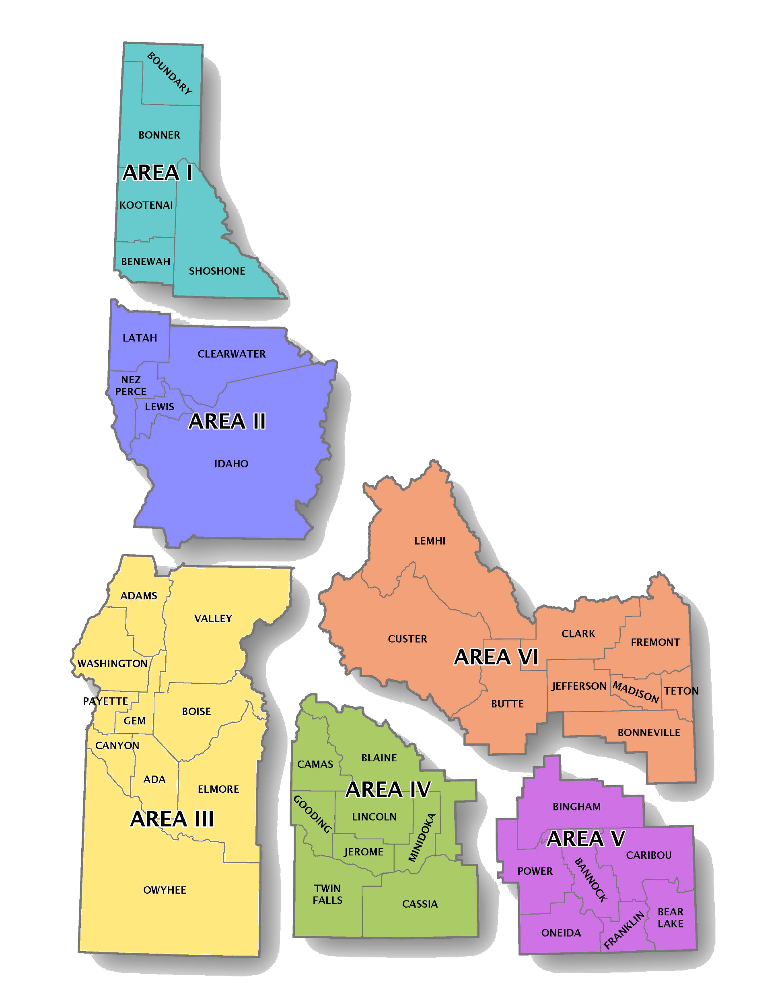
Resource Page
State Agency:
  Idaho Commission on Aging (ICOA)
    1-208-334-3833 or 1-877-471-2777
    https://aging.idaho.gov/stay-informed/planning-coordination/
Area Agencies on Aging (AAA)
  North Idaho Area Agency on Aging I – Coeur d’Alene
    1-208-667-3179 or 1-800-786-5536
    http://www.aaani.org/
  North Central Idaho Area Agency on Aging II – Lewiston
    1-208-743-5580 or 1-800-877-3206
    http://www.cap4action.org/PSAgencyOnAging.html
  Southwest Idaho Area Agency on Aging III – Meridian
    1-208-898-7060 or 1-844-850-2883
    http://www.a3ssa.com
  South Central Idaho Area Agency on Aging IV – Twin Falls
    1-208-736-2122 or 1-800-574-8656
    https://sites.google.com/site/csiofficeonaging/
  Southeastern Idaho Area Agency on Aging V – Pocatello
    1-208-233-4032 or 1-800-526-8129
    http://www.sicog.org/aaa-home.html
  Eastern Idaho Area Agency on Aging VI – Idaho Falls
    1-208-522-5391 or 1-800-632-4813
    http://www.eastidahoaging.com
Statewide needs assessment: https://aging.idaho.gov/stay-informed/education-outreach/

Slide 47













THANK YOU
Notes:
How did we do?
We placed our services in four essential categories: Stay Home, Stay Safe, Stay Healthy and Stay Informed

