Slide 1
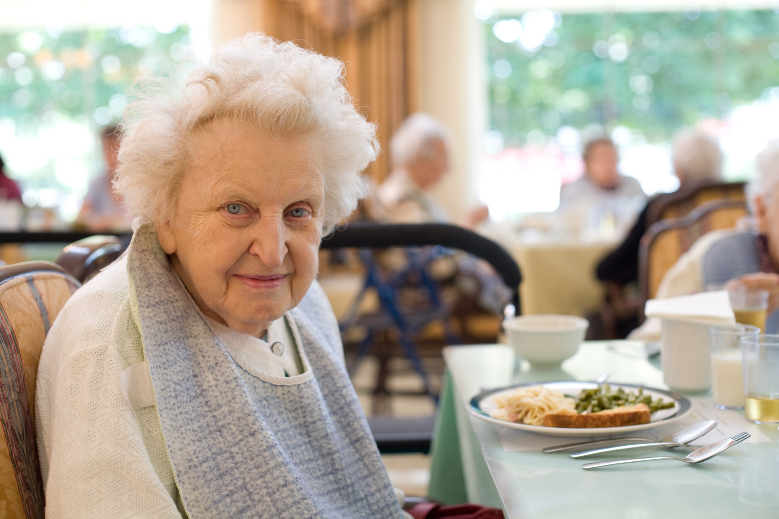
Nutrition Programs:
Meal Site Dietician Training

Slide 2
Dietitian Training for Meal Sites and Staff
Notes:
Today we will learn together what the Dietician plays for a role in all of our working lives. The Dietician will provide Nutrition Education and Nutrition Counseling, will approve all menus submitted by the meal sites and will give advice to menu creators to be in compliance.

Slide 3
Learner Objectives
Funding Flow
Review regulations and Dietary Guidelines
Discuss menu planning, templates and menu planning help sheet
Sanitation: To Glove or not to Glove..?
Food costs.. how to make a dollar go further.
Heating / Cooling and Storage
Diet Counseling

Slide 4
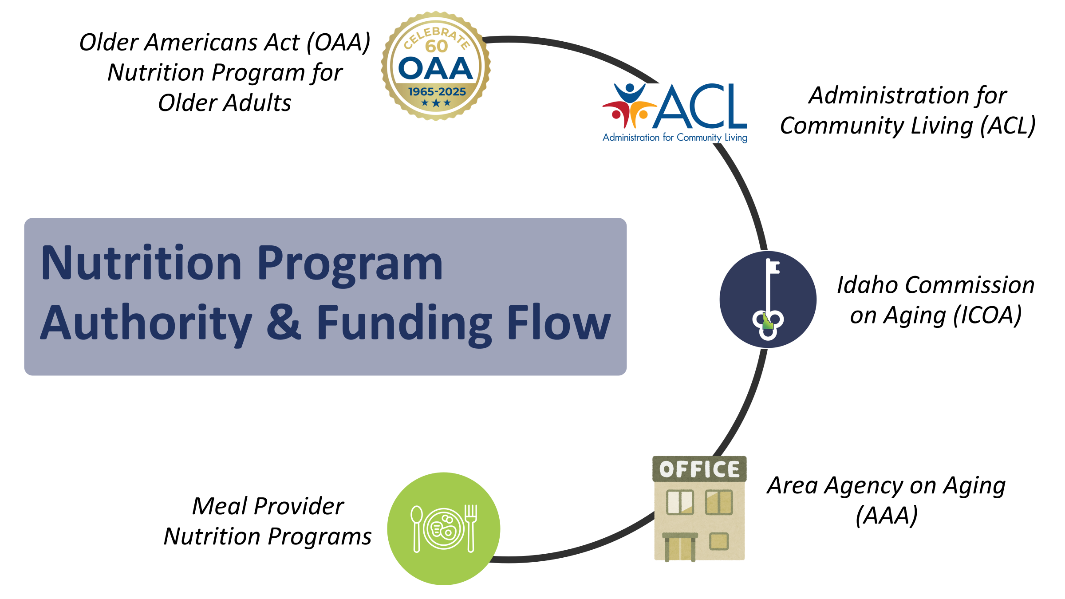






Older Americans Act (OAA) Nutrition Program for Older Adults
Administration for Community Living (ACL)
Nutrition Program Authority & Funding Flow
Idaho Commission on Aging (ICOA)
Area Agency on Aging (AAA)
Meal Provider Nutrition Programs

Slide 5
Older Americans Act, Section 339.Nutrition
A State that establishes and operates a nutrition project under this chapter shall— utilize the expertise of a dietitian Provides meals that comply with the most recent Dietary Guidelines for Americans Provide a minimum of 33 1⁄3 percent of the dietary reference intakes established by the Food and Nutrition Board of the National Academies of Sciences, Engineering, and Medicine if the project provides one meal per day. to the maximum extent practicable, are adjusted to meet any special dietary needs of program participants. Including meals adjusted for cultural considerations and preferences and medically tailored meals. encourages individuals who distribute nutrition services to provide, to homebound older individuals, available medical information approved by health care professionals, such as informational brochures and information on how to get vaccines, including vaccines for influenza, pneumonia, and shingles, in the individuals’ communities Link to the Older Americans Act
Notes:
The OAA established the Administration on Aging within the Department of Health, Education and Welfare, and called for the creation of State Units on Aging. The Older Americans Act (OAA) was passed by Congress in 1965 as a response to policymaker concerns about the lack of services for older adults. The original act gave authority for grants to States for community planning, social services, research and development projects, and training on aging related issues.
Above I added a few very important requirements out of the OAA for your convenience.
The purposes of these programs are to 1) reduce hunger, food insecurity and malnutrition, 2) promote socialization, 3) promote health and well-being, and 4) delay adverse health conditions. The intent is to make community based nutrition services available to older adults who may be at risk of losing their independence and their ability to remain in the community.
If you are interested in the full version of the Older Americans Act, please go to

Slide 6



OAA Nutrition Program Goals
Reduce hunger & food insecurity and malnutrition
Promote socialization
to promote the health and well-being of older individuals by assisting such individuals to gain access to nutrition and other disease prevention and health promotion services to delay the onset of adverse health conditions resulting from poor nutritional health or sedentary behavior
Notes:
The OAA established the Administration on Aging within the Department of Health, Education and Welfare, and called for the creation of State Units on Aging. The Older Americans Act (OAA) was passed by Congress in 1965 as a response to policymaker concerns about the lack of services for older adults. The original act gave authority for grants to States for community planning, social services, research and development projects, and training on aging related issues.
Above I added a few very important requirements out of the OAA for your convenience.

Slide 7
Dietary Guidelines for Americans
The Dietary Guidelines for Americans provides evidence-based nutrition information and advice for people ages two and older to help Americans make healthy choices about food and beverages in their daily lives. The Guidelines also serve as the basis for federal food and nutrition education programs.
The Dietary Guidelines for Americans, produced by HHS and the U.S. Department of Agriculture every five years, analyze the latest research to help Americans make smart choices about food and physical activity so they can live healthier lives.
The link is provided here: https://www.hhs.gov/fitness/eat-healthy/dietary-guidelines-for-americans/index.html

Slide 8
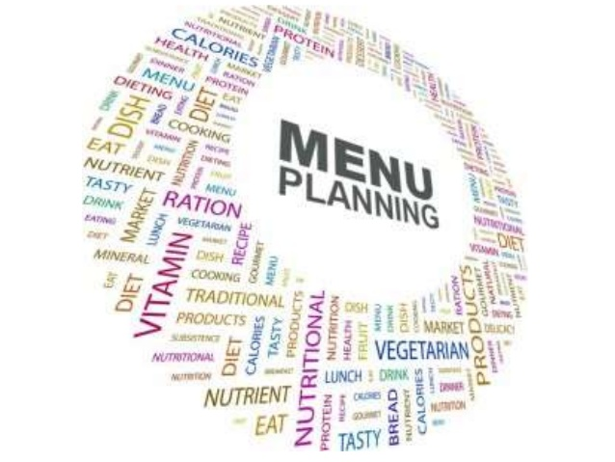
Menu Planning
Notes:
Menu planning can be tough! People want you to include their favorite dish, cooks want an easy meal to prep, the food bank doesn’t have prime rib, and your nutritionist is saying you need more whole grains! This powerpoint won’t solve all your problems but will help clear some things up. If there are any further questions or if you are having problems with anything be sure to reach out. We are happy to help.

Slide 9
Menu Recommendations
Guidelines:
Nutrition Guideline: Portion size must be included, C=Cup
P= Meat or Protein 2 oz edible portion
V= Vegetable ½ C cooked or canned or 1 C fresh(High Vit A source 2-3x/wk)
F=Fruit ½ C cooked or canned or 1 C fresh (high Vit C source daily)
G=Grain/Bread 1/3-1/2 C or 1 slice/piece (half to be whole grain)
D-Dairy 1 C milk or equivalent
Dessert optional

Slide 10
Menu Recommendations
The guidelines indicate the amount needed to meet the minimum needs for the general population.
The Serving Size should indicate the amount you are serving at your center.
Although the guideline states 2 oz of protein is needed you may serve a 3 or 4 oz portion. This should be the amount indicated on your menu.
This especially comes in handy when items are not just one meal component. For example, writing 2 oz drumstick, may not allow for 2 oz of protein once the bone is subtracted. Or 2 oz breaded chicken also would not allow for enough protein once you subtract the breading.
Or you can double up the grain portion to include 2 servings, for instance; 1 cup of rice or pasta or 2 oz roll meets both grain recommendations.
Notes:
The guidelines reflect the amount needed to meet the average person's nutritional requirements. However we want to know the size of your portion. For multiple reasons:
1) 2 oz of meatloaf isn't going to provide 2 oz of protein due to the added ingredients so the portion will need to be larger.
2) Entrees need to be large enough to provide full serving sizes of multiple components, ie 2 cups of spaghetti would be large enough to provide 1 cup noodles (2 grains) 1/2 cup tomato sauce (1 vegetable) and 2 oz of hamburger (1 protein).
3) We also want to know if portions are too large and/or adding unhealthy amounts of things such as fats or sugars etc.

Slide 11
Menu Recommendations
Guidelines are broken out by food component, however serving sizes can describe the entree if you prefer, such as 4” x 4” lasagna or 2 cups of chicken pot pie.
P: 2 cups chicken pot pie or 2 oz chicken (pot pie)
V: “ “ 1/2 cup carrots,peas, potatoes
V: 1 cup salad 1 cup salad (NOT iceburg lettuce)
G: ww crust 2 oz ww crust
G: “ “ 1 cup milk
D: 1 cup Milk
P: 4”x4” lasagna or 2 oz hamburger (lasagna)
V: “ “ ½ cup tomato sauce
V: 1 cup salad 1 cup salad
G: ww noodles 1 cup ww noodles
G: “ “ 1 cup milk
D: 1 cup Milk
Notes:
It is assumed that the traditional ingredients (carrots, peas and potatoes with top and bottom crust) are included in your chicken pot pie when written this way. If you are including non-traditional items please make note of it so that the nutritional composition can be determined.

Slide 12
Ounces - vs - Cups
Ounces are a weight measurement. We weigh items so that we don’t have to grind and/or smash them into a scoop or measuring cup. These are items such as:
Meats
breads and pastries
If purchasing meats and breads pre portioned or pre-sliced then you will be able to determine the portion size from the packaging and will not have to physically weigh them.
If slicing meat or making homemade bread - slice one that weighs the desired amount then use it as your guide for future slices.
Cups should be used for all other measuring. (8 oz of lettuce would be about 5 cups, that’s a huge side salad!)

Slide 13
Grain - vs - Carbohydrate or Starch
The Dietary Guideline for Americans looks at the number of grains and whole grains offered with meals.
Corn, potatoes, peas, carrots, beans are classified as vegetables, not a grain. (Beans can be a vegetable OR a protein). Corn offers little nutritive value and should not be relied on as a vegetable.
While we are not specifically reviewing the number of carbohydrates in your meals, if you have a significant number of people with diabetes in your population you may want to consider limiting your “starchy” vegetables when planning your meals. Your dietitian may advise you that the meal(s) may not be “diabetic friendly”.

Slide 14
Menu Recommendations
Grains:
1 serving =
1 oz bread
½ cup rice or pasta
2 servings are recommended per meal
Check your bread labels and list the oz on the menu.
Some are:
1.5 oz or even 2 oz.
Rolls are often 2 oz.
1 oz of rice or pasta DOES NOT = 1 serving. (see the slide on ounces vs cups)
Please do not list a roll every day for the 2 grains. This is boring for participants getting it on their plate day after day.
Breading, gravy and oatmeal on dessert is counted as ½ of a grain serving.

Slide 15
Menu Recommendations
Vitamin A and C
“½ cup vegetable” doesn’t provide enough information to ensure vitamin A and C recommendations are met. Be sure to list the vegetable or fruit that will be served.
Including vitamin A and C items on the salad bar will help meet this recommendation. To cut down on space you can list just the items that are always offered and high in A and C.
However, specific vegetables still need to be listed to ensure variety of vegetables
and fruits (and therefore vitamins and minerals) are offered.
4 oz Chicken Breast 1/2 Cup Broccoli 1 cup Salad Bar 1 Whole Grain Roll 1 cup Milk | 4 oz Sloppy Joe with 2 oz Wheat Bun 1/2 cup peas 1 cup Salad Bar 1 cup Milk | Salad Bar offered daily and includes lettuce, carrots, tomatoes, broccoli, variety of salad dressings

Slide 16
Menu Recommendations
As Defined by the Dietary Guidelines 2020- 2025
Variety—A diverse assortment of foods and beverages across and within all food groups and subgroups selected to fulfill the recommended amounts without exceeding the limits for calories and other dietary components. For example, in the vegetables food group, selecting a variety of foods could be accomplished over the course of a week by choosing from all subgroups, including dark green, red and orange, legumes (beans and peas), starchy, and other vegetables.
Notes:
Other than looking for high vitamin A and C items, we are also verifying that a variety of fruits and vegetables are provided to ensure the seniors receive a variety of vitamins and minerals throughout the month.

Slide 17
Menu Recommendations
Other Tips and Tricks:
Use the format that works for you, but it must:
be in calendar layout
include portion sizes
include center name
and list the month
You can reuse previously approved menus; just let the dietitian know.
You can submit several menus at a time, for instance quarterly.

Slide 18
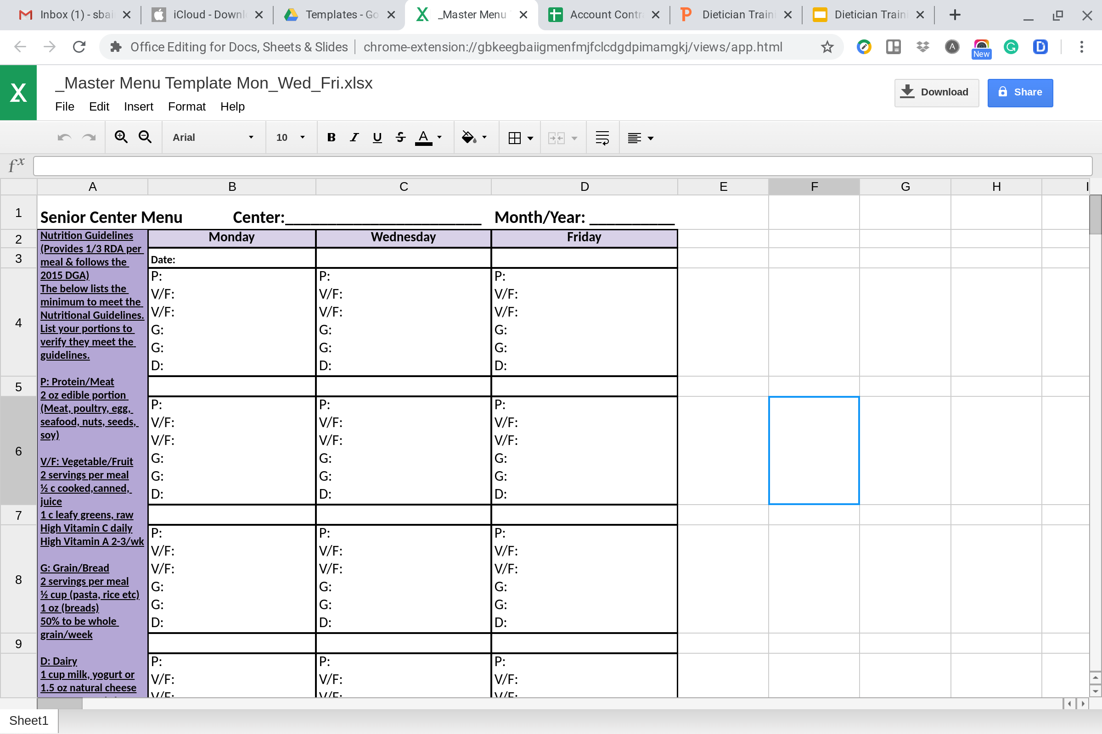
Menu Recommendations
Notes:
This is one example in excel. You can remove days that you don’t serve (for instance, this is for a center that serves Mon/Wed/Fri). In excel you can also add a sheet for each month of the year to keep your menus all in one place. You can copy and paste from the month previous. Also, you could have one sheet with the portion to submit to the dietitian and then copy and paste to a second sheet to decorate and print for your participants. Let your dietitian know if you need help setting these up.

Slide 19
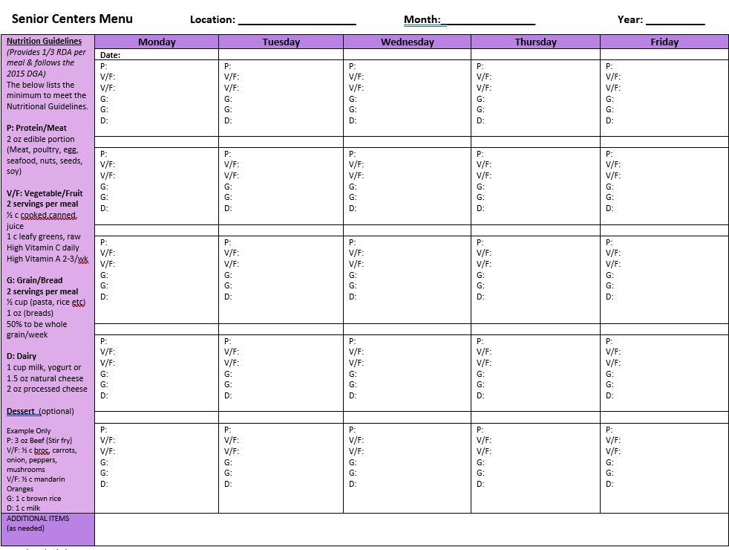
Menu Recommendations
Notes:
This is in Word format for anyone who prefers this. You could also do a second page in word to copy and paste for a more decorative page without portions to print.

Slide 20
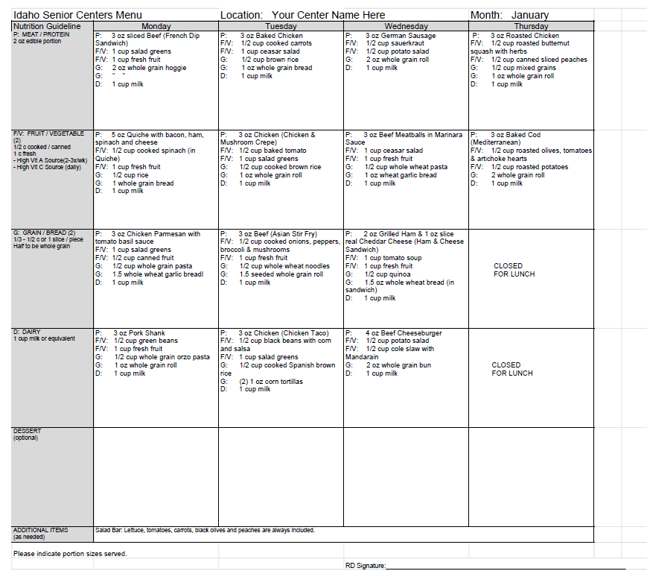
Menu Recommendations
Notes:
Let me know if you’d like any help setting up a template that works better for your needs.

Slide 21
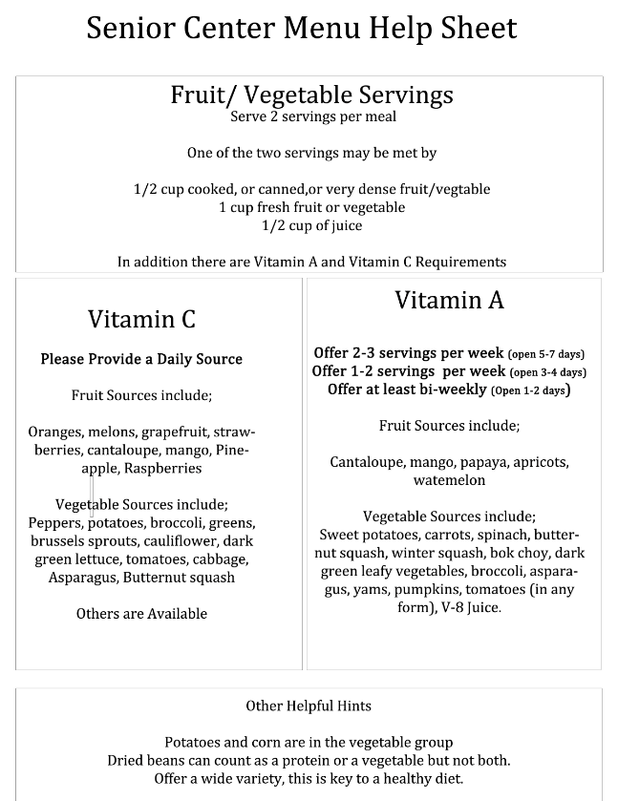
Meal Site Menu Help Sheet

Slide 22
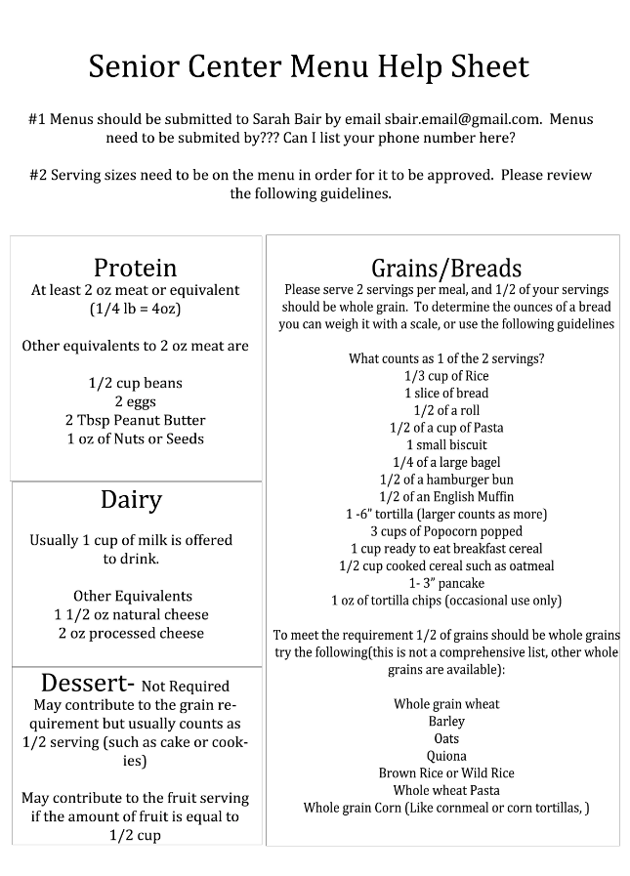
Meal Site Menu Help Sheet

Slide 23
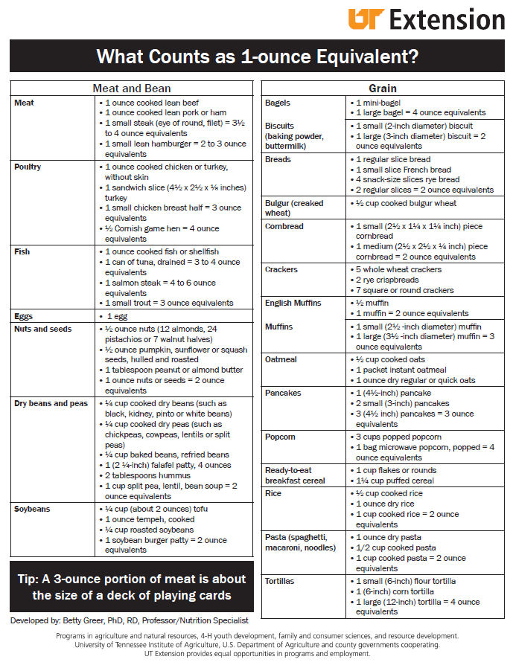
Meal Site Menu Help Sheet

Slide 24
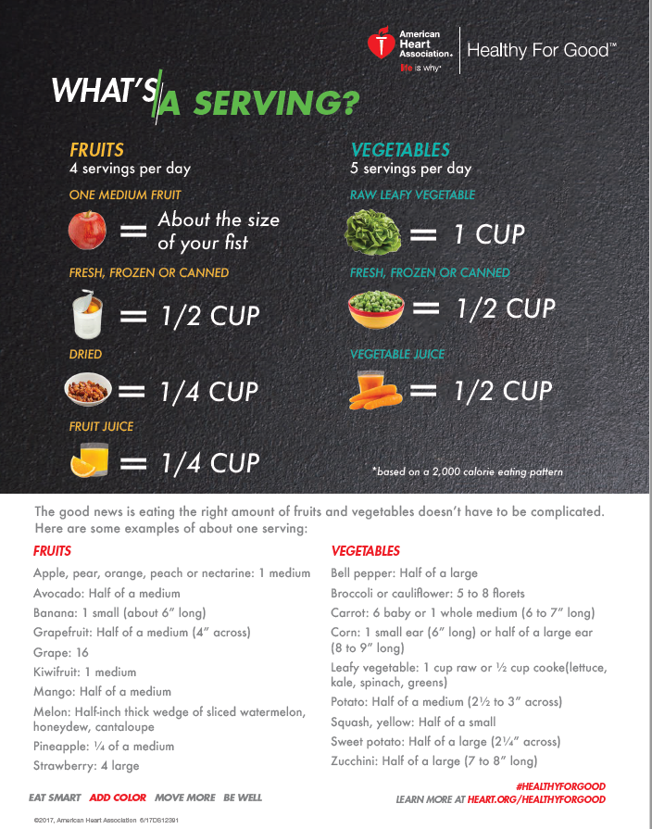
Meal Site Menu Help Sheet

Slide 25
Sanitation
To Glove or not to Glove? That is the question.
Wear gloves with anything that is going to come into contact with the consumer’s mouth (that is not still going to be cooked). Ready to eat foods, silverware, glasses, etc.
Other option is to use utensils for the food whenever possible and not touch glasses and silverware where the mouth may touch.
Change gloves when changing tasks and when gloves have come into contact with a non food item that may be contaminated.
Wash hands prior to putting gloves on and when changing gloves.
Notes:
Gloves are not worn to protect your hands! Gloves can give a false sense of security, just because your hands are gloved does not mean everything is protected. Think of yourself as a surgeon, after you have properly washed your hands and/or gloved your hands anything you touch could contaminate your hands. Once you have touched something, that will contaminate the next thing, and so on.

Slide 26

Food Costs
Meat is often the highest cost for menus. Look at reducing portions. Or cutting down the meat in recipes. Purchase larger cuts and break it down yourself.
Do homemade when possible. Breads, soups, desserts, etc
Utilize food on hand before it expires. Keep the inventory manageable.
Track and use leftovers.

Slide 27
Cooling / Heating / Storage
Take and record food temps prior to service.
Cooling to 70 in 2 hours and 41 in 6 hours (may have to break down into smaller sections or containers to meet this).
Storing leftovers with labels and dates. Tossing expired items.
Thawing in the refrigerator, under water or cook from frozen.

Slide 28
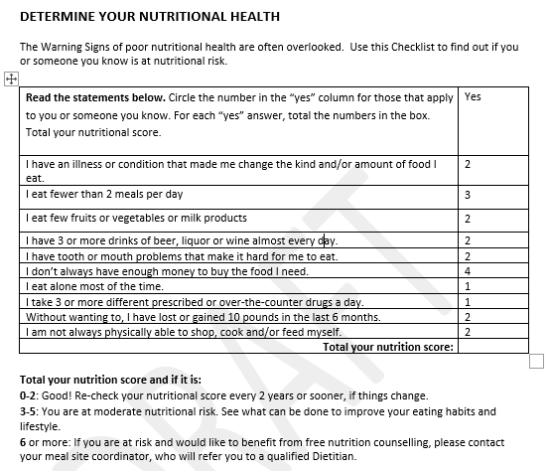
Dietitian Counseling
Notes:
The Nutritional Risk Survey

