Slide 1




Home Delivered Meals Delivery Driver Training

Slide 2

Idaho Commission on Aging
Area Agency on Aging
Meal Provider
PARTNERS

Slide 3
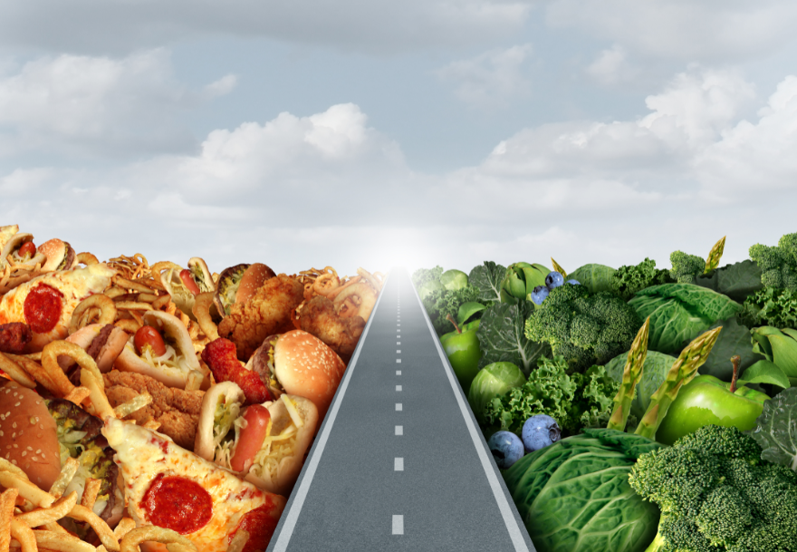
This training discusses the food safety responsibilities of drivers in a home- delivered meal program.

Slide 4
Drivers need to be in good health and maintain good personal hygiene.
Home-delivered meals are at high risk of foodborne illness. To prevent foodborne illness Drivers need to be in good health and maintain good personal hygiene
A. Health
Home-delivered meal clients are at high risk of foodborne illness. People who are ill and who handle meals can transfer harmful viruses or bacteria to the meals, which can lead to foodborne illness in clients. They can also transfer harmful viruses or bacteria directly to the clients, who can then become ill. If a driver is diagnosed with a foodborne illness, or shows any of the following symptoms, he or she should report this to the program management and be excluded from delivering meals:
• vomiting
• diarrhea
• jaundice (yellowing of the skin and eyes)
• sore throat with fever
Also, any wounds on hands or arms should be covered with a clean, dry, impermeable bandage that keeps the wound from leaking. Bandages on hands should also be covered with disposable gloves.

Slide 5

Staff and volunteer drivers need to wash their hands properly. Washing hands is one of the best ways to reduce risk of foodborne illness, as it decreases the spread of harmful viruses and bacteria. Up to 70 percent of all infections are transmitted by hand touch, and harmful bacteria and viruses can sometimes survive on unwashed hands for hours.
Hands should be scrubbed in warm soapy water for at least 20 seconds before and after handling food, after using the restroom, after handling pets, and after touching one’s hair, face, body, clothing, or anything else that could contaminate hands. Hands should be dried with a clean paper towel or a hand dryer.
Drivers should clean their hands before handling any food containers during meal pick-up and delivery. It is best to wash hands with soap and clean running water. Washing hands with soap and water is more effective than using hand sanitizers, as hand sanitizers don’t remove soil and other material that might be on hands. However, drivers should carry alcohol-based disposable hand sanitizing wipes or hand sanitizing lotion in their vehicles, as they may not always have access to soap and water during meal delivery. The lotion should have an alcohol content of at least 60 percent.
To use an alcohol-based hand sanitizing lotion:
• Apply it to the palm of one hand.
• Rub hands together.
• Rub it over all surfaces of hands and fingers until hands are dry.

Slide 6
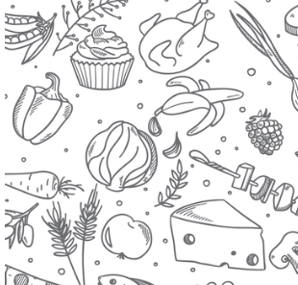
Personal Hygiene Poor personal hygiene is a common cause of foodborne illness. Drivers need to have good personal hygiene so that they don’t spread harmful viruses or bacteria to food or to other people. They should bathe or shower before delivering meals and keep their hair and fingernails clean. Clothing can contaminate food and lead to foodborne illness. When delivering meals, drivers should wear clean clothes. If outer clothes such as coats and gloves or mittens are worn, it is important that they also be washed often and kept clean.

Slide 7

Procedures for delivering safe meals
A. Temperature Requirements
Food can become contaminated if it is not handled safely and kept at the correct temperatures. Bacteria grow fastest at temperatures between 41°F and 135°F, known as the temperature “danger zone.” To prevent the growth of harmful bacteria, it is very important to keep cold food cold, and hot food hot. It is safest to keep hot food at 135°F or above, and 5 cold food at 41°F or below until clients receive their meals. Temperature requirements can differ by state or region.
The time from when food is prepared to when it is eaten should be as short as possible. The shorter a driver’s route, the less chance for harmful bacteria to grow to unsafe levels in the meals. Drivers’ routes should be as short as possible for both meal safety and meal quality.
It is recommended that the time at which drivers pick up meals from the kitchen and deliver the meals to each client be recorded. Meal temperatures should also regularly be measured and written down when meals are picked up from the kitchen.

Slide 8

How to Deliver Meals Safely I. Cleanliness of delivery vehicle The inside of program vehicles and volunteers’ private vehicles should be cleaned regularly. Program delivery vehicles should be checked for cleanliness before drivers go on their routes. Volunteer drivers should remember to keep the inside of their vehicles clean. Drivers should not bring pets along in their vehicles during meal delivery, as pets could contaminate drivers’ hands and the meals. II. Appropriate containers for meals Delivery equipment should be able to keep meals at proper temperatures at all times. It is recommended that insulated food containers that can keep hot food at 135°F or above and cold food at 41°F or below being used. Containers should be food-grade, and designed so that food will not mix, leak or spill. They should be able to let air circulate to keep temperatures even. III. How to handle meal containers Meal containers should be cleaned and sanitized after each use. During delivery, containers should be secured in the vehicle to keep them from moving too much during a route. It is very important to close insulated containers completely during a route, and as soon as possible after removing a meal, so that meals can be kept at safe temperatures.

Slide 9

How Clients Should Handle and Store Meals I. Give food safety instructions to clients Clients need to eat their meals right after they receive them, or refrigerate or freeze the meals. It is recommended that home-delivered meals be labeled with a “use-by” date, as well as instructions for storage and reheating. If the client can’t read the “use-by” date or instructions, it is important to read and explain them to the client upon meal delivery. II. What to do if the client is not at home If a client is not at home, the driver should not leave the meal, outside or inside, for the client. Leaving a meal in the temperature danger zone strongly increases the chance that will cause foodborne illness. Even if a client has provided an insulated container for the meal, the container may not keep the meal at a safe temperature. There is an added risk of tampering when meals are left outside. The client may also be away from home for a longer time than planned, which increases the chance that the meal will become unsafe to eat.

Slide 10

KEY POINTS ⮚ Staff and volunteer drivers need to be in good health and have good personal hygiene. It is very important that they wash their hands properly. ⮚ It is recommended that meals be kept at safe temperatures, out of the temperature danger zone which is between 41°F and 135°F, until clients receive the meals. It is very important to keep cold food cold, and hot food hot. ⮚ The inside of program vehicles should be cleaned regularly, and volunteer drivers should remember to keep their vehicles clean. ⮚ Delivery equipment should be able to keep meals at proper temperatures at all times. ⮚ Meal containers should be cleaned and sanitized after each use. ⮚ Clients need to eat their meals right after they receive them, or refrigerate or freeze the meals. It is recommended that home-delivered meals be labeled with a “use-by” date, as well as instructions for storage and reheating. If the client can’t read the “use-by” date or instructions, it is important to read and explain them to the client upon meal delivery. ⮚ If a client is not at home, the driver should not leave the meal, outside or inside, for the client.

Slide 11
FOOD SAFETY WEBSITES Centers for Disease Control and Prevention https://www.cdc.gov/foodsafety/index.html Food safety for older adults https://www.foodsafety.gov/people-at-risk/older-adults Federal food safety gateway https://www.foodsafety.gov U.S. Department of Agriculture (USDA) Food Safety and Inspection Service https://www.fsis.usda.gov/ U.S. Food and Drug Administration (FDA) education resource library and retail food protection https://epublication.fda.gov/epub/

Slide 12
Thank you for participating! Find more and this information under www.aging.Idaho.gov Congregate Meals - Idaho Commission on Aging Home-Delivered Meals - Idaho Commission on Aging Commodity Supplemental Food Program - Idaho Commission on Aging Malnutrition - Idaho Commission on Aging

