Slide 1
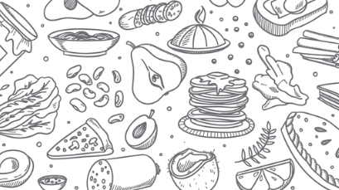



Kitchen Staff Training
Notes:
We came together today to learn more about the kitchen staff responsibilities and have more detailed information on temperatures and measuring.

Slide 2
PARTNERS
Idaho Commission on Aging
Area Agency on Aging
Meal Provider
Notes:
The ICOAs federal partner is the Administration for Community Living and follows the rules of the OAA. There are certain requirements everyone needs to follow, starting from ICOA, to the AAA to the mela providers. We are all a big team and partners.
ICOA gets funding from the ACL and distributes this to all AAAs based on an IFF. Then the AAAs needs to work with the given budgets and determine a reimbursement rate. The AAA allocates the money to the meal providers, base on meal served.
This is the fifth training I developed to help meal providers to be more successful every day.
Sometimes there is a huge turnover in staff that have not had the opportunity to learn from the person that worked there before and it is difficult at times to learn as fast without documentation in writing. This PPP will help you to understand the program and your tasks better.
For any questions in the future please reach out to your AAA.

Slide 3
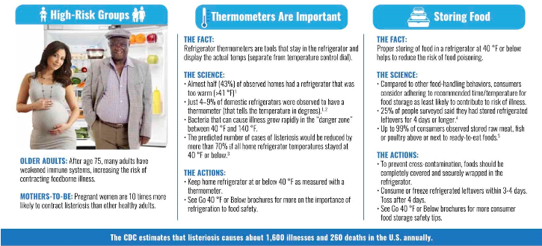
Notes:
This chart talks about staying under 40.

Slide 4
Taking and Documenting Temperatures
Lesson Objectives:
1. Take and record temperatures during steps in the food flow process:
receiving, storing, preparing/cooking, holding, transporting, serving, cooling, reheating, and cleaning/sanitizing.
2. Document temperatures using appropriate forms.
3. Identify appropriate corrective actions to be taken if appropriate temperatures are not met.
4. Clean, sanitize, and store thermometers properly.
Notes:
Temperature control is one of the main methods for controlling biological
hazards. Biological hazards include bacteria, viruses, parasites, fungi, and
plants and fishes that carry harmful toxins. Temperature and time control is
the main method for controlling biological hazards.
Review the temperatures, types of thermometers to use, and methods for
taking temperatures at each step. The method for taking food temperatures
varies by food product type.
Example templates were attached to this Power Point Presentation.
■ Roasts—the thermometer should be placed at the midway point in the
roast, being careful to avoid any bone. Take a temperature in several
places.
■ Poultry—the thermometer should be placed in the thickest area of the
poultry part being checked, being careful to avoid any bone.
■ Thin Foods—for thin foods such as a hamburger patty, chicken patty,
chicken nugget, or chicken breast, use of a digital stemmed thermometer
(thermistor) or thermocouple (digital) is recommended for taking temperatures
because they are tip sensitive. To avoid burns, remove the food item
to a clean plate or spatula and insert the food thermometer.
■ Combination Dishes—the thermometer should be placed into the thickest
part of casseroles and other combination dishes, and temperatures should
be checked in several places.
Inserting thermometers correctly into products is important to obtaining an
accurate internal temperature reading. These thermometers must be inserted 2 to 3 inches into the
food product. Insert thermometer and wait at least 15 seconds to get an accurate internal
temperature reading.

Slide 5
Taking Storage/Work Area Temperatures
Refrigeration equipment—walk-in refrigerators, reach-in refrigerators,
milk coolers: at or below 41 °F
Freezers: at or below 0 °F
Storeroom for dry goods: 50 °F to 70 °F
Notes:
Temperatures of storage and work areas must be monitored daily. The standards for storage areas should be maintained as indicated above.

Slide 6
Taking Equipment Temperatures
1. Storage
a. Refrigerators: 35 °F to 41 °F
b. Milk Coolers: 35 °F to 41 °F
c. Freezers: at or below 0 °F
2. Cooking—Ovens: temperature on dial setting
3. Holding Equipment
a. Hot Holding Cabinets: at 135 °F or above
b. Cold Holding Cabinets: at or below 41 °F
4. Dish Machine: 180 °F final rinse temperature for high temperature dish washer machines
Notes:
Dish machine water must be at least 160 °F when it comes in contact with the surface of the tray, dish, or other item being sanitized). Follow manufacturer’s instructions.

Slide 7
Cleaning and Sanitizing Thermometers
1. Wash probe of thermometer by hand with warm, soapy water. Do NOT
Immerse dial in water.
2. Rinse the probe with clean, warm water.
3. Sanitize the probe with an approved food contact surface sanitizing solution or with alcohol swabs.
4. Air dry. Air drying minimizes the risk of contamination of the probe.
5. Store in clean case or sleeve.

Slide 8

Documenting temperatures
1. Ensures food is cooked to the appropriate internal end point temperature.
2. Shows that foodservice employees are diligent in their jobs and are concerned about the health of participants.
3. Contributes to an overall food safety management system that includes hazard analysis and critical control point principles.
4. Provides a record for verification.
5. Ensures overall quality of food served.

Slide 9
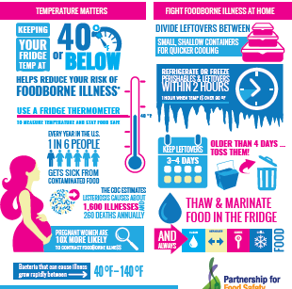
Protect your food Protect your family
Notes:
If you feel safer, print this page out and utilize this as a poster and hang by your fridge or ice chests, walk in freezers etc.

Slide 10

B. Washing Hands
Hands should be scrubbed in warm soapy water for at least 20 seconds before and after handling food, after using the restroom, after handling pets, and after touching one’s hair, face, body, clothing, or anything else that could contaminate hands. Hands should be dried with a clean paper towel or a hand dryer.
Anybody who works with food must wear gLoves and hair protection.
.
Notes:
Up to 70 percent of all infections are transmitted by hand touch, and harmful bacteria and viruses can sometimes survive on unwashed hands for hours.
Staff need to wash their hands properly. Washing hands is one of the best ways to reduce risk of foodborne illness, as it decreases the spread of harmful viruses and bacteria

Slide 11
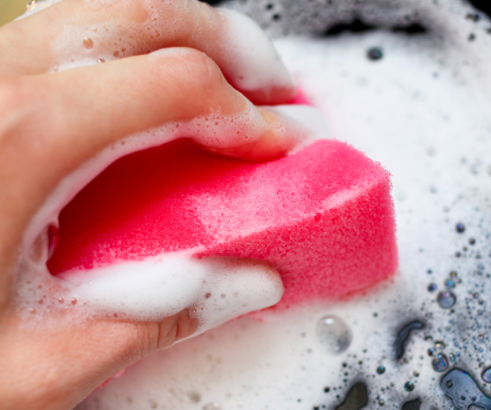
Hand Sanitizers
Alcohol hand sanitizers, now referred to as hand antiseptics by the FDA Food Code, are
effective in killing bacteria and some viruses on clean hands. However, sanitizers may not be
used instead of handwashing by foodservice employees. You may use sanitizer after washing
hands properly. Do not touch food or equipment or put on gloves prior to antiseptic drying.
Notes:
Why not Sanitizer Alone?
The hands of food workers are often wet and contaminated with fatty material or with food
high in proteins. The presence of water, food, fatty materials, feces, and blood on the hands can significantly reduce the effectiveness of an alcohol-based hand antiseptic.

Slide 12

Sinks There are sinks dedicated to handwashing. Sinks should have: • Hot and cold running water • Soap • Hand dryer or single-use paper towel • Disposal area such as a garbage can
Notes:
This sink should not be used for any other activity. It should not be place for dishes, food,
dirty water or other items. Do not place items in front of or on the sink. Do your part to keep
the sinks accessible and easy to use

Slide 13

Hair Restraints
Hair contains pathogens that can make food unsafe. I addition to that , no one likes to find hair in their food. Hats, hair coverings or nets, or beard restraints must be worn to effectively keep their hair from contacting exposed food; clean equipment, utensils, and linens; and unwrapped single-service and single-use articles.
Notes:
You should discuss the policy/policies that are in place at your location with your meal site board and coordinator. It helps to have something in writing by the time you hire personnel.

Slide 14

CLothing and Jewelry
Uniforms and clothing should be clean. Jewelry should be limited to one single band ring
Notes:
You should discuss this policy with your meal site board and coordinator. It helps to have something in writing by the time you hire personnel.

Slide 15
Employee Sickness
Six foodborne illnesses that must be reported are those caused by:
1. Norovirus
2. Hepatitis A virus
3. Shigella spp.
4. Shiga Toxin-Producing Escherichia Coli
5. Salmonella Typhi
6. Non-typhoidal Salmonella
Notes:
Again, it would be very beneficial to have a plan in writing to make sure everyone complies and understand their tasks. With CoVID-19 being around it is up to each meal site board to determine what safety rules they want to have in place.

Slide 16
Proper Glove Usage
Gloves must be worn for anybody who will work with food.
Gloves should be changed:
• If gloves become damaged or soiled
• When changing food preparation tasks
• After sneezing, coughing, touching hair, face, or other non-disinfected surfaces
• Every hour when working on the same task
Notes:
Glove usage is important to keep food safe. The use of disposable gloves is not a
substitute for handwashing, and hands need to be clean before putting gloves on
them.
Gloves should be changed with the same frequency as you would wash your hands.
Anything that can contaminate your hands will contaminate the gloves as well.

Slide 17
FOOD SAFETY WEBSITES Centers for Disease Control and Prevention https://www.cdc.gov/foodsafety/index.html Food safety for older adults https://www.foodsafety.gov/people-at-risk/older-adults Federal food safety gateway https://www.foodsafety.gov U.S. Department of Agriculture (USDA) Food Safety and Inspection Service https://www.fsis.usda.gov/ U.S. Food and Drug Administration (FDA) education resource library and retail food protection https://epublication.fda.gov/epub/

Slide 18
Thank you for participating! Find more and this information under www.aging.Idaho.gov Congregate Meals - Idaho Commission on Aging Home-Delivered Meals - Idaho Commission on Aging Commodity Supplemental Food Program - Idaho Commission on Aging Malnutrition - Idaho Commission on Aging

