Slide 1
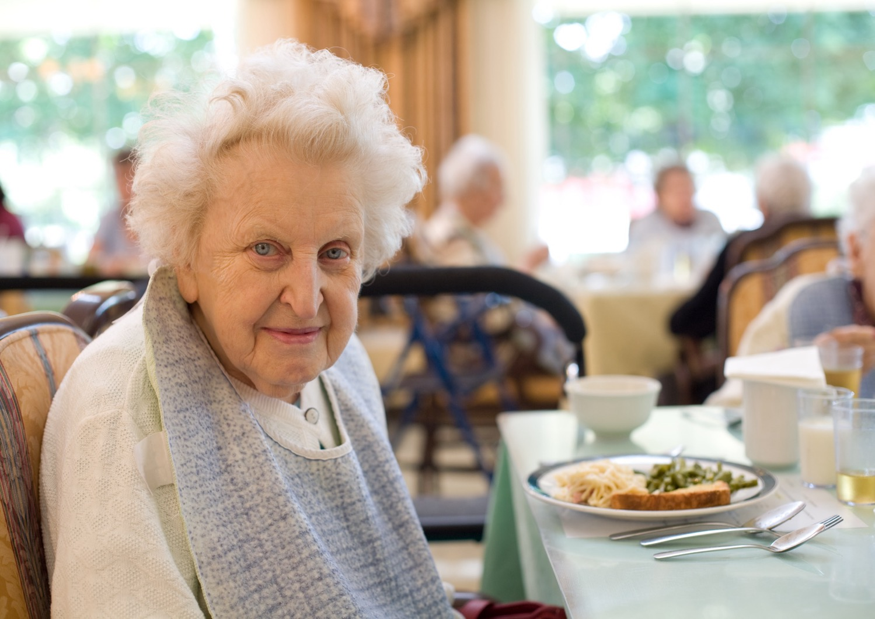
Nutrition Programs:
Meal Site Dietician Training

Slide 2
Dietitian Training for Meal Sites and Staff
Notes:
Today we will learn together what the Dietician plays for a role in all of our working lives. The Dietician will provide Nutrition Education and Nutrition Counseling, will approve all menus submitted by the meal sites and will give advice to menu creators to be in compliance.

Slide 3
Learner Objectives
Funding Flow
Review regulations and Dietary Guidelines
Discuss menu planning, templates and menu planning help sheet
Sanitation: To Glove or not to Glove..?
Food costs.. how to make a dollar go further.
Heating / Cooling and Storage
Diet Counseling

Slide 4
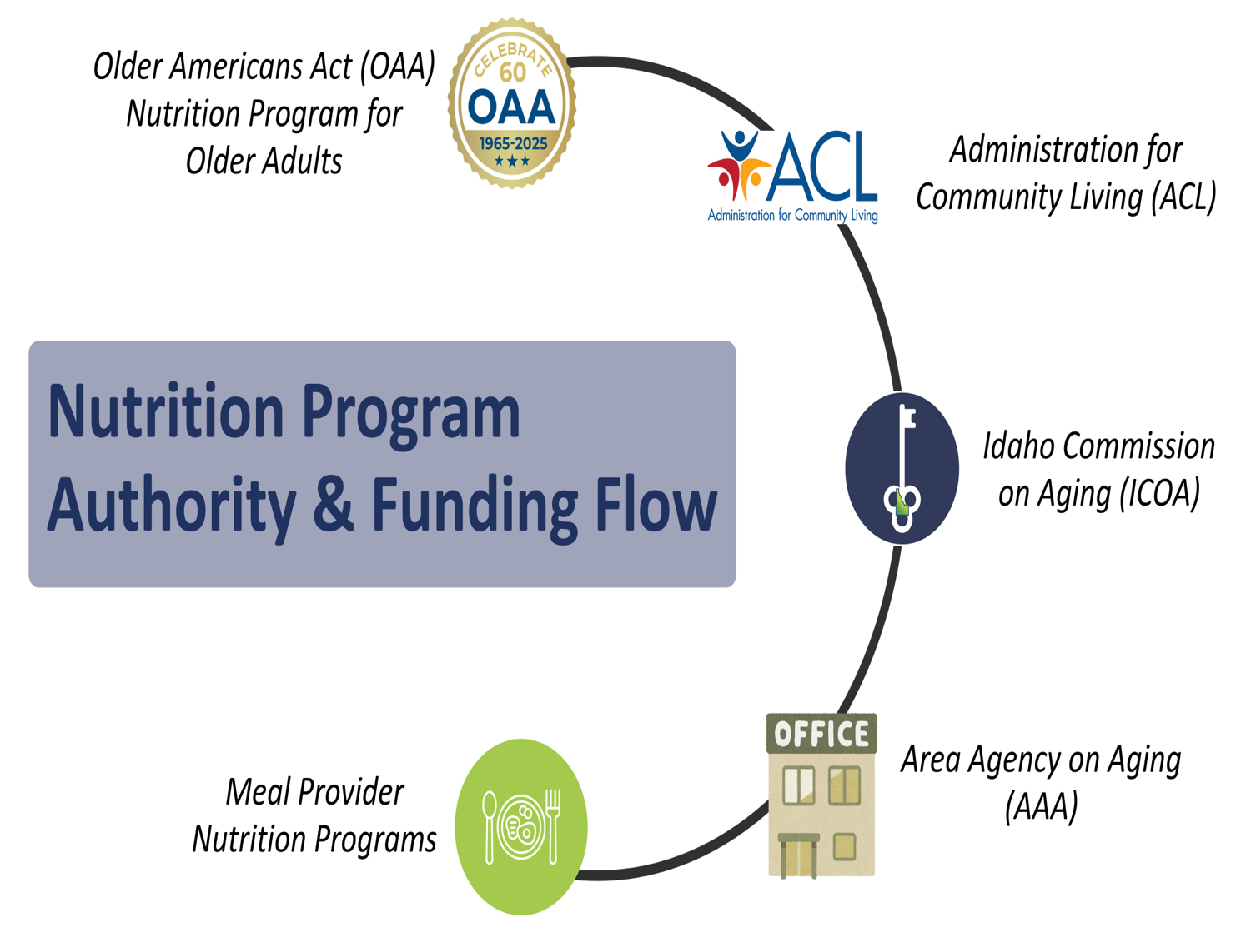




Older Americans Act (OAA) Nutrition Program for Older Adults
Administration for Community Living (ACL)
Nutrition Program Authority & Funding Flow
Idaho Commission on Aging (ICOA)
Area Agency on Aging (AAA)
Meal Provider Nutrition Programs

Slide 5
Older Americans Act, Section 339.Nutrition
A State that establishes and operates a nutrition project under this chapter shall— utilize the expertise of a dietitian Provides meals that comply with the most recent Dietary Guidelines for Americans Provide a minimum of 33 1⁄3 percent of the dietary reference intakes established by the Food and Nutrition Board of the National Academies of Sciences, Engineering, and Medicine if the project provides one meal per day. to the maximum extent practicable, are adjusted to meet any special dietary needs of program participants. Including meals adjusted for cultural considerations and preferences and medically tailored meals. encourages individuals who distribute nutrition services to provide, to homebound older individuals, available medical information approved by health care professionals, such as informational brochures and information on how to get vaccines, including vaccines for influenza, pneumonia, and shingles, in the individuals’ communities Link to the Older Americans Act
Notes:
The OAA established the Administration on Aging within the Department of Health, Education and Welfare, and called for the creation of State Units on Aging. The Older Americans Act (OAA) was passed by Congress in 1965 as a response to policymaker concerns about the lack of services for older adults. The original act gave authority for grants to States for community planning, social services, research and development projects, and training on aging related issues.
Above I added a few very important requirements out of the OAA for your convenience.
The purposes of these programs are to 1) reduce hunger, food insecurity and malnutrition, 2) promote socialization, 3) promote health and well-being, and 4) delay adverse health conditions. The intent is to make community based nutrition services available to older adults who may be at risk of losing their independence and their ability to remain in the community.
If you are interested in the full version of the Older Americans Act, please go to

Slide 6



OAA Nutrition Program Goals
Reduce hunger & food insecurity and malnutrition
Promote socialization
Enhance the health and well-being of older individuals by assisting such individuals to gain access to nutrition and other disease prevention and health promotion services to delay the onset of adverse health conditions resulting from poor nutritional health or sedentary behavior
Notes:
The OAA established the Administration on Aging within the Department of Health, Education and Welfare, and called for the creation of State Units on Aging. The Older Americans Act (OAA) was passed by Congress in 1965 as a response to policymaker concerns about the lack of services for older adults. The original act gave authority for grants to States for community planning, social services, research and development projects, and training on aging related issues.
Above I added a few very important requirements out of the OAA for your convenience.

Slide 7
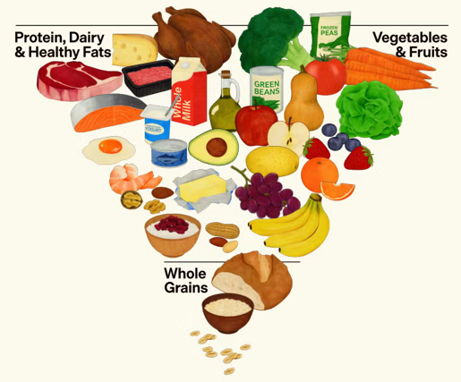
Dietary Guidelines for Americans
The Dietary Guidelines for Americans provides evidence-based nutrition information and advice for people ages two and older to help Americans make healthy choices about food and beverages in their daily lives. The Guidelines also serve as the basis for federal food and nutrition education programs.
The Dietary Guidelines for Americans, produced by HHS and the U.S. Department of Agriculture every five years, analyze the latest research to help Americans make smart choices about food and physical activity so they can live healthier lives.
https://realfood.gov
https://cdn.realfood.gov/Daily%20Serving%20Sizes.pdf

Slide 8
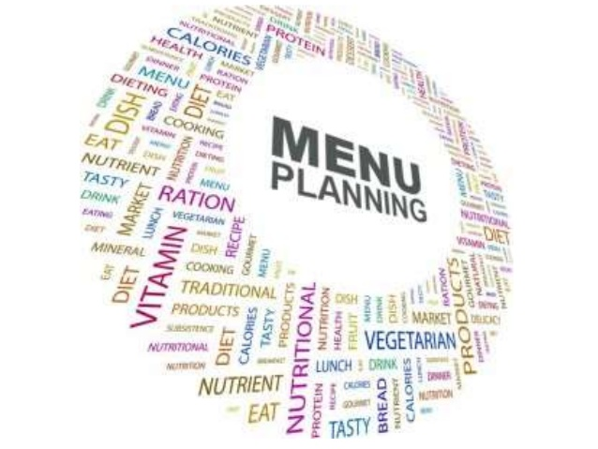
Menu Planning
Notes:
Menu planning can be tough! People want you to include their favorite dish, cooks want an easy meal to prep, the food bank doesn’t have prime rib, and your nutritionist is saying you need more whole grains! This powerpoint won’t solve all your problems but will help clear some things up. If there are any further questions or if you are having problems with anything be sure to reach out. We are happy to help.

Slide 9
Menu Requirements (provides 1/3 of senior's daily needs)
Protein = 3 oz meat, poultry, fish, tofu; 1 egg; ½ c. beans or lentils; 1 oz nuts or seeds; 2 oz nut butter
Vegetable = 1 cup (fresh, frozen, canned, juice; leafy greens count as half their serving size because they are not as dense)
Fruit = ½ cup fresh, frozen, canned, dried, or 100% fruit juice (dried fruit counts as 2x serving size because it is dense)
Grains = 1 oz bread, bun, tortilla, crackers or croutons, or ½ cup rice or pasta
Goal is 100% whole grains
Dairy = 8 oz milk, 6 oz yogurt, or 1 oz cheese
Dessert optional (dietary guidelines emphasize reducing added sugar)

Slide 10
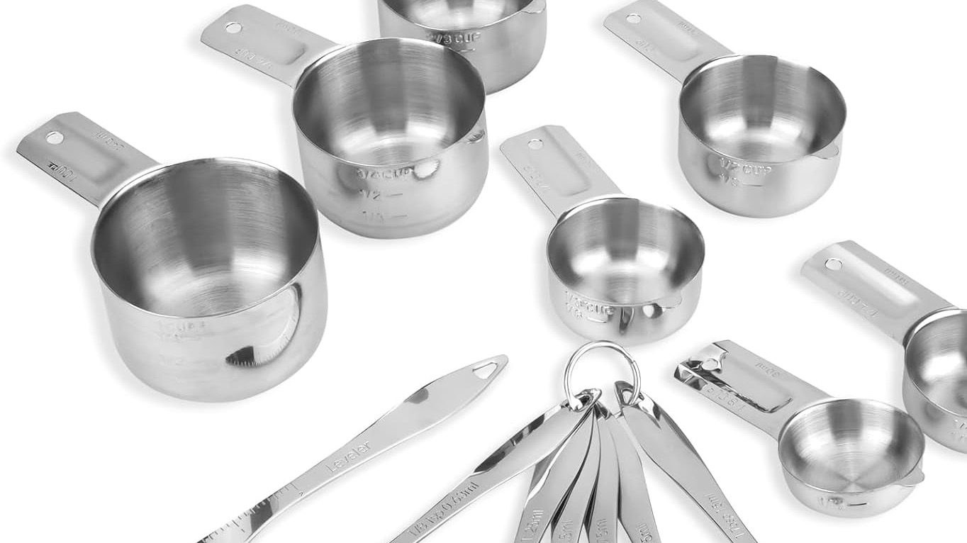
Serving Sizes
The guidelines indicate the amount needed to meet the minimum needs for the general population.
The Serving Size should indicate the amount you are serving at your center. Serving Sizes should be listed in common terms that staff, volunteers, and seniors understand. Use common measurements such as 1 cup, ½ cup, ¼ cup for vegetables, fruits, rice, pasta, and beans. Other examples of common measurements are:
1 slice or bun
1 oz condiments (ketchup, salad dressing)
1 tsp added fats (mayonnaise, olive oil)
2x2 piece of cornbread
8” whole wheat tortilla
Notes:
The guidelines reflect the amount needed to meet the average person's nutritional requirements. However we want to know the size of your portion. For multiple reasons:
1) 2 oz of meatloaf isn't going to provide 2 oz of protein due to the added ingredients so the portion will need to be larger.
2) Entrees need to be large enough to provide full serving sizes of multiple components, ie 2 cups of spaghetti would be large enough to provide 1 cup noodles (2 grains) 1/2 cup tomato sauce (1 vegetable) and 2 oz of hamburger (1 protein).
3) We also want to know if portions are too large and/or adding unhealthy amounts of things such as fats or sugars etc.

Slide 11

Ounces - vs - Cups
Ounces are a weight measurement. We weigh items so that we don’t have to grind and/or smash them into a scoop or measuring cup. These are items such as:
Meats
Bread or pastries
If purchasing meats and breads pre portioned or pre-sliced, you will be able to determine the portion size from the packaging and will not have to physically weigh them.
If slicing meat or making homemade bread - slice one that weighs the desired amount, then use it as your guide for future slices.
Common weight measurements
3 oz meat = size of a deck of cards
1 oz bread = thin slice of sandwich bread

Slide 12
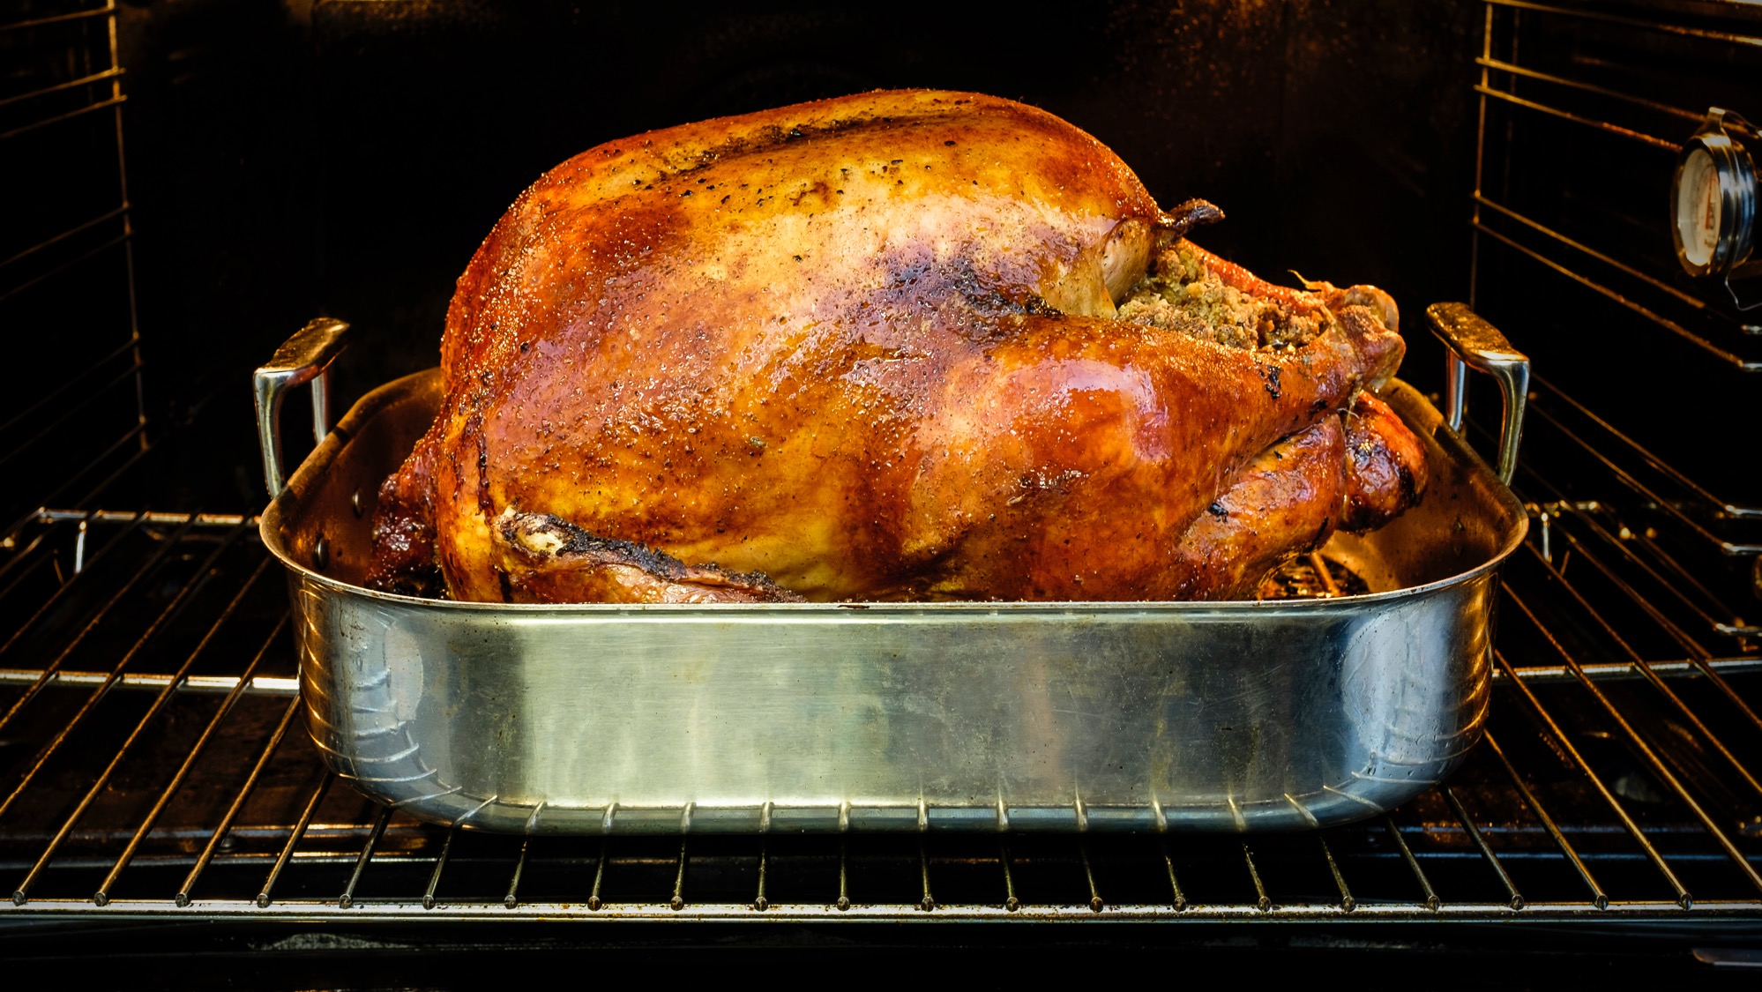
Protein
Offer a variety of proteins:
Chicken – whole, legs & thighs, boneless, ground, boneless breast, casseroles, soups
Turkey – roasted, burgers, casseroles, soups, hot turkey sandwiches
Beef – meatloaf, burgers, roasts, tacos and enchiladas, add beans and lentils for cost effectiveness
Pork – roasts, pork tenderloin (very easy for seniors to eat), BBQ pork, ham, sausages
Lamb – boneless leg of lamb, stew, lamb meatballs, gyros
Fish – fish & chips, tuna casserole, salmon
Shellfish – shrimp alfredo, clam chowder, stir fry, seafood salad, shrimp cocktail
Eggs – quiche, egg casseroles, fried rice with egg on tip, egg salad, deviled eggs
Beans & Lentils – chili, taco soup, white bean soup, hummus, split pea or lentil soup, baked beans
Tofu – stir fry, sweet & sour tofu
Cottage cheese – cottage cheese pancakes, cottage cheese & fruit plates
Notes:
The guidelines reflect the amount needed to meet the average person's nutritional requirements. However we want to know the size of your portion. For multiple reasons:
1) 2 oz of meatloaf isn't going to provide 2 oz of protein due to the added ingredients so the portion will need to be larger.
2) Entrees need to be large enough to provide full serving sizes of multiple components, ie 2 cups of spaghetti would be large enough to provide 1 cup noodles (2 grains) 1/2 cup tomato sauce (1 vegetable) and 2 oz of hamburger (1 protein).
3) We also want to know if portions are too large and/or adding unhealthy amounts of things such as fats or sugars etc.

Slide 13
Grains vs Starchy Foods
The Dietary Guideline for Americans recommends 2-4 servings of whole grains for seniors per day; therefore, 1 serving should be offered with the center meals.
Grains include baked breads, buns, tortillas, tortilla chips, croutons, crackers, pastas, rice, quinoa, barley, couscous, and pasta and rice in salads and soups. Breading on the entrée should not be counted as the only grain.
Corn, potatoes, peas, carrots, beans are classified as vegetables, not a grain. (Beans can be a vegetable OR a protein).
The menus are planned for general nutrition and not considered diabetic, gluten, heart, or renal friendly. If you have seniors that are following therapeutic guidelines, please encourage them to follow the advice of their physician and dietitian.

Slide 14
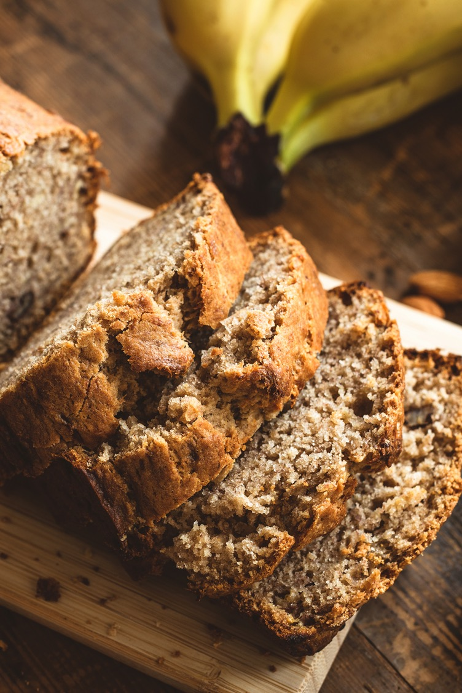
Grains
Grains:
1 serving =
1 oz bread
½ cup rice or pasta
Check your bread labels and list the oz on the menu.
Rolls are often 2 oz.
Large slices of bread such are usually 1.5 oz or even 2 oz.
Buns are usually 2 oz.
1 oz of rice or pasta DOES NOT = 1 serving. (see the slide on ounces vs cups)
Please do not menu the same grain every day. Seniors need more variety of types of grains.
Breading and oatmeal on dessert is counted as ½ of a grain serving

Slide 15
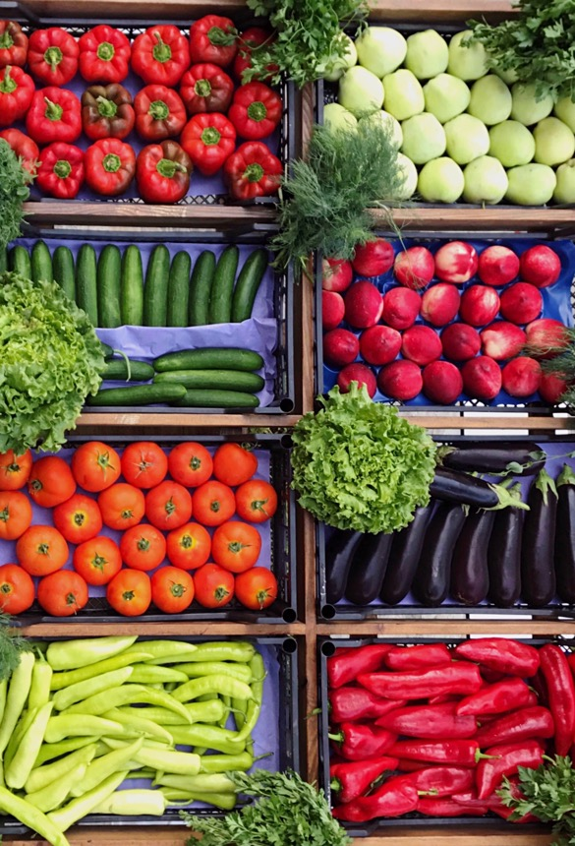
Vegetables
Vary the vegetables:
Dark Green: variety of lettuces, spinach, broccoli, kale, bok choy
Red Orange: carrots, bell peppers, beets, tomatoes, salsas, winter squash
Beans & Lentils: kidney, black, garbanzo, great northern, green and red lentils
Starchy: potatoes, sweet potatoes, corn, green peas
Other: cabbage, celery, cucumbers, onions, olives, green peppers, cauliflower, radishes, zucchini, yellow squash, cilantro, jalapenos, asparagus
Notes:
It is assumed that the traditional ingredients (carrots, peas and potatoes with top and bottom crust) are included in your chicken pot pie when written this way. If you are including non-traditional items please make note of it so that the nutritional composition can be determined.

Slide 16
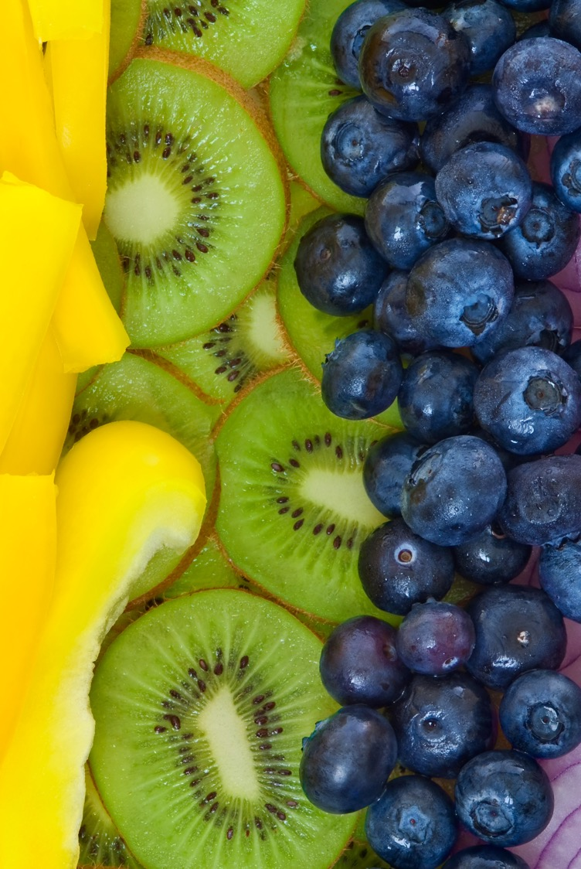
Fruit
Vary the fruit:
Green: grapes, kiwi, melon, limes
Red & Purple: berries, plums, watermelon, apples, grapefruit
Orange & Yellow: oranges, cantaloupe, mango, pineapple, bananas, mandarin oranges, peaches, papaya, lemons
Light: applesauce, baked apples, pears
Notes:
It is assumed that the traditional ingredients (carrots, peas and potatoes with top and bottom crust) are included in your chicken pot pie when written this way. If you are including non-traditional items please make note of it so that the nutritional composition can be determined.

Slide 17

Dairy
Must make dairy available during a meal. Can be served by staff or volunteers.
Milk: offer fat variety that meets preference
Yogurt: regular and Greek yogurt
Cheese: cheddar, mozzarella, colby, Swiss, parmesan, muenster, gouda, feta, cottage cheese, blue cheese
Notes:
It is assumed that the traditional ingredients (carrots, peas and potatoes with top and bottom crust) are included in your chicken pot pie when written this way. If you are including non-traditional items please make note of it so that the nutritional composition can be determined.

Slide 18
Menu Recommendations
Remember to include:
Center name and month
Calendar layout
Common name of food
Beef stew vs. diced beef
Turkey club sandwich vs. slice turkey
Portion sizes
You can reuse previously approved menus; just let the dietitian know
You can submit several menus at a time, for instance quarterly

Slide 19
Utilize Provide Menu Forms
Notes:
This is in Word format for anyone who prefers this. You could also do a second page in word to copy and paste for a more decorative page without portions to print.

Slide 20
Sanitation
To Glove or not to Glove? That is the question.
Wear gloves with anything that is going to come into contact with the consumer’s mouth (that is not still going to be cooked). Ready to eat foods, silverware, glasses, etc.
Other option is to use utensils for the food whenever possible and not touch glasses and silverware where the mouth may touch.
Change gloves when changing tasks and when gloves have come into contact with a non food item that may be contaminated.
Wash hands prior to putting gloves on and when changing gloves.
Notes:
Gloves are not worn to protect your hands! Gloves can give a false sense of security, just because your hands are gloved does not mean everything is protected. Think of yourself as a surgeon, after you have properly washed your hands and/or gloved your hands anything you touch could contaminate your hands. Once you have touched something, that will contaminate the next thing, and so on.

Slide 21

Food Costs
Meat is often the highest cost for menus. Recommend adding beans or lentils to meat when possible. Purchase larger cuts and break it down yourself.
Do homemade when possible. Breads, soups, desserts, etc
Utilize food on hand before it expires. Keep the inventory manageable.
Track and use leftovers.

Slide 22
Cooling / Heating / Storage
Take and record food temps prior to service.
Cooling to 70 in 2 hours and 41 in 6 hours (may have to break down into smaller sections or containers to meet this).
Storing leftovers with labels and dates. Tossing expired items.
Thawing in the refrigerator, under water or cook from frozen.

Slide 23
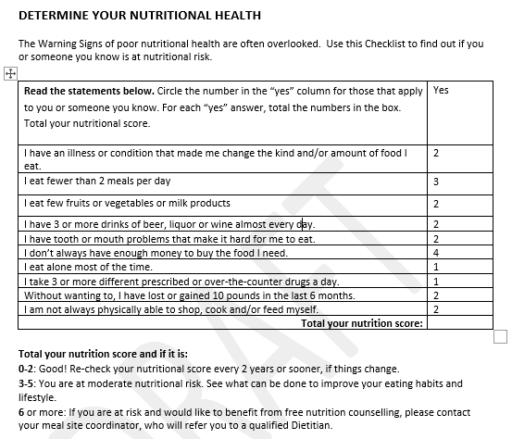
Dietitian Counseling
Notes:
The Nutritional Risk Survey

